Slide 1

School of Business and Economics
Generating insights in a simulation
project: the Consultant’s perspective
Stewart Robinson, Anastasia Gogi* & Antuela A Tako
*a.gogi@lboro.ac.uk
12th July 2015, EURO2015 Conference, Glasgow

Slide 2
Contents
Previous Study, Findings
Rationale
Study Design
Results
Conclusions

Slide 3
What is Insight?
Where
I am now
Where
I want to be
Impasse
Insight
A new idea emerges
New idea applied
Problem solved
Aha!
I think I know
No, I didn’t know…
Start Solving
Impasse phase
Initial trials failed
Prior experience applied

Slide 4
What is Insight?

Slide 5
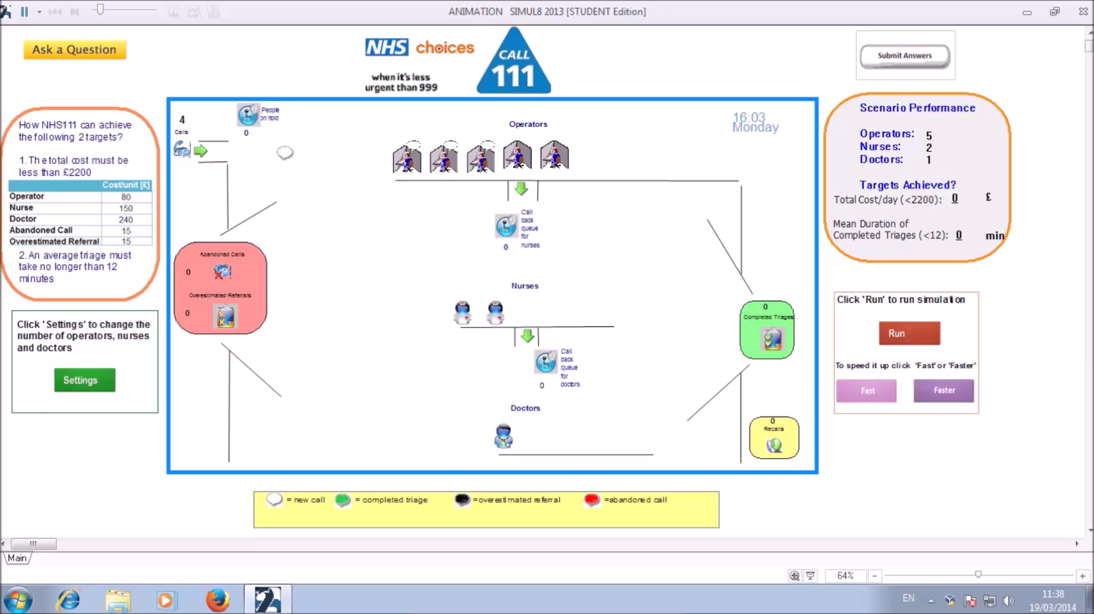
Models and Insight
Model

Slide 6
Models and Insight
  Task solved + Valid Answer = Insight
                Proportions
                Task Duration
                Problem solving patterns
Solvers with Insight
Solvers
Non-solvers

Slide 7
Models and Insight
Solvers with Insight | Significant difference? (a = .05)
Proportions
Statistics > Animation (50%) (28%) | No (p = .21)
Task Duration
Statistics < Animation (11.38 min) (20.70 min) | Yes (p = .01)

Slide 8
Models and Insight
Problem Solving Patterns
Scenario Category | Description
1 | Operators ≥ Nurses + Doctors
2 | Operators < Nurses + Doctors
3 | A system with no Experts (no Doctors or/and Nurses)
4 | A system with only Experts (no Operators)
5 | Only 5 Doctors OR 5 Nurses and up to 2 Doctors

Slide 9
A Simulation Project is More than the Model
Real world
(problem)
Implementation
Conceptual
modelling
Solution
validation
Conceptual
model validation
validation
validation
Solutions/
Data
validation
Conceptual
understanding
model
Experimental
validation
Black-box
White-box
Verification
Experimentation
Model coding
Computer
model

Slide 10
Interviews - Aim
Experiment
Interviews
Broader Factors
One Factor (model)
‘Artificiality’
www.dribbble.com

Slide 11
Procedure Study design
“Describe a Project in which clients have learned from simulation”
Factors that interviewees felt were important in client’s learning
How did clients learn?
Indirect way of getting to examples of Insight

Slide 12





Interviews in Numbers Study design
3
10
Companies
Interviewees
16
4
M L S H
Projects
Sectors
7.5hrs
Interviews

Slide 13
Transcripts Analysis Study design
When?
How?
Conceptual Modelling
System Complexity
Models as tools for thinking
Model Coding
Verification and Validation
Why?
Lack of communication
Model/ data Inaccuracies
Cognitive biases
Experimentation
Models as tools for prediction

Slide 14
Types of Learning Findings
Types of Learning
Problem Solving/Prediction
Improved Understanding
General Learning
Aha! moment

Slide 15
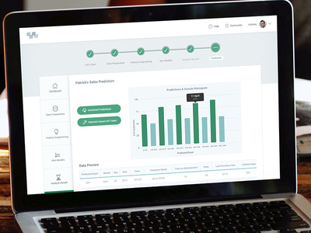
Problem Solving/Prediction Findings
‘The ability to understand whether a schedule (what if scenario) is a good enough. And also take other schedules and try that out….It is about turning data into knowledge.’
Why?
How?
When?
System Complexity
Model as a tool for prediction
Experimentation

Slide 16

General Learning Findings
“they discover that the engineers move a storage area, they believed that it would be on the ground floor and it was now on the first floor. And they were not aware of this until they visually see it.”
(about the system)
(about the model)
“So they had some results and the output they got didn't match the results they got and that was an indication for them that the model is not behaving the way that it should have behaved.”
Why?
How?
When?
Model / Data inaccuracies
Testing Model/ Outcomes with the client
Validation
Lack of communication

Slide 17

Aha! Moment Findings
“So we went Aha! there must be some connection here between rejecting the wheels and having this”
Why?
How?
When?
Mental Model Flaws
Different approaches
Different Phases

Slide 18
Cognitive biases Findings
‘if it is theoretically possible that some things will happen, I can't guarantee you it won't happen. It is going to happen. It is that simple.’ (neglect of probability)
‘And they haven't thought it yet because they always think that this is the process.’ (framing)
‘if we reported back that you need 85 classrooms, they were gonna tell us that we haven't done our work properly.’ (confirmation bias)

Slide 19
Key Factors Findings
No model
Prior Experience: Consultant brings ideas from projects in the same or different industry
Model
Explore: Together they expose conceptual issues
Scoping: Consultant makes client aware of mental model issues
‘Wrong’ model:
facilitate discussion

Slide 20
Interviews Conclusions
O1. Simulation Insights
Many examples of Insights
Examples of Insights:
with no model
with model as a tool of thinking
with ‘wrong’ model
O2. Process
>
Content

