Slide 1
How to make ambiguity an enabling factor in group decision: hints from drought risk management
Raffaele Giordano
Irene Pluchinotta
Water Research Institute – National Research Council, Italy
LAMSADE-CNRS, Paris Dauphine University (France)

Slide 2
Background
Information
Mental
model
Information
Decisions
Mental
model
Decisions
Decisions
Mental
model
Information

Slide 3
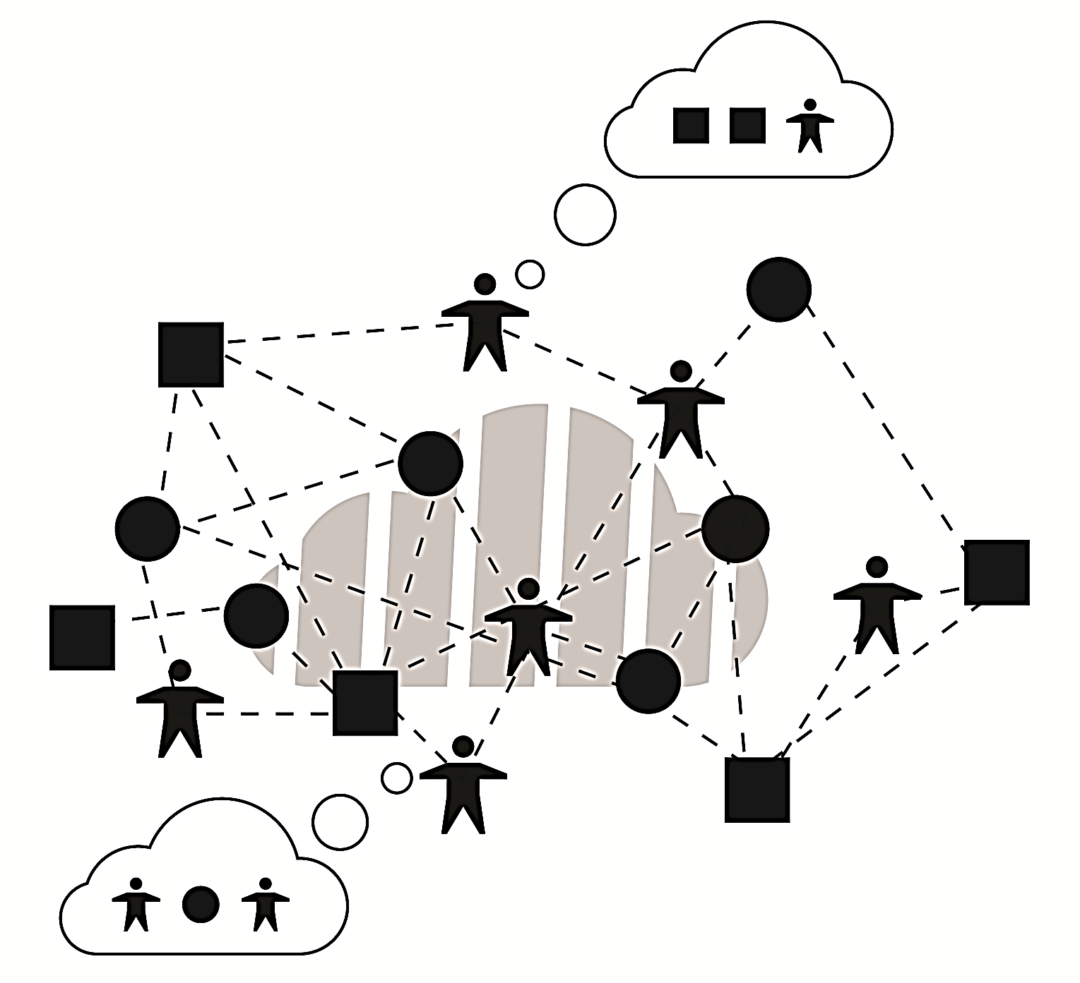
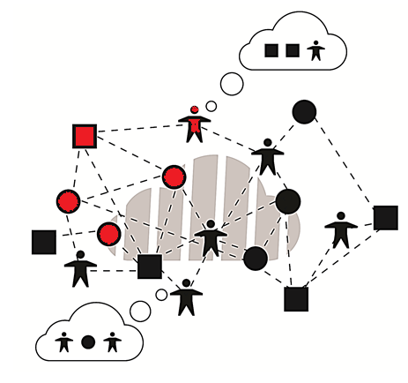
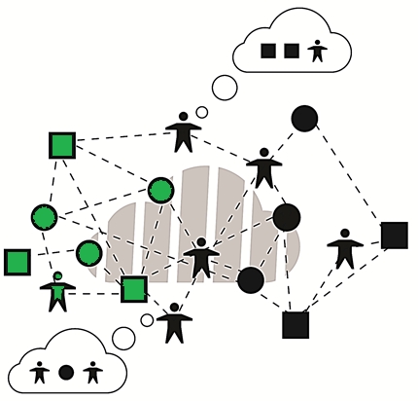
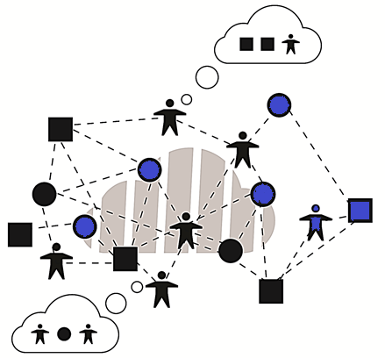
Background
The behavioural repertoires the agents use to interact with one another affect the creation of the sharing understanding

Slide 4
Goal and methodology
This work aims to demonstrate that sufficient overlap in interaction frames is a sine-qua-non condition allowing decision-actors with divergent problem frames to interactively co-construct overlap in their decisions; that is, to develop collective action.
Decision-agents’ understanding of the interaction space
Decision-agents’ understanding of the system dynamic (Mental Model of Dynamic System)
Ambiguity analysis
Learning process
Notes:
The analyst

Slide 5
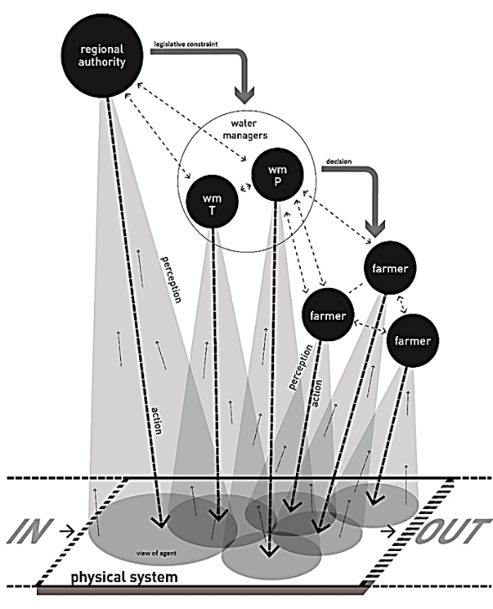
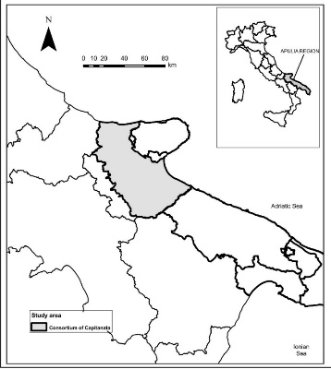
Drought risk management in the Apulia Region
The Regional Water Authority proposed the enforcement of restrictive measures in the use of groundwater in case of drought
The new legislation caused strong conflicts between farmers, the Regional Authority and the Irrigation Consortium due to the expected economic damages to the agricultural sector
Due to this conflicting situation, the Water Protection Plan has not been implemented yet, and the Regional Authority is carrying on a time and money consuming revision process
Decision-Agent | Role | Type
Regional Authority | Controller (high level) | Organization
Water Manager Irrigation Consortium | Technician/Seller (middle level) | Organization
Farmers | Users (Low level) | Individual

Slide 6
The interaction space
Objects |  | Actors |  | Resources
$$o_{1}$$ | Environmental protection | $$a_{3}$$ | Regional Authority | $$r_{2}$$ | Legislative constraints and regulations
$$o_{2}$$ | Agricultural productivity | $$a_{1}$$ | Irrigation consortium | $$r_{1}$$ | Economic resources (water price)
 |  |  |  | $$r_{3}$$ | Information flow
 |  | $$a_{2}$$ | Farmers | $$r_{5}$$ | Water accessibility
 |  |  |  | $$r_{6}$$ | Illegal actions
 |  |  |  | $$r_{8}$$ | Yield
$$o_{3}$$ | Effectiveness of the irrigation water management | $$a_{1}$$ | Irrigation consortium | $$r_{1}$$ | Economic resources (water price)
 |  |  |  | $$r_{3}$$ | Information flow
 |  | $$a_{3}$$ | Regional Authority | $$r_{2}$$ | Legislative constraints and regulations
$$o_{4}$$ | Water availability | $$a_{1}$$ | Irrigation consortium | $$r_{3}$$ | Information flow
 |  | $$a_{2}$$ | Farmers | $$r_{3}$$ | Information flow
 |  |  |  | $$r_{6}$$ | Illegal actions
 |  |  |  | $$r_{8}$$ | Yield
 |  | $$a_{3}$$ | Regional Authority | $$r_{2}$$ | Legislative constraints and regulations
$$o_{5}$$ | Decrease of groundwater overexploitation | $$a_{3}$$ | Regional Authority | $$r_{2}$$ | Legislative constraints and regulations
 |  | $$a_{1}$$ | Irrigation consortium | $$r_{1}$$ | Economic resources (water price)
 |  |  |  | $$r_{7}$$ | Technical resources
$$o_{6}$$ | Water distribution and control of the irrigation network | $$a_{1}$$ | Irrigation consortium | $$r_{1}$$ | Economic resources (water price)
 |  |  |  | $$r_{2}$$ | Legislative constraints and regulations
 |  |  |  | $$r_{3}$$ | Information flow
 |  |  |  | $$r_{4}$$ | Decisional power
 |  |  |  | $$r_{7}$$ | Technical resources
 |  | $$a_{2}$$ | Farmers | $$r_{7}$$ | Technical resources
 |  |  |  | $$r_{6}$$ | Illegal actions
$$o_{7}$$ | Reduction of water consumption during drought | $$a_{1}$$ | Irrigation consortium | $$r_{4}$$ | Decisional power
 |  |  |  | $$r_{7}$$ | Technical resources
$$o_{8}$$ | Env., econ. and social sustainability of the agricultural activities | $$a_{3}$$ | Regional Authority | $$r_{2}$$ | Legislative constraints
 |  |  |  | $$r_{9}$$ | Control of the territory
$$IS= <A, O, R, S>$$
Formal structure to describe the system of interactions within a finite set of agents

Slide 7
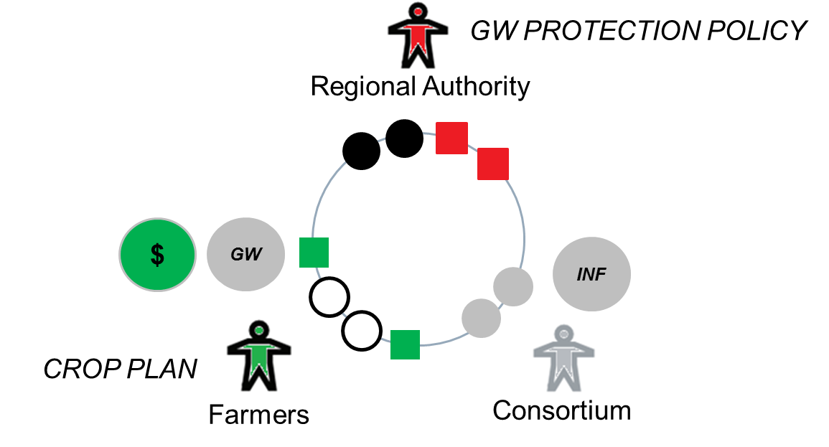
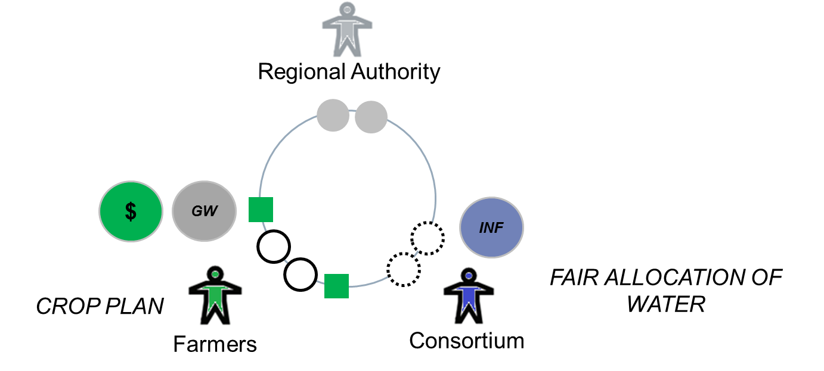
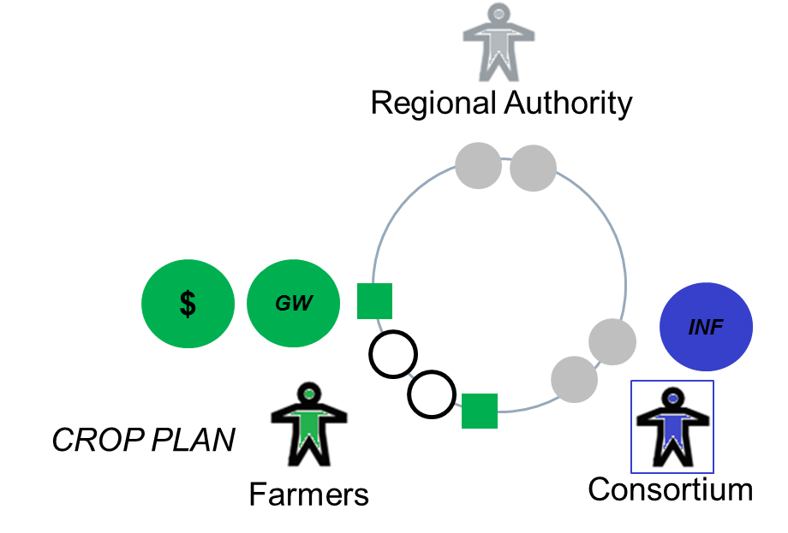
The decision-agents’ understanding of the interaction space
$${<A, O, R, S> }_{Reg}$$
$$({A) }_{Reg,1}$$ | Perception of other actors | $$a_{2}$$ | Farmers
$${(O) }_{Reg,1}$$ | Perception of other actors’ objectives | $$o_{2}$$ | Agricultural productivity
$${(R) }_{Reg,1}$$ | Perception of other actors’ resources | $$r_{5}$$ | Water accessibility
 |  | $$r_{8}$$ | Yield
$$({A) }_{Reg,2}$$ | Perception of other actors | $$a_{1}$$ | Irrigation consortium
$${(O) }_{Reg,2}$$ | Perception of other actors’ objectives | $$o_{6}$$ | Water distribution and control of the irrigation network
$${(R) }_{Reg,2}$$ | Perception of other actors’ resources | $$r_{7}$$ | Technical resources
$${<A, O, R, S> }_{I}$$
$$({A) }_{I, 1}$$ | Perception of other actors | $$a_{2}$$ | Farmers
$${(O) }_{I,1}$$ | Perception of other actors’ objectives | $$o_{2}$$ | Agricultural productivity
 |  | $$o_{4}$$ | Water availability
$${(R) }_{I,1}$$ | Perception of other actors’ resources | $$r_{3}$$ | Information flow
 |  | $$r_{8}$$ | Yield
$$({A) }_{I, 2}$$ | Perception of other actors | $$a_{3}$$ | Regional Authority
$${(O) }_{I,2}$$ | Perception of other actors’ objectives | $$o_{1}$$ | Environmental protection
$${(R) }_{I,2}$$ | Perception of other actors’ resources | $$r_{2}$$ | Legislative constraints and regulations
Regional Authority
Irrigation consortium
$${<A, O, R, S> }_{F}$$
$$({A) }_{F,1}$$ | Perception of other actors | $$a_{1}$$ | Irrigation consortium
$${(O) }_{F,1}$$ | Perception of other actors’ objectives | $$o_{6}$$ | Water distribution and control of the irrigation network
 |  | $$o_{7}$$ | Reduction of water consumption during drought
$${(R) }_{F,1}$$ | Perception of other actors’ resources | $$r_{1}$$ | Economic resources (water price)
 |  | $$r_{2}$$ | Legislative constraints and regulations
 |  | $$r_{4}$$ | Decisional power
 |  | $$r_{7}$$ | Technical resources
$$({A) }_{F,2}$$ | Perception of other actors | $$a_{3}$$ | Regional Authority
$${(R) }_{F,2}$$ | Perception of other actors’ objectives | $$o_{5}$$ | Decrease of groundwater overexploitation
$${(R) }_{F,2}$$ | Perception of other actors’ resources | $$r_{2}$$ | Legislative constraints and regulations
Farmers

Slide 8
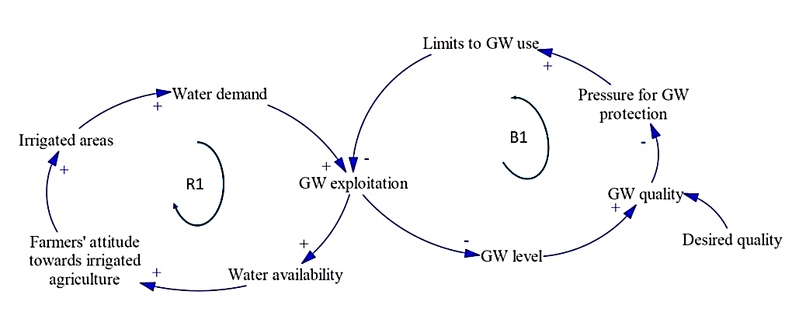
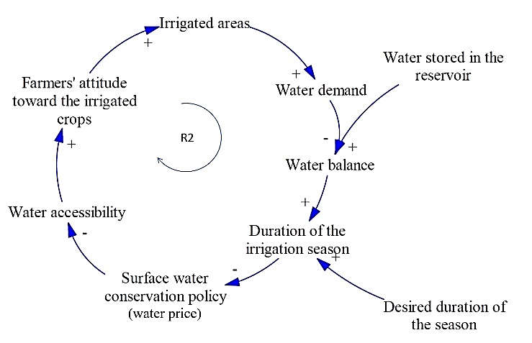
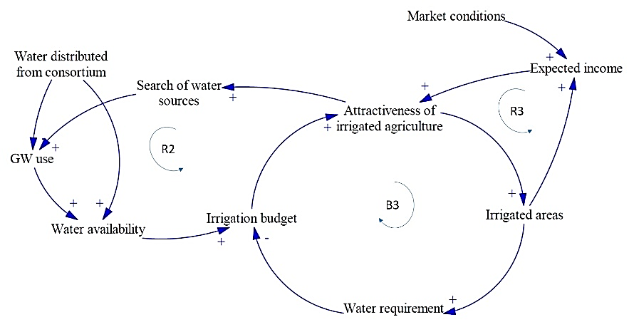
The decision-agents’ mental models of dynamic system (MMDS)
Regional Authority
Irrigation consortium
Farmers
Representing the perceived cause-effect chains influencing the dynamic evolution of a system
EDUCEN - Murcia Progress Meeting (October 2015)

Slide 9
The Ambiguity analysis
DIFFERENCES IN IS PERCEPTION: THE JACCARD INDEX
Given two sets, $A$ and $B$, each having $n$ binary attributes, the J index measures the degree of overlap between two sets by computing the ratio of the number of shared attributes between $A$ and $B$
$$J \left(A,B\right)=\frac{\left|A∩B\right|}{\left|A∪B\right| }$$
DIFFERENCES IN MMDS: THE MODEL DISTANCE RATIO (MDR) INDEX
The method is based on three measures:
i) Elements Distance Ratio (EDR), the differences between two MMDS considering the variables and the causal links in each pair of MMDS;
ii) Loop Distance Ratio (LDR), the similarity between each pair of loops for the two compared MMDS;
$$LDR(m,n)=lpold\left(m,n\right)+EDR(m,n)$$
iii) the Model Distance Ratio (MDR) is the average of all loop distance ratios (Schaffernicht and Groesser, 2011).
The MDR index allowed to define the distance between two actors’ MMDS by aggregating the LDR for each pair of similar loops.
Notes:
The region of intersection $\left(A∩B\right)$ and union $\left(A∪B\right)$ between these two sets can be measured according to set theory.

Slide 10
The Ambiguity analysis
DIFFERENCES IN IS PERCEPTION:
THE JACCARD INDEX
DIFFERENCES IN MMDS:
THE MODEL DISTANCE RATIO (MDR) INDEX
 | Actor | J index | Distance
Analyst | Irrigation Consortium | 0,42 | 0,58
Analyst | Farmer | 0,48 | 0,52
Analyst | Regional Authority | 0,35 | 0,65
 | Regional Authority | Irrigation Consortium | Farmers
Regional Authority | - | 0,21 | 0,90
Irrigation Consortium | 0,21 | - | 0,82
Farmers | 0,90 | 0,82 | -
The main differences:
1) the IC neglects the capability of the F to activate illegal pumping
2) the IC considers the information flow as a crucial resource in the interaction with F
3) the RA ignores the role played by the market
4) the RA perceives the control of the territory as a crucial resource to achieve its main goal
The main differences:
1) The RA perceives the limits to GW as an action to restore the system equilibrium
2) The RA and the IC perceive the water availability as the only driver influencing the system dynamic

Slide 11
The learning process
The Irrigation Consortium became aware of the importance of providing information to farmers in time to actually influence their decision process
The Irrigation Consortium became aware of the illegal pumping activities, which requires a better understanding of the impact of the water price policy.
The Regional Authority introduced the irrigation consortium’s role in influencing the farmers’ behaviour.
 | Actor | J coefficients
Analyst | Irrigation consortium | 0,64
Analyst | Farmer | 0,53
Analyst | Regional Authority | 0,62

Slide 12
The learning process

Slide 13
Conclusions
Decision-agents have a limited understanding of the complexity of the INTERACTION SPACE
Decision-agents tend to neglect the existence of different and equally valid problem framing → they ignore the AMBIGUITY
In order to take actions, decision-agents make assumptions about how the others are going to act and/or react to their actions → CONFLICTING SITUATION
COLLABORATIVE DROUGHT RISK MANAGEMENT CLAIMS FOR A DECISION-MAKING ENVIRONMENT IN WHICH THE PARTIES ARE FULLY AWARE OF THEIR ROLE AND THE ROLES OF THE OTHERS IN THE INTERACTION ENVIRONMENT (INTERDEPENDENCY PRINCIPLE)

Slide 14
Thank you.
raffaele.giordano@cnr.it
irene.pluchinotta@dauphine.fr

