Slide 1

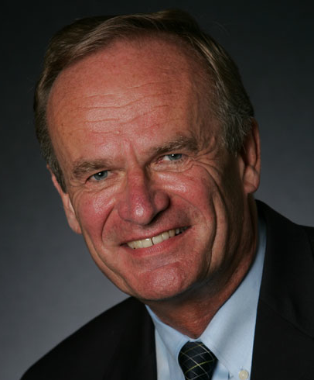

Cognitive and Motivational Biases in Risk and Decision Analysis
Gilberto Montibeller
Dept. of Management, London School of Economics, UK
&
Detlof von Winterfeldt
CREATE, University of Southern California, USA

Slide 2
The Prescriptive-Descriptive Split in Decision Analysis
All research prior to the 1950s (from Bernoulli to Savage) was prescriptive
Some researchers criticized the DA principles of descriptive grounds (Ellsberg, Allais) already in the 50s
Edwards laid the foundation of scientific descriptive work, but with a prescriptive agenda
Notes:
Bernoulli – utility
Savage – formalised subjective expected utility

Slide 3
The Prescriptive-Descriptive Split of the 70s
Prescriptive work since 1960:
  60’s: experimental applications of DA
  70’s: Multiattribute utility theory and influence diagrams
  80’s: Major applications
  90’s Computerization
  2000 and beyond: Specialization
Descriptive work
  50s and 60s: Early violations of SEU (Allais, Ellsberg)
  70s: Probability Biases and Heuristics
  80s: Utility biases and Prospect Theory
  90s: Generalized expected utility theories and experiments

Slide 4
Two Ways Decision Analysts Deal with Biases
The easy way
  Biases exist and are harmful
  Decision analysis helps people overcome these biases
The hard way
  Some biases can occur in the decision analysis process whenever a judgment is needed in the model and may distort the analysis
  Need to understand and correct for these biases in decision analysis

Slide 5
Judgements in Modelling Uncertainty
Eliciting distributions
d₁
d₂
d_{M}
U₁
U₂
...
U_{M}
Identifying
Variables
U_{t}
Aggregating distributions
d_{Te}

Slide 6
Judgements in Modelling Values
Identifying objectives
Eliciting weights
O
w₁
w₂
w_{N}
O₁
O₂
O_{N}
Eliciting value functions
g₁
g₂
g_{N}
...
x₁
x₂
x_{N}
Defining attributes

Slide 7
Judgments in Modelling Choices
Identifying uncertainties
P_{1,1}
X_{1,1}
P_{1,2}
C₁
X_{1,2}
P_{1,k1}
...
a₁
X_{1, k1}
Identifying alternatives
P_{2,1}
X_{2, 1}
a₂
C₂
P_{2,2}
X_{2, 2}
D
P_{2, k2}
...
...
X_{2, k2}
Eliciting Probabilities
a_{Z}
P_{Z,1}
X_{Z, 1}
C_{Z}
P_{Z,2}
P_{Z, kZ}
X_{Z, 2}
...
Estimating
Consequences
X_{Z, kZ}

Slide 8
Biases that Matter vs. Those that Don’t
Biases that matter
They occur in the tasks of eliciting inputs into a decision and risk analysis (DRA) from experts and decision makers.
Thus they can significantly distort the results of an analysis.
Biases that don’t matter
They do not occur or can easily be avoided in the usual tasks of eliciting inputs for DRA

Slide 9
Cognitive Biases that Matter
Cognitive biases are distortions of judgments that violate a normative rules of probability or expected utility
Overconfidence
Availability
Anchoring
Certainty effect
Omission biases
Partitioning biases
Scaling biases
Proxy bias
Range insensitivity

Slide 10
Cognitive Biases That Don’t Matter
Base rate bias
Conjunction fallacy
Ambiguity aversion
Conservatism
Gambler’s fallacy
Hindsight bias
Hot hand fallacy
Insensitivity to sample size
Loss aversion
Non-regressiveness
Status quo biases
Sub/Superadditivity of probabilities

Slide 11
Motivational Biases That Matter
Motivational biases are distortions of judgments because of desires for specific outcomes, events, or actions
Confirmation bias
Undesirability of a negative event or outcome (precautionary thinking, pessimism)
Desirability of a positive event or outcome (wishful thinking, optimism)
Desirability of options or choices

Slide 12
Mapping Biases
P_{1,1}
X_{1,1}
P_{1,2}
C₁
X_{1,2}
Eliciting Probabilities
P_{1,k1}
...
a₁
X_{1, k1}
P_{2,1}
X_{2, 1}
• Anchoring bias (C)
• Availability bias (C)
• Confirmation bias (M)
• Desirability biases (M)
• Gain-loss bias (C)
• Overconfidence bias (C)
• Equalizing bias (C)
• Splitting bias (C)
a₂
C₂
P_{2,2}
D
X_{2, 2}
P_{2, k2}
...
...
X_{2, k2}
a_{Z}
P_{Z,1}
X_{Z, 1}
C_{Z}
P_{Z,2}
P_{Z, kZ}
X_{Z, 2}
...
X_{Z, kZ}

Slide 13
Debiasing
Older experimental literature shows low efficacy
Recent literature is more optimistic
Decision analysts have developed many (mostly untested) best practices:
  Prompting
  Challenging
  Counterfactuals
  Hypothetical bets
  Less bias prone techniques
  Involving multiple experts or stakeholders

Slide 14
New Treatment of the Biases Literature
We view biases from the perspective of an analyst concerned with possible distortions of judgments required for an analysis.
We include motivational biases, which have largely been ignored by BDR, even though they are important and pervasive in DRA.
We separate biases in those that matter for DRA versus those that do not matter in this context.

Slide 15
New Treatment of the Bias Literature (continued)
We provide guidance on debiasing techniques
  which includes not only the behavioral literature on debiasing,
  but also the growing set of “best practices” in the decision and risk analysis field.

Slide 16
Thank you for your attention!
Contact: Dr Gilberto Montibeller
  Email: g.montibeller@lse.ac.uk
  Address:
  Department of Management
  London School of Economics
  Houghton St., London, WC2A 2AE

