Slide 1
Why emotional behaviors matter for the design of decision support systems (DSSs)
Evidence from text-based electronic negotiations
Work presented at the 20th Conference of the International Federation of Operational Research Societies in Barcelona, Spain. 14.07.2014
Patrick Hippmann | patrick.hippmann@univie.ac.at
Notes:
EXPLAIN what a DSS is

Slide 2
Motivation
Focus: Behavioral issues connected to decision support (e.g., Hämäläinen et al., 2013)
Emotions are important to consider in negotiations and should be when developing negotiation support systems, since these impact negotiation effectiveness (Broekens et al., 2010; Hindriks & Jonker, 2008)
  Research should focus more on how decision or negotiation support affects interactions between the negotiators (Kersten & Lai, 2007; Turel et al., 2007; Weigand et al., 2003)
  Unfortunately, the impact of DSSs on emotional behavior and specifically emotional dynamics lacks empirical attention (Bui, 1994; Lim & Benbasat, 1991; Pommeranz et al., 2009)
Notes:
- Research on DSS looked at x,y,x … and also “emotions” (Delany, or Kersten e.g.) but only very marginally and measurement/theory weaknesses
This is an important gap because (2 points): affect is important in negos (bring some quick examples from slides on, (a) why emos are important, and (b) emos in CMC), thus it influences the nego process AND do research on DSS because we want to improve the nego process+outcome
Thus it is not unimportant (at all) to incorporate emotions here … mention {Broekens 2010 #1117} who talk about introducing ANSSs
The present work brings us closer to that and breaks new ground … blabla
We are particularly interested in what we see in the graphs: i.e. the procedural dynamics of affective expressions (explain that), how these differ between Successful/Failed (explain), and how DSS impacts these
- - - -
Besides technological solutions, negotiation support research should concentrate more on socio-emotional aspects
Empirical findings regarding the effects of decision support:
- Increase of joint outcomes and satisfaction, reduction of perceived negative climate (Foroughi et al., 1995; Perkins et al., 1996), positively impacts social aspects (Delaney et al., 1997)
- More integrative but no improvements in outcomes (Rangaswamy & Shell, 1997)
- Increase of communication effectiveness and perception of group process (Jain & Solomon, 2000)
- Problem of over-structuring (Schoop et al., 2003)
- Without graphical support a lower number of offers, but more words per dyad were transmitted (Weber et al., 2006)
- DSS users show more positive emotions (Kersten, 2004)
(AD)
(Foroughi et al. 1995): NSS allowed the negotiators to achieve higher joint outcomes, more balanced contracts, and higher satisfaction. Perceived negative climate was reduced.
{Perkins 1996 #1112}: Managers arrived at better (more fair) contracts (higher joint outcomes and more balanced contracts) in less time when provided with DSS
Delaney et al. (1997): DSS improves information processing, joint outcomes and contract balance. Electronic communication reduces negative climate. Positive impact on socio-emotional aspects of the negotiation, such as perceived satisfaction and negative climate as well as the information processing aspects. Although the DSS improved some aspects of the negotiation outcomes compared to no computer support, the comprehensive NSS provided a wider range of enhancements to the negotiation. These results thus provide support for Lira and Benbasat's [17] theory of negotiation, which recognizes the separate but important roles played by the two components of NSS - DSS and electronic communication - and hypothesizes that the effects of each component will be different. While the DSS plays the role of improving information processing capacities, the electronic communication component impacts positively on the sociological aspects of negotiator interaction.
Rangaswamy and Shell’s (1997): DSS users made more integrative trades; the support system played a key role in helping parties to overcome some of the barriers to integrative bargaining. Equivalence in outcomes (in terms of integrative trades) suggests that the mere use of computer technology will not improve negotiation outcomes (inconclusive results of studies regarding outcome).
Lim (2000): Confirms the positive influence of DSS on individual and joint outcomes. DSS reduces cognitive effort.
{Jain 2000 #1110}: DSS increases effectiveness of communication and perception of the group process (attitudes that measure the socio-emotional behavior). DSS and FtF two groups are equivalent on satisfaction with outcomes. FtF group achieved better outcomes.
{Schoop 2003 #871}: Problem of over-structuring
- An individual's attentional capacity is split between internal (somesthetic) and external (environmental) stimuli (Blascovich, 1990, 1992) -> tradeoff {Feldman 1995 #282}
{Kersten 2004 #555}: Differences in cognitive requirements; DSS users show more positive emotions. Trade-off between the loss of communication bandwidth and the gain of processing capability.
(These systems, perhaps paradoxically, may be able to help their users in establishing rapport and trust, and reduce social-distance with the other party. They may facilitate employing the rational problem-solving approach together with counterpart-oriented positive emotional style.)
-> positive influence of the analytical tools on the relationship between the negotiators exemplified with their positive emotions
{Weber 2006 #1109}: Compared e-negotiations with and without graphical support. No difference in proportion of successful negotiations. Without graphical support a lower number of offers, but more words per dyad were transmitted.
{Hindriks 2008 #1115}: Negotiation is a complex emotional decision-making process but few people are effective negotiators. Adequate human-machine collaborative systems are required.
{Pommeranz 2009 #1116}: Decision and negotiation support research concentrates on technological solutions, but the social problems that they intend to solve are secondary or even completely neglected. Swaab and colleagues (Swaab et al. 2009) argue for a careful analysis of social and psychological processes in order to design good support systems. +
+ {Bui 1994 #1113}: Research on decision and negotiation support should look beyond the usual rational/instrumental perspective and also needs to incorporate socio-emotional aspects, to assess guidelines, functionality, and design issues of DSSs. Support influences the dynamics of negotiations by creating an atmosphere that emphasizes order, rationality, equality and empathy with the other party’s position. The impact of DSSs goes beyond analytical processing capabilities (Lim and Benbasat, 1991) and also affects the socio-emotional tone of the interaction. Normative and socio-emotional biases, while not completely eliminated, may be controlled and limited to a degree.
{Broekens 2010 #1117}: Affect is an important issue to consider when developing a negotiation support system. Up until now, a negotiation support system (NSS) supports negotiators with the rational part of the negotiation process, but they should also help negotiators cope with the interplay between emotion and the negotiation process. Emotions are strongly linked to motivation, which means that the expression of emotion during the negotiation process should be taken as a signal (fear - pessimistic; anger, enthusiasm - optimistic; value claiming; strategic use of emotion; …).
-> {Kersten 2007 #498}{Turel 2007 #992}: Research should focus on how Decision or Negotiation Support affects interactions between the negotiators
- The provision of this support has been the object of little attention on the part of DSS researchers (Te’eni, 1992)
- The research of DSS in negotiations has neglected the communication perspective (individual, interpersonal, dyadic, and temporal perspectives) {Weigand 2003 #1036}

Slide 3
Motivation
Focus: Behavioral issues connected to decision support (e.g., Hämäläinen et al., 2013)
Emotions are important to consider in negotiations and should be when developing negotiation support systems, since these impact negotiation effectiveness (Broekens et al., 2010; Hindriks & Jonker, 2008)
  Research should focus more on how decision or negotiation support affects interactions between the negotiators (Kersten & Lai, 2007; Turel et al., 2007; Weigand et al., 2003)
  Unfortunately, the impact of DSSs on emotional behavior and specifically emotional dynamics lacks empirical attention (Bui, 1994; Lim & Benbasat, 1991; Pommeranz et al., 2009)
The impact of decision support on the dynamics of emotional expressions in text-based online negotiations
Main contributions:
  DSSs impact emotional expressions in and throughout text-based online negotiations (initial evidence)
  Incorporating affective behavior is important when designing DSSs (supplementary evidence to Broekens et al., 2010)
Notes:
- Research on DSS looked at x,y,x … and also “emotions” (Delany, or Kersten e.g.) but only very marginally and measurement/theory weaknesses
This is an important gap because (2 points): affect is important in negos (bring some quick examples from slides on, (a) why emos are important, and (b) emos in CMC), thus it influences the nego process AND do research on DSS because we want to improve the nego process+outcome
Thus it is not unimportant (at all) to incorporate emotions here … mention {Broekens 2010 #1117} who talk about introducing ANSSs
The present work brings us closer to that and breaks new ground … blabla
We are particularly interested in what we see in the graphs: i.e. the procedural dynamics of affective expressions (explain that), how these differ between Successful/Failed (explain), and how DSS impacts these
- - - -
Besides technological solutions, negotiation support research should concentrate more on socio-emotional aspects
Empirical findings regarding the effects of decision support:
- Increase of joint outcomes and satisfaction, reduction of perceived negative climate (Foroughi et al., 1995; Perkins et al., 1996), positively impacts social aspects (Delaney et al., 1997)
- More integrative but no improvements in outcomes (Rangaswamy & Shell, 1997)
- Increase of communication effectiveness and perception of group process (Jain & Solomon, 2000)
- Problem of over-structuring (Schoop et al., 2003)
- Without graphical support a lower number of offers, but more words per dyad were transmitted (Weber et al., 2006)
- DSS users show more positive emotions (Kersten, 2004)
(AD)
(Foroughi et al. 1995): NSS allowed the negotiators to achieve higher joint outcomes, more balanced contracts, and higher satisfaction. Perceived negative climate was reduced.
{Perkins 1996 #1112}: Managers arrived at better (more fair) contracts (higher joint outcomes and more balanced contracts) in less time when provided with DSS
Delaney et al. (1997): DSS improves information processing, joint outcomes and contract balance. Electronic communication reduces negative climate. Positive impact on socio-emotional aspects of the negotiation, such as perceived satisfaction and negative climate as well as the information processing aspects. Although the DSS improved some aspects of the negotiation outcomes compared to no computer support, the comprehensive NSS provided a wider range of enhancements to the negotiation. These results thus provide support for Lira and Benbasat's [17] theory of negotiation, which recognizes the separate but important roles played by the two components of NSS - DSS and electronic communication - and hypothesizes that the effects of each component will be different. While the DSS plays the role of improving information processing capacities, the electronic communication component impacts positively on the sociological aspects of negotiator interaction.
Rangaswamy and Shell’s (1997): DSS users made more integrative trades; the support system played a key role in helping parties to overcome some of the barriers to integrative bargaining. Equivalence in outcomes (in terms of integrative trades) suggests that the mere use of computer technology will not improve negotiation outcomes (inconclusive results of studies regarding outcome).
Lim (2000): Confirms the positive influence of DSS on individual and joint outcomes. DSS reduces cognitive effort.
{Jain 2000 #1110}: DSS increases effectiveness of communication and perception of the group process (attitudes that measure the socio-emotional behavior). DSS and FtF two groups are equivalent on satisfaction with outcomes. FtF group achieved better outcomes.
{Schoop 2003 #871}: Problem of over-structuring
- An individual's attentional capacity is split between internal (somesthetic) and external (environmental) stimuli (Blascovich, 1990, 1992) -> tradeoff {Feldman 1995 #282}
{Kersten 2004 #555}: Differences in cognitive requirements; DSS users show more positive emotions. Trade-off between the loss of communication bandwidth and the gain of processing capability.
(These systems, perhaps paradoxically, may be able to help their users in establishing rapport and trust, and reduce social-distance with the other party. They may facilitate employing the rational problem-solving approach together with counterpart-oriented positive emotional style.)
-> positive influence of the analytical tools on the relationship between the negotiators exemplified with their positive emotions
{Weber 2006 #1109}: Compared e-negotiations with and without graphical support. No difference in proportion of successful negotiations. Without graphical support a lower number of offers, but more words per dyad were transmitted.
{Hindriks 2008 #1115}: Negotiation is a complex emotional decision-making process but few people are effective negotiators. Adequate human-machine collaborative systems are required.
{Pommeranz 2009 #1116}: Decision and negotiation support research concentrates on technological solutions, but the social problems that they intend to solve are secondary or even completely neglected. Swaab and colleagues (Swaab et al. 2009) argue for a careful analysis of social and psychological processes in order to design good support systems. +
+ {Bui 1994 #1113}: Research on decision and negotiation support should look beyond the usual rational/instrumental perspective and also needs to incorporate socio-emotional aspects, to assess guidelines, functionality, and design issues of DSSs. Support influences the dynamics of negotiations by creating an atmosphere that emphasizes order, rationality, equality and empathy with the other party’s position. The impact of DSSs goes beyond analytical processing capabilities (Lim and Benbasat, 1991) and also affects the socio-emotional tone of the interaction. Normative and socio-emotional biases, while not completely eliminated, may be controlled and limited to a degree.
{Broekens 2010 #1117}: Affect is an important issue to consider when developing a negotiation support system. Up until now, a negotiation support system (NSS) supports negotiators with the rational part of the negotiation process, but they should also help negotiators cope with the interplay between emotion and the negotiation process. Emotions are strongly linked to motivation, which means that the expression of emotion during the negotiation process should be taken as a signal (fear - pessimistic; anger, enthusiasm - optimistic; value claiming; strategic use of emotion; …).
-> {Kersten 2007 #498}{Turel 2007 #992}: Research should focus on how Decision or Negotiation Support affects interactions between the negotiators
- The provision of this support has been the object of little attention on the part of DSS researchers (Te’eni, 1992)
- The research of DSS in negotiations has neglected the communication perspective (individual, interpersonal, dyadic, and temporal perspectives) {Weigand 2003 #1036}

Slide 4
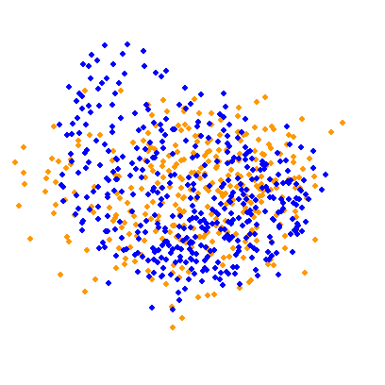
Theoretical & Methodological Introduction
Emotional Expressions
Theoretical foundation
  Dimensional perspective of affect (Russell, 1980; Watson & Tellegen, 1984; Yik et al., 1999)
Methodological foundation
  Multidimensional scaling based on similarity judgments (e.g. Borg & Groenen, 2005; Lawless et al., 1995)
(surprised, astonished, aroused, active)
High activation
(angry, annoyed, anxious)
Activated Displeasure
(elated, enthusiastic, excited)
Activated Pleasure
Displeasure
(unhappy, displeased, irritated)
Pleasure
(glad, happy, pleased)
Deactivated Displeasure
(dull, sluggish, indifferent)
Deactivated Pleasure
(serene, content, relaxed)
Temporal dynamics
Theoretical foundation
  Phase model theories of negotiations (e.g. Adair & Brett, 2005; Holmes, 1992; Weingart & Olekalns, 2004)
Methodological foundation
  Data driven identification of phase split-points (Koeszegi et al., 2011; Vetschera, 2013)
Low activation
(tranquil, factual, quiet)
Activation
Neg. Act.
Pos. Act.
Behavioral dynamics
Theoretical foundation
  Multilevel framework: (a) Dyadic, (b) intra-personal, (c) inter-personal level
Methodological foundation
  Multilevel modeling: Actor-partner interdependence model (e.g. Kenny et al., 2006)
Valence
Notes:
Dimensional vs.
Componential perspective: Mostly appraisal theories (Scherer, Lazarus, Smith, Ortony, Frijda): This perspective is mainly shaped by cognitive appraisal theories which basically explicate that emotions are linked to anterior functions of the organism {Gratch 2009 #1259}{Smith 1985 #907}{Broekens 2010 #1117}. In particular, it is the appraisal of the environment or ones context, which is believed to be responsible for differences in emotional experiences {Scherer 1999 #953}. In other words, the meaning attributed to a context by an individual precedes his or her emotional responses {Parkinson 2009 #1265}. Hence different appraisals of events are responsible for different emotions {Frijda 2009 #1279}. Since these different appraisals are based on different cognitive processes it is concluded that the interpretation of environmental stimuli is cognitively driven {Broekens 2010 #1117}. Emotions are thus viewed as resulting from cognitive evaluations, which are necessary for attributing personal relevance to contexts {Scherer 2001 #1139}. The central issue is that of personal relevance or meaning attributed to a situation. Accordingly, similar contexts may be interpreted very differently and result in different emotions, just as very different contexts may be interpreted similarly and result in similar emotions {Balahur 2012 #1194}{Parkinson 2009 #1265}. Hence, the organism’s cognitive evaluation, or appraisal, of a situation is assumed to be influenced by various cognitive dimensions or factors of judgment {Smith 1985 #907}, referred to as appraisal variables or criteria {Gratch 2009 #1259}{Balahur 2012 #1194}. Importantly, distinct appraisal variables are believed to be related to distinct appraisals, which further relate to distinct emotions. Thus, the kind of emotion being experienced depends on the activation or deactivation of certain appraisal variables. The relationship of these variables with specific, distinct emotions is therefore sometimes explained as taking a tree-shaped form {Cowie 2003 #1303}. Depending on the appraisal variables of interest, as well as on the emotions of interest, different interconnections, and accordingly explanations for these, have been found. Thus, there is no truly universal conceptualization of emotions in line with this perspective, due to the existence of different appraisal theories.
Categorical perspective: A categorical perspective of emotions presumes that each distinct emotion can be uniquely linked to specific somatic responses {Gratch 2009 #1259}{Mauss 2009 #1281}, similar to appraisal theories. Within this perspective the aim is to develop a list of words, or an “affective lexicon” {Ortony 1987 #731}, and to link these words with particular discrete emotions. Empirical research, however, only addressed a very limited number of words, and thus emotions, at a time, which means that emotions have been added to the “affective lexicon” in isolation from each other {Butt 2006 #135}. The categorical perspective of discrete emotions is thus generally attested a lack of comprehensibility {Butt 2006 #135}{Butt 2005 #136}. In particular emotions are being categorized and labeled based on commonplace or ordinary language, by using either quantitative {Fehr 1984 #1312} or qualitative {Ortony 1988 #1305} methods {Cowie 2003 #1303}. Based on these efforts of classification researchers developed affective lexicons of different volume. For example, {Fehr 1984 #1312 /footcit} outlined 196 distinct emotions, whereas {Shaver 1987 #891 /footcit} outlined 213. The shortcoming of these classifications, however, is that they might not capture “every shade of emotion” {Cowie 2003 #1303: 13}, irrespective of how long the list of emotion words may be. In addition there is a trade-off with respect to completeness, universality, comprehensibility, and usefulness that needs to be taken into account. This is exemplified by {Cowie 2003 #1303 /footcit} who argue that a list of e.g. 60 words may be too complex to be tractable, but too simple to determine meaningful distinctions. Moreover a strict classification of emotions may be problematic since one emotional term, e.g. anger, may be used and interpreted in different ways. Anger, for example, could be further sub-classified as “cold anger” and “hot anger” {Scherer 1986 #1313}.
Dimensional perspective: Dimensional perspectives of emotions intend to specify the general, relational structure of affect {Daly 1983 #204}, based on the assumption that emotions can be described by a number of underlying and related dimensions {Broekens 2010 #1117}. Importantly it is proposed that a large number of emotions can be described by very few, general affective dimensions {Russell 2003 #1290}. This presumption is rooted in the understanding that several psychological and physiological commonalties are shared by a number of distinct emotions {Seo 2008 #957}{Gratch 2009 #1259}{Mauss 2009 #1281}. Put in more simple terms, it is argued that discrete emotions are defined by certain underlying affective dimensions. Hence the primary issue is to identify these dimensions. One of the most prominent dimensional models of emotions is the circumplex model of affect {Russell 1980 #853}, which is described by the two bipolar affective dimensions of valence (pleasure and displeasure) as well as degree of arousal (arousal and sleepiness) {Russell 1978 #851}{Russell 1979 #852}. Both of these dimensions are defined as subjective feelings or experiences of pleasantness or unpleasantness and activation or deactivation, respectively {Feldman Barrett 1998 #277}. A second prominent model is the PANA model of positive activation (PA) and negative activation (NA) {Watson 1985 #1030}. Importantly both of these models consensually assume that the predominant number of emotional phenomena can be explained by two underlying bipolar dimensions {Russell 1978 #851}{Russell 1979 #852}{Watson 1985 #1030}. Also it has been shown that these dimensions provide a basic structure to emotional phenomena by spanning a two-dimensional Cartesian space, around which affective states are ordered in a circular manner {Russell 1979 #852}{Schaefer 1966 #1334}{Feldman 1995 #282}. Thus, “any affective state may be defined by its placement relative to circumplex dimensions” {Feldman 1995 #282: 153}.
Advantages of a dimensional perspective over the other two: In sum, the affective circumplex and its underlying conceptualization of core affect is a valuable framework to identify distinct emotional episodes, i.e. expressed emotions, and to define these based on their degree of valence and arousal. As compared to a componential perspective in line with appraisal theories, it is advantageous not to characterize emotions as fixed entities that can be ordered into detailed taxonomies, since emotions that are classified into specific taxonomies may not be fully defined by these and may not be mutually independent from other taxonomies {Frijda 2009 #1279}. The categorical perspective of emotions shares this limitation and is further also based on a conceptualization of emotions as subjective feeling states {Broekens 2010 #1117}. The dimensional perspective of emotions, to which the affective circumplex belongs, is however based on the analysis of displayed emotions, mostly facially expressed emotions {Smith 1985 #907}{Cowie 2003 #1303}. Also when disregarding these theoretical and methodological differences, a dimensional perspective is to be preferred as it is more parsimonious and better able to grasp the central, basic elements of emotions {Mauss 2009 #1281}.

Slide 5
Theoretical & Methodological Introduction
Emotional Expressions
Theoretical foundation
  Dimensional perspective of affect (Russell, 1980; Watson & Tellegen, 1984; Yik et al., 1999)
Methodological foundation
  Multidimensional scaling based on similarity judgments (e.g. Borg & Groenen, 2005; Lawless et al., 1995)
Phase 1: Initiation
Temporal dynamics
Theoretical foundation
  Phase model theories of negotiations (e.g. Adair & Brett, 2005; Holmes, 1992; Weingart & Olekalns, 2004)
Methodological foundation
  Data driven identification of phase split-points (Koeszegi et al., 2011; Vetschera, 2013)
Phase 2: Problem solving
Phase 3: Resolution
Behavioral dynamics
Theoretical foundation
  Multilevel framework: (a) Dyadic, (b) intra-personal, (c) inter-personal level
Methodological foundation
  Multilevel modeling: Actor-partner interdependence model (e.g. Kenny et al., 2006)
Notes:
The tricky part: Negotiations of different lengths → thus phase models are very useful
The next tricky part then: Phases in different negotiations need not be equally long → thus data driven split points for each! Negotiation individually
The classical” descriptive phase model is a three-phase model provided by {Douglas 1962 #246 /footcit}, upon which most other phase models are based {Putnam 1990 #799}{Gulliver 1979 #371}{Pruitt 1981 #1357}{Abbott 1986 #1385}{Walton 1965 #1386}. Her phases are denominated as establishing the negotiation range, reconnoitering the range, and precipitating the decision-reaching crises, which can, as indicated before, be summarized as initiation, problem solving, and resolution phases.
Based on these traditional phase models of negotiations, more recent models were developed and tested {Adair 2005 #8}{Broekens 2010 #1117}{Morris 2000 #677}. {Morris 2000 #677 /footcit} propose a four-phase model that differentiates opening moves, positioning, problem solving, and endgame. Their model is one of the very few that explicitly focuses on emotions by explaining that specific relational problems arising in each of the negotiation phases can be resolved with specific emotional behaviors. Consequently, it is argued that negotiation progress, in terms of moving from one phase to the next, depends on the expressions of certain kinds of emotions at certain points in time as well as the inter-personal effects of these. {Adair 2005 #8 /footcit} propose a similar four-phase model of negotiations that includes relational positioning, identifying the problem, generating solutions, and reaching agreement phases. Their phases are described by general competitive and cooperative behaviors of the negotiators, whereas a move from one phase to the next indicates a shift or change of these behaviors. {Broekens 2010 #1117 /footcit} propose a four-phase model, which includes the phases of private preparation, joint exploration, bidding, and closing. In their model the first phase, however, is a pre-negotiation phase, whereas in the previous two models {Adair 2005 #8}{Morris 2000 #677} the first phase already pertains to the negotiation process. Hence, this model is more closely oriented at the traditional three-phase models originating from {Douglas 1962 #246 /footcit}, with the addition of a pre-negotiation planning phase.

Slide 6
Theoretical & Methodological Introduction
Emotional Expressions
Theoretical foundation
  Dimensional perspective of affect (Russell, 1980; Watson & Tellegen, 1984; Yik et al., 1999)
Methodological foundation
  Multidimensional scaling based on similarity judgments (e.g. Borg & Groenen, 2005; Lawless et al., 1995)
(a) Collective Level
Dyad Level Average Affect (t)
Δ
Dyad Level Average Affect (t+1)
Temporal dynamics
Theoretical foundation
  Phase model theories of negotiations (e.g. Adair & Brett, 2005; Holmes, 1992; Weingart & Olekalns, 2004)
Methodological foundation
  Data driven identification of phase split-points (Koeszegi et al., 2011; Vetschera, 2013)
(b+c) Intra- and Inter-Personal Level
Affect A_{t}
a_{A}
Affect A_{t+1}
p_{A}
r
Behavioral dynamics
Theoretical foundation
  Multilevel framework: (a) Collective, (b) intra-personal, (c) inter-personal level
Methodological foundation
  Mostly multilevel modeling: Actor-partner interdependence model (e.g. Kenny et al., 2006)
p_{B}
Affect B_{t}
Affect B_{t+1}
a_{B}
r … Intra-phase reciprocity of affective expression
p … Inter-personal influence of affective expressions
a … Intra-personal influence of affective expressions
Notes:
Here also explain:
that we have dyadic data
indistinguishable dyad members → analytical challenge
Interdependence is of UTMOST importance in any dyadic design, such as when analyzing negotiations
we need to treat that accordingly by using the correct methods (ICCS, APIMs)
to understand what is actually happening we need to use a multilevel framework: collective, intra-personal, inter-personal, temporal + [within and between phases]
We need the collective level because we have indistinguishable dyad members, otherwise the individual scores can be used (in addition)

Slide 7
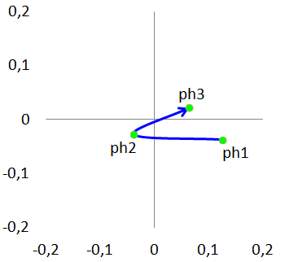
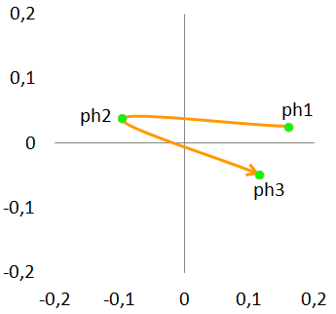
Results: Impact of a DSS in Successful negotiations (dyadic level)
Activation
Table 1. Between phase comparisons: Successful (t-tests)
 | Positive Activation
 | DSS | noDSS
Ph1 vs. Ph2 | 3.105 (.009) *** | 3.235 (.015) **
Ph2 vs. Ph3 | -3.546 (.006) *** | -1.392 (.198)
Ph1 vs. Ph3 | 0.019 (.985) | 1.342 (.198)
 | Negative Activation
 | DSS | noDSS
Ph1 vs. Ph2 | -2,374 (.084)* | -3.862 (.003) ***
Ph2 vs. Ph3 | 0.839 (.411) | 3.651 (.003) ***
Ph1 vs. Ph3 | -1.667 (.167) | 0.342 (.737)
* p < .10; ** p < .05; *** p < .01 | p-values adjusted using false discovery rate (FDR)
DSS
Valence
Activation
noDSS
Valence
Dyad Level Average Affect (t)
Δ
Dyad Level Average Affect (t+1)
Notes:
Paired samples t-tests (of course)
Interesting part: phase 2 > phase 3: with DSS PA increases / without DSS NA decreases

Slide 8
Results: Impact of a DSS in Successful negotiations (dyadic level)
Activation
(elated, enthusiastic, excited)
Activated Pleasure
Table 1. Between phase comparisons: Successful (t-tests)
 | Positive Activation
 | DSS | noDSS
Ph1 vs. Ph2 | 3.105 (.009) *** | 3.235 (.015) **
Ph2 vs. Ph3 | -3.546 (.006) *** | -1.392 (.198)
Ph1 vs. Ph3 | 0.019 (.985) | 1.342 (.198)
 | Negative Activation
 | DSS | noDSS
Ph1 vs. Ph2 | -2,374 (.084)* | -3.862 (.003) ***
Ph2 vs. Ph3 | 0.839 (.411) | 3.651 (.003) ***
Ph1 vs. Ph3 | -1.667 (.167) | 0.342 (.737)
* p < .10; ** p < .05; *** p < .01 | p-values adjusted using false discovery rate (FDR)
DSS
Valence
Activation
noDSS
Valence
In successful negotiations pleasure increases from ph2 to ph3:
  DSS: towards activated pleasure (e.g. elated, excited)
  noDSS: towards deactivated pleasure (e.g. content, at ease)
Deactivated Pleasure
(serene, content, relaxed)

Slide 9
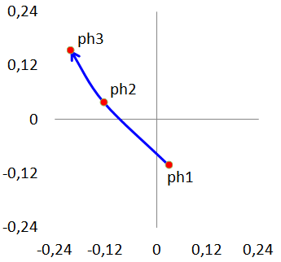
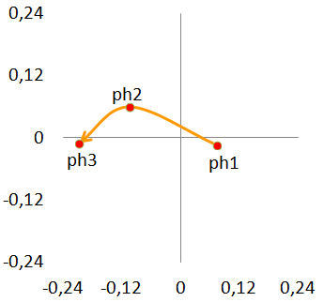
Results: Impact of a DSS in Failed negotiations (dyadic level)
Activation
Table 2. Between phase comparisons: Failed (t-tests)
 | Valence
 | DSS | noDSS
Ph1 vs. Ph2 | 2.854 (.026) ** | 2.932 (.036) **
Ph2 vs. Ph3 | 1.118 (.290) | 1.844 (.108)
Ph1 vs. Ph3 | 4.116 (.006) *** | 2.866 (.036) **
 | Activation
 | DSS | noDSS
Ph1 vs. Ph2 | -2,328 (.063)* | -0.834 (.662)
Ph2 vs. Ph3 | -1.866 (.092) * | 0.816 (.662)
Ph1 vs. Ph3 | -4.613 (.003) *** | -0.036 (.972)
* p < .10; ** p < .05; *** p < .01 | p-values adjusted using false discovery rate (FDR)
DSS
Valence
Activation
noDSS
Valence
Dyad Level Average Affect (t)
Δ
Dyad Level Average Affect (t+1)
Notes:
Interesting parts: in both displeasure increases / with DSS activation increases / without DSS activation remains somewhat stable

Slide 10
Results: Impact of a DSS in Failed negotiations (dyadic level)
(angry, annoyed, anxious)
Activated Displeasure
Activation
Table 2. Between phase comparisons: Failed (t-tests)
 | Valence
 | DSS | noDSS
Ph1 vs. Ph2 | 2.854 (.026) ** | 2.932 (.036) **
Ph2 vs. Ph3 | 1.118 (.290) | 1.844 (.108)
Ph1 vs. Ph3 | 4.116 (.006) *** | 2.866 (.036) **
 | Activation
 | DSS | noDSS
Ph1 vs. Ph2 | -2,328 (.063)* | -0.834 (.662)
Ph2 vs. Ph3 | -1.866 (.092) * | 0.816 (.662)
Ph1 vs. Ph3 | -4.613 (.003) *** | -0.036 (.972)
* p < .10; ** p < .05; *** p < .01 | p-values adjusted using false discovery rate (FDR)
DSS
Valence
Activation
noDSS
Valence
In failed negotiations displeasure increases over time:
  DSS: towards activated displeasure (e.g. angry, anxious)
  noDSS: towards displeasure (e.g. displeased, unhappy)
  Final CI is significantly (t=-2.144) lower (Δ=-0.0903) with DSS
Displeasure
(unhappy, displeased, irritated)
Notes:
Also use this to shoe and explain that using ALL 4 DIMENSIONS is necessary (maybe)
Final CI (Welch two sample t-test): Mean diff: -0.0903 / df=16.93 / t=-2.144 / sig.=.047
This DIFFERENCE between failed negotiations with and without a DSS we will explore further subsequently, based on our multilevel framework …

Slide 11
Results: Reciprocation of Affective Behaviors within Phases
Table 3. ICCs (Intraclass Correlation Coefficients)
 | Phase 1 |  | Phase 2 |  | Phase 3
 | Valence | Activation | Valence | Activation | Valence | Activation
Successful (DSS) | .428 ** | -.335 * | .367 * | .160 | .024 | .436 **
Successful (noDSS) | .170 | .149 | .285 | .374 * | .661 *** | .277
Failed (DSS) | .299 | -.332 | -.263 | .169 | .344 | -.053
Failed (noDSS) | -.163 | -.023 | .321 | .410 | -.034 | .342
 | AP/DD | AD/DP | AP/DD | AD/DP | AP/DD | AD/DP
Successful (DSS) | .001 | .229 | .138 | .365 * | .578 *** | .083
Successful (noDSS) | .133 | .205 | .203 | .395 * | .546 *** | .466 **
Failed (DSS) | .141 | -.059 | .218 | -.050 | .292 | -.000
Failed (noDSS) | -.125 | -.071 | .159 | .483 * | -.065 | .282
* p < .10; ** p < .05; *** p < .01 AP/DD (Activated Pleasure vs. Deactivated Displeasure); AD/DP (Activated Displeasure vs. Deactivated Pleasure)
Activation
AD
AP
Valence
Phase 3
(noDSS)
Affect N1_{t}
DD
DP
Affect N2_{t}
Notes:
Also explain in line with previous results
+ explanations from my results (as in results)

Slide 12
Results: Reciprocation of Affective Behaviors within Phases
Table 3. ICCs (Intraclass Correlation Coefficients)
 | Phase 1 |  | Phase 2 |  | Phase 3
 | Valence | Activation | Valence | Activation | Valence | Activation
Successful (DSS) | .428 ** | -.335 * | .367 * | .160 | .024 | .436 **
Successful (noDSS) | .170 | .149 | .285 | .374 * | .661 *** | .277
Failed (DSS) | .299 | -.332 | -.263 | .169 | .344 | -.053
Failed (noDSS) | -.163 | -.023 | .321 | .410 | -.034 | .342
 | AP/DD | AD/DP | AP/DD | AD/DP | AP/DD | AD/DP
Successful (DSS) | .001 | .229 | .138 | .365 * | .578 *** | .083
Successful (noDSS) | .133 | .205 | .203 | .395 * | .546 *** | .466 **
Failed (DSS) | .141 | -.059 | .218 | -.050 | .292 | -.000
Failed (noDSS) | -.125 | -.071 | .159 | .483 * | -.065 | .282
* p < .10; ** p < .05; *** p < .01 AP/DD (Activated Pleasure vs. Deactivated Displeasure); AD/DP (Activated Displeasure vs. Deactivated Pleasure)
Activation
AD
AP
Valence
Phase 3
(DSS)
Affect N1_{t}
DD
DP
Affect N2_{t}
Notes:
Also explain in line with previous results
+ explanations from my results (as in results)

Slide 13
Results: Reciprocation of Affective Behaviors within Phases
Table 3. ICCs (Intraclass Correlation Coefficients)
 | Phase 1 |  | Phase 2 |  | Phase 3
 | Valence | Activation | Valence | Activation | Valence | Activation
Successful (DSS) | .428 ** | -.335 * | .367 * | .160 | .024 | .436 **
Successful (noDSS) | .170 | .149 | .285 | .374 * | .661 *** | .277
Failed (DSS) | .299 | -.332 | -.263 | .169 | .344 | -.053
Failed (noDSS) | -.163 | -.023 | .321 | .410 | -.034 | .342
 | AP/DD | AD/DP | AP/DD | AD/DP | AP/DD | AD/DP
Successful (DSS) | .001 | .229 | .138 | .365 * | .578 *** | .083
Successful (noDSS) | .133 | .205 | .203 | .395 * | .546 *** | .466 **
Failed (DSS) | .141 | -.059 | .218 | -.050 | .292 | -.000
Failed (noDSS) | -.125 | -.071 | .159 | .483 * | -.065 | .282
* p < .10; ** p < .05; *** p < .01 AP/DD (Activated Pleasure vs. Deactivated Displeasure); AD/DP (Activated Displeasure vs. Deactivated Pleasure)
Activation
AD
AP
Valence
Phase 2
(noDSS)
Affect N1_{t}
DD
DP
Affect N2_{t}
Notes:
Also explain in line with previous results
+ explanations from my results (as in results)

Slide 14
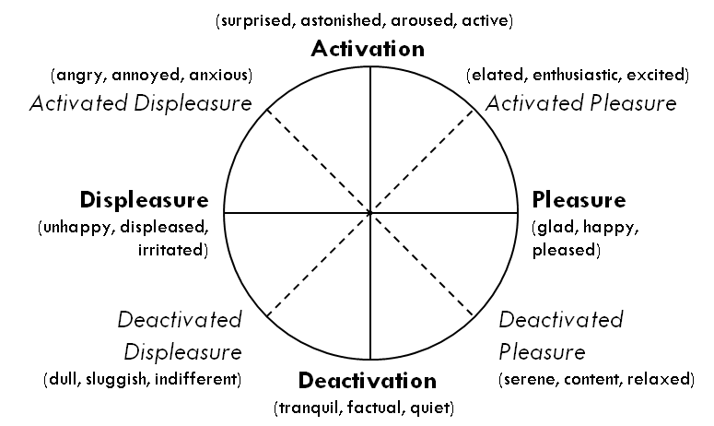
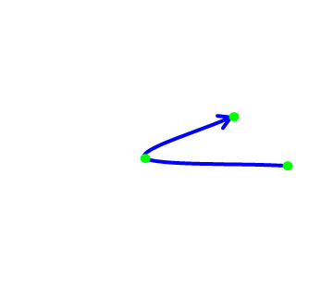
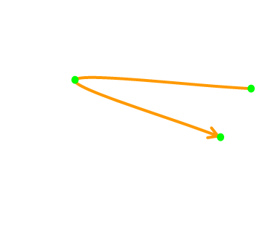
Results: Actor and Partner Effects of Affective Behaviors between Phases – Successful Negotiations
Table 4. APIMs (Actor-Partner Interdependence Models)
 | Valence (phase 3) |  | Activation (phase 3)
 | Model 1 | Model 2 | Model 3 | Model 4
Predictors (phase 2) | DSS | noDSS | DSS | noDSS
Intercept | -0.001 | -0.301 ** | -0.035 | -0.001
c_CI (actor) | -0.164 | -0.460 | -0.062 | -0.172
c_CI (partner) | -0.045 | -0.261 | -0.204 | -0.056
Valence (actor) | -0.378 ** | -0.004 | -0.038 | -0.046
Valence (partner) | -0.025 | -0.058 | -0.235 | -0.169
Activation (actor) | -0.026 | -0.070 | -0.293 | -0.313
Activation (partner) | -0.150 | -0.003 | -0.252 | -0.196
Pseudo R² | -0.188 | -0.135 | -0.146 | -0.118
 | AP/DD (phase 3) |  | AD/DP (phase 3)
 | Model 5 | Model 6 | Model 7 | Model 8
Predictors (phase 2) | DSS | noDSS | DSS | noDSS
Intercept | -0.024 | -0.213 | -0.025 | -0.212 *
c_CI (actor) | -0.159 | -0.448 | -0.075 | -0.205
c_CI (partner) | -0.178 | -0.225 | -0.110 | -0.143
AP/DD (actor) | -0.341 ** | -0.207 | -0.011 | -0.146
AP/DD (partner) | -0.160 | -0.160 | -0.329 | -0.214
AD/DP (actor) | -0.075 | -0.167 | -0.331 * | -0.097
AD/DP (partner) | -0.056 | -0.046 | -0.067 | -0.015
Pseudo R² | -0.316 | -0.142 | -0.108 | -0.107
Phase 2
Phase 3
Problem Solving
Resolution
Affect N1_{t-1}
Affect N1_{t}
Affect N2_{t-1}
Affect N2_{t}
Activation
AD
AP
Valence
*** p<.01; ** p<.05; * p<.10
DD
DP
Notes:
Only actor effects with DSS (no effects without DSS)
VA (p=0.031), AP/DD (p=0.021), AD/DP (p=0.093)
MEANS:
Negotiators who show more (less) pleasure in phase 2, show more (less) pleasure in phase 3
Negotiators who show more activated pleasure in phase 2, show more activated pleasure in phase 3
Negotiators who show more deactivated pleasure in phase 2, show more deactivated pleasure in phase 3
Explanation for differences between DSS and noDSS:
We know that a DSS can induces agreement oriented communication or increase the satisfaction with the negotiations process, which is argued to potentially increase (at least to some extent) emotional stability ->
And that is why observe these differences here, we have some more “stability” of affective behaviors over a prolonged period of time (phase 2 to phase 3)
ALSO the additional information of a DSS and its impact on cognitive resources (cognitive effort decreases) mean that a negotiator has more cognitive abilities available for example to pay more attention to his own affective behaviors, so affective awareness may increase
OR due to the additional information of the DSS a negotiator may be more satisfied with the progression of the negotiation, which results in some stability of affective behaviors

Slide 15
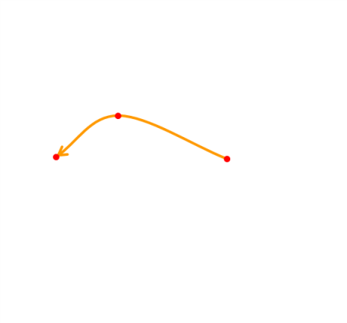
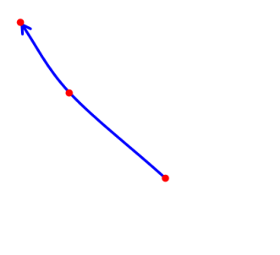
Results: Actor and Partner Effects of Affective Behaviors between Phases – Successful Negotiations
Table 5. APIMs (Actor-Partner Interdependence Models)
 | Valence (phase 3) |  | Activation (phase 3)
 | Model 9 | Model 10 | Model 11 | Model 12
Predictors (phase 2) | DSS | noDSS | DSS | noDSS
Intercept | -0.060 | -0.346 | -0.182 | -0.035
c_CI (actor) | -0.190 | -0.580 | -0.001 | -0.053
c_CI (partner) | -0.149 | -0.326 | -0.095 | -0.076
Valence (actor) | -0.480 * | -0.616 | -0.419 | -0.614 *
Valence (partner) | -0.032 | -0.120 | -0.639 ** | -0.040
Activation (actor) | -0.314 * | -0.266 | -0.010 | -0.013
Activation (partner) | -0.355 ** | -0.636 | -0.499 ** | -0.339
Pseudo R² | -0.362 | -0.284 | -0.373 | -0.213
 | AP/DD (phase 3) |  | AD/DP (phase 3)
 | Model 13 | Model 14 | Model 15 | Model 16
Predictors (phase 2) | DSS | noDSS | DSS | noDSS
Intercept | -0.089 | -0.211 | -0.170 | -0.279
c_CI (actor) | -0.132 | -0.429 | -0.137 | -0.391
c_CI (partner) | -0.172 | -0.163 | -0.041 | -0.302
AP/DD (actor) | -0.176 | -0.498 | -0.611 * | -0.155
AP/DD (partner) | -0.739 *** | -0.048 | -0.393 | -0.467
AD/DP (actor) | -0.124 | -0.734 * | -0.296 | -0.152
AD/DP (partner) | -0.107 | -0.218 | -0.271 | -0.534
Pseudo R² | -0.479 | -0.443 | -0.286 | -0.092
Phase 2
Phase 3
Problem Solving
Resolution
Affect N1_{t-1}
Affect N1_{t}
Affect N2_{t-1}
Affect N2_{t}
Activation
AD
AP
Valence
*** p<.01; ** p<.05; * p<.10
DD
DP
Notes:
AC (p=0.081) AP/DD (p=0.054)
MEANS:
- Negotiators who show more AD in phase 2, show more DD in phase 3
- Negotiators who show more displeasure in phase 2, show less activation in phase 3

Slide 16
Results: Actor and Partner Effects of Affective Behaviors between Phases – Successful Negotiations
Table 5. APIMs (Actor-Partner Interdependence Models)
 | Valence (phase 3) |  | Activation (phase 3)
 | Model 9 | Model 10 | Model 11 | Model 12
Predictors (phase 2) | DSS | noDSS | DSS | noDSS
Intercept | -0.060 | -0.346 | -0.182 | -0.035
c_CI (actor) | -0.190 | -0.580 | -0.001 | -0.053
c_CI (partner) | -0.149 | -0.326 | -0.095 | -0.076
Valence (actor) | -0.480 * | -0.616 | -0.419 | -0.614 *
Valence (partner) | -0.032 | -0.120 | -0.639 ** | -0.040
Activation (actor) | -0.314 * | -0.266 | -0.010 | -0.013
Activation (partner) | -0.355 ** | -0.636 | -0.499 ** | -0.339
Pseudo R² | -0.362 | -0.284 | -0.373 | -0.213
 | AP/DD (phase 3) |  | AD/DP (phase 3)
 | Model 13 | Model 14 | Model 15 | Model 16
Predictors (phase 2) | DSS | noDSS | DSS | noDSS
Intercept | -0.089 | -0.211 | -0.170 | -0.279
c_CI (actor) | -0.132 | -0.429 | -0.137 | -0.391
c_CI (partner) | -0.172 | -0.163 | -0.041 | -0.302
AP/DD (actor) | -0.176 | -0.498 | -0.611 * | -0.155
AP/DD (partner) | -0.739 *** | -0.048 | -0.393 | -0.467
AD/DP (actor) | -0.124 | -0.734 * | -0.296 | -0.152
AD/DP (partner) | -0.107 | -0.218 | -0.271 | -0.534
Pseudo R² | -0.479 | -0.443 | -0.286 | -0.092
Phase 2
Phase 3
Problem Solving
Resolution
Affect N1_{t-1}
Affect N1_{t}
Affect N2_{t-1}
Affect N2_{t}
Activation
AD
AP
Valence
*** p<.01; ** p<.05; * p<.10
DD
DP
Notes:
VA (p=0.086, 0.079, 0.049), AC (p=0.039, 0.016), AP/DD (p=0.003), AD/DP (p=0.064)
MEANS:
On VA
Negotiators who show more displeasure in phase 2, show more displeasure in phase 3
Negotiators who show less activation in phase 2, show more displeasure in phase 3
Negotiators who’s opponent shows less activation in phase 2, show more displeasure in phase 3
On AC
Negotiators who’s opponent shows more pleasure in phase 2, show more activation in phase 3
Negotiators who’s opponent shows less (more) activation in phase 2, show more less (more) in phase 3
On AP/DD
Negotiators who’s opponent shows more DD in phase 2, show more DD in phase 3
On AD/DP
Negotiators who show more DD in phase 2, show more AD in phase 3

Slide 17
Conclusio
Emotional dynamics differ with respect to whether a DSS is provided or not – even for a basic analytical DSS
  Activation is a central source of differences
    Successful negotiations
      DSS: towards activated pleasure (e.g. elated, excited)
      noDSS: towards deactivated pleasure (e.g. content, at ease)
    Failed negotiations
      DSS: towards activated displeasure (e.g. anxious)
      noDSS: towards displeasure (e.g. displeased, unhappy)
  Impact of decision support on intra-personal and inter-personal effects of emotional behaviors
The impact of DSSs (on affective behaviors)
  Information, feedback, or guidance functions (e.g. Bui, 1994; Singh & Ginzberg, 1996)
  Cognitive resources (e.g. Blascovich, 1990; Feldman, 1995; Jain & Solomon, 2000)
  EASI (emotion as social information) model (Van Kleef et al., 2010)
    Dynamics of affective behaviors: Driven by inferential processes and affective reactions
    Contingent on: Context (competitive or cooperative) and epistemic motivation
    Decision support can increase Epistemic ability

Slide 18
Implications
Importance of considering all behavioral aspects within and throughout the negotiations process
  Research on DSSs should focus more on the (emotional) behaviors of the people in interaction, since these are to be supported
    Inter-personal and intra-personal effects over time: Reciprocity, actor effects, partner effects
  Using more elaborate research frameworks and treating dyadic interaction data appropriately is important to “pry open the black box of the negotiation process” (Weingart & Olekalns, 2004: p.154)
Toward “Affective Negotiation Support Systems” (Broekens et al., 2010)
Notes:
Individuals facing acute time pressure, who are fatigued, or who are working under environmental noise experience increased need for closure, have lower epistemic motivation, and engage in more superficial and less deliberate information processing (De Dreu, 2003;
62 Gerben A. Van Kleef et al. De Grada et al., 1999; Van Kleef et al., 2004b).
Perceived competitiveness in and of itself may heighten epistemic motivation.
We propose that inferential processes take precedence over affective processes when the situation is perceived as predominantly competitive and/or recipients have high epistemic motivation and a concomitant tendency to engage in deliberate information processing. Conversely, we propose that affective reactions take precedence over inferential processes when the situation is perceived as predominantly cooperative and/or epistemic motivation is low.
Regardless of the nature of the situation, anger tends to elicit negative impressions, reciprocal feelings of anger, and a reduced desire to work together (e.g., Friedman et al., 2004; Kopelman et al., 2006; Van Beest et al., 2008; Van Kleef et al., 80 Gerben A. Van Kleef et al. 2004a,b). However, in competitive settings these affective reactions have few consequences for the social decisions people make, unless epistemic motivation is undermined (Van Dijk et al., 2008). Instead, decisions are fueled by the strategic inferences people draw regarding the other’s toughness, which tend to overrule tendencies to react negatively to a counterpart’s anger. Thus, even though individuals may experience a desire to retaliate to their counterpart’s anger, they often choose not to do so in order to secure an agreement (Van Kleef & Coˆ te´, 2007).
EASI: briefly explain competitive phases more inferential processes / last phase in successful negotiation cooperative = more (or an increase of ) affective reactions (automatic spread), in particular without a DSS since emotions are reciprocated in the entire right half (pleasure half) of the circumplex structure of affect; with a DSS, however not the case AND THAT seems to be related to epistemic motivation (tweaking of final solution) → so when talk about a DSS we should not only talk about epistemic motivation but also about epistemic ABILITY, since the DSS enables the negotiators to increase or make use of their epistemic motivation !!!
Then make a case for the following: taken the importance of the effects outlined in the EASI model (and the importance of using and interpreting emotions), and hence the importance of epistemic motivation, I argue that the DSS’s impact on a negotiator’s epistemic ability may be a major driver for affective expressions, but also behavior in general, the likelihood for negotiation success (and success here means not only agreement, but also process and outcome satisfaction!)
So these effects of DSSs seem to be important, and given that research on DSSs has somewhat stalled since the late 1990’s, I argue that more research effort in this area could be very beneficial, in particular with respect to the support of actual negotiation behavior, and even more so with support of affective expressions (just because we know that emotions are a very important component in and for communication)

Slide 19
Thank you for listening
Patrick Hippmann | patrick.hippmann@univie.ac.at
Notes:
EXPLAIN what a DSS is

Slide 20
BACKUP

Slide 21
Affective Behaviors – Some Examples
Activation
Message a43: “Hi Kevin,Thank you for […] I'm glad to tell you […] made it possible to have a very efficient negotiation. Thank you for this […] Best rgards.”
Message c59: “Husar,I am very disappointed […]. It feels like a message of distrust. […] I find a 50-50 split unacceptable. […] I will never go lower than […].”
Valence
(surprised, astonished, aroused, active)
Activation
(angry, annoyed, anxious)
Activated Displeasure
(elated, enthusiastic, excited)
Activated Pleasure
Displeasure
(unhappy, displeased, irritated)
Pleasure
(glad, happy, pleased)
Message a122: “Good Morning Mr Koller,Thank you for your understanding in the time limit problem! […] It glads me to see that we are getting closer and closer an agreement! […] I also want to give you some nice news. […] eager to get started as soon as possible :)!I wish you a good day!Yours sincerlyMrs. Husar”
Deactivated Displeasure
(dull, sluggish, indifferent)
Deactivated Pleasure
(serene, content, relaxed)
Deactivation
(tranquil, factual, quiet)
Message b72: “Unfortunetelly i showed you my minimum constraints and you tried to take advantage out of it. […] You tried to cheat me with wrong numbers […] and you really think i am willing to deal with that?Dear Mr. Koller! […] Take it, or reject.”
8

Slide 22
Results: Data
Online negotiation simulations using Negoisst (a negotiation support system)
  Electronic communication channel (+ a DSS)
Competitively framed negotiation case
  Joint venture negotiation: Austrian and Ukrainian aircraft manufacturers
  7 issues:
    Distribution of the future profits
    Executive control (members on the board of directors)
    Secrecy clause
    Contract duration
    Payment of workers
    Pay increase for Ukrainian workers
    Court of jurisdiction
57 dyadic negotiations (114 negotiators)
  Participants: Students at Universities in Austria and the Netherlands
10
Notes:
38 Successful n.: 21 with DSS / 17 without DSS
19 Failed n.: 11 with DSS / 8 without DSS

Slide 23
B - Emotions and individual differences
Emotions are unpredictable or uncontrollable (Sturdy, 2003)
Emotions may change quickly and frequently within any individual (Larsen & Fredrickson, 1999)
Emotions can be influenced by:
  Internal temporary causes and external causes
  Perceptions
  Physical condition (e.g. tiredness, health, immune responses, hormone changes, drugs, diurnal rhythms)
  History, recent life events, similar social interactions
  Personality traits (e.g. pessimism, hostility, irritability, motivational tendencies, emotional expressivity, self-monitoring, The Big Five personality factors, depression, anxiety)
  Emotional intelligence, emotion recognition
  Interaction process, context
Also evidence that
  personality traits do not impact joint gains, while emotions do (Anderson & Thompson, 2004; Barry & Friedman, 1998)
  personality traits do not correlate with expressions of emotions (Eisenkraft & Elfenbein, 2010)

Slide 24
B - Emotions in online negotiations
Text-based computer mediated communication (CMC) allows for the transmission/expression of emotions (Boudourides, 1995; Derks et al., 2008; Liu et al., 2001; Lupton et al., 2006; Walther 1994; 1995).
In CMC environments:
  Emotions provide context and guide judgments (Murphy et al., 2007), and influence message meaning and interpretation (Liu et al., 2001; Lupton et al., 2006)
  More positive emotions in successful e-negotiations (Hine et al., 2009)
  Emotional contagion/reciprocity (Barsade, 2002; Friedman et al., 2004; Nielek et al., 2010; Van Kleef et al., 2004)
  “Hyperpersonal communication” (Hancock & Dunham, 2001): (Kiesler & Sproull, 1992), more high risk and aggressive negotiation styles (Sokolova & Szpakowicz, 2006; 2007), spread of negative emotions (Kato & Akahori, 2005), escalation of conflict (Friedman et al., 2002; 2003),
Although research has started to address the effects of emotions in online negotiations, more work is needed to develop a more comprehensive understanding of these (Martinovski, 2010).

Slide 25
B - Paralanguage: How to communicate affect via text
More specifically emotions can be communicated via:
  Emotional language, words, terms (Brett et al., 2007; Hancock et al., 2007): e.g. angry, sad, happy, pleased
  “Informal codes” or “emotext” (Jaffe et al., 1999; Liu et al., 2001): e.g. intentional misspelling (sooo gooood), lexical surrogates, grammatical markers, strategic capitalization, and emoticons
  Alternations in word spacing (Murphy et al., 2007)
  “Prosody of text” (Hancock, 2004; Hancock et al., 2007): punctuation or exclamation marks (%$@*#)
  Acronyms: e.g. LOL, WTF, …
  Chronemics (timing, speed), duration, and frequency
  Language style (powerful vs. powerless): e.g. politeness, hedges, hesitations, deictic phrases, intensifiers (Adkins & Brushers, 1995)
Jointly these cues are referred to as “paralanguage of written communication” (Boudourides, 1995; Lea & Spears, 1992; Liu et al., 2001)
  “Informativeness of a message”: Linguistic, factual, contextual, emotional (Sokolova & Lapalme, 2010)
  “Message Layers”: Factual, self revelation, relational information, appeal (Watzlawick et al., 1967; Schulz von Thun, 1981), and emotions (Griessmair & Koeszegi, 2009)

Slide 26
B – General effects of support in negotiations
Support (in general) increases decision making efficiency and effectiveness (Singh & Ginzberg, 1996)
  Guidance, knowledge, facilitates understanding (Balzer et al., 1989)
  Helps avoid dysfunctional behavior (Todd & Benbasat, 1992)
  Helps avoid misjudgments and biases (Bazerman & Caroll, 1987) and deal with cognitive limitations (Bazerman & Neale, 1983; Fiske & Taylor, 1984), e.g. framing (Tversky & Kahnemann, 1981), fixed-pie assumptions (Pruitt, 1983), face saving (Bazerman, 1983), misinterpretations (Pinkley, 1988), overconfidence (Neale & Bazerman, 1983), or escalation of conflict (Lewicki & Litterer, 1985)
  Impacts intentions, behavior, and negotiation outcome (Bui, 1994)
  Helps cope with complexity (Foroughi, 1998)
  Reduces cognitive effort
Lim & Benbasat (1992): Negotiations support system (NSS) = Electronic communication channel + Decision support system (DSS)

Slide 27
B- Effects of DSSs
Empirical findings regarding the effects of decision support:
  Increase of joint outcomes and satisfaction, reduction of perceived negative climate (Foroughi et al., 1995; Perkins et al., 1996), positively impacts social aspects (Delaney et al., 1997)
  More integrative but no improvements in outcomes (Rangaswamy & Shell, 1997)
  Increase of communication effectiveness and perception of group process (Jain & Solomon, 2000)
  Problem of over-structuring (Schoop et al., 2003)
  Without graphical support a lower number of offers, but more words per dyad were transmitted (Weber et al., 2006)
  DSS users show more positive emotions (Kersten, 2004)
Besides technological solutions, negotiation support research should concentrate more on socio-emotional aspects (Bui, 1994; Lim & Benbasat, 1991; Pommeranz et al., 2009)
  Affect is an important issue to consider when developing negotiation support systems, since these impact negotiation effectiveness (Broekens et al., 2010; Hindriks & Jonker, 2008)
  Research should focus on how decision or negotiation support affects interactions between the negotiators (Kersten & Lai, 2007; Turel et al., 2007; Weigand et al., 2003)
The impact of DSSs on emotional behavior and specifically emotional dynamics lacks empirical attention

Slide 28
B – Affective Dimensions
The dimensions of valence and activation
In accordance with existing research:
  Affective Circumplex model of valence and arousal (Reisenzein, 1994; Remington et al., 2000; Russell, 1978, 1979, 1980; Russell & Feldman Barrett, 1999)
  PA/NA model of positive and negative activation (Feldman Barrett & Russell, 1998; Tellegen et al., 1999; Watson et al., 1988; Watson et al., 1999; Watson and Tellegen, 1985)
  across cultures (Russell, 1983, 1991; Russell et al., 1989; Watson et al., 1984)
  across different age groups (Russell & Bullock, 1985; Russell & Ridgeway, 1983)
  across messages differing in comprehensiveness and content (Bush, 1973; Feldman, 1995, Russell, 1980)
  for perceptions of facially expressed emotions (Abelson & Sermat, 1962; Russell et al., 1989)
  for self-report data (Feldman, 1995; Russell 1978)
  in online negotiations (Griessmair & Koeszegi, 2009)

Slide 29
B – Multidimensional scaling (MDS) I
“Emotion detection from text […] can be best tackled using approaches based on commonsense knowledge” (Balahur et al., 2012)
Advantages of MDS
  Relies on fundamental aspects of human perception (Shepard, 1987; Tversky, 1977)
  Attribute-free (Hair et al., 2006), inductive, and open approach (Lawless et al., 1997; Robinson and Bennett 1995)
  Does not require metric data (Pinkley et al., 2005)
MDS is successfully used for the analysis and classification of emotions (Bigand et al., 2005; Feldman Barrett, 2004; Hamann and Adolphs 1999; Russell 1980; Russell and Bullock, 1985; Watson and Tellegen, 1985)
3-step method (Borg & Groenen, 2005; Borg et al., 2010; Hair et al., 2006)
  (1) Input data based on similarity judgments of items (i.e. negotiation messages) performed by uninvolved/unbiased raters (Bijmolt et al., 1995; Robinson and Bennett, 1995)
  (2) Data analysis using SMACOF (De Leeuw & Mair, 2008) and PERMAP (Heady & Lucas, 2010)
  (3) Identification and interpretation of dimensions (axes) of the dimensional space

Slide 30
B – Multidimensional scaling (MDS) II
(Step 1) Input data based on similarity judgments
  Similarity judgments performed by uninvolved raters
    Undergraduate students at the University of Vienna
  Three data sub-groups (each 1/3 of all negotiations)
  All negotiation messages of each sub-group handed out to 30 raters
  Rating of whole negotiation messages according to emotional similarity (free sorting)
    In many cases emotions are not directly expressed using words with affective meaning (Balahur et al., 2012)
    Emotions can be communicated in lower-bandwidth environments (Lee, 1994; Murphy et al., 2007; Walther, 1994; 1995; Zack & McKenny, 1995)
      Variations in language are related to variations of emotions (Cheshin et al., 2011; Hancock et al., 2007; 2008; Walther et al., 2005)

Slide 31
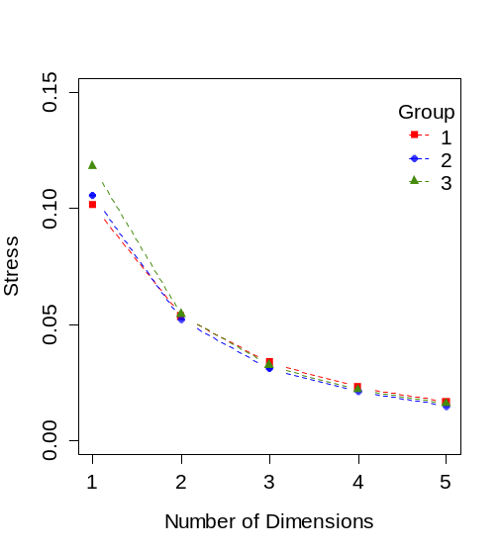
B – Multidimensional scaling (MDS) III
(Step 2) Data analysis using SMACOF/PERMAP
  Based on similarity matrix constructed from similarity judgments
(Step 3) Identification and interpretation of dimensions
  For each data sub-group (consistent)
  Comparisons of extreme values in the multidimensional space at the two main, and the two 45° rotated, axes
  Characterizations of the decks of emotional similarity, provided by raters
  Evaluations of “emotional strength”, provided by raters for each deck
  Compatibility with existing literature (Duncan et al., 2007; Feldman Barrett, 2004; Gill et al., 2008; Kring et al., 2003; Larsen et al., 1992; Reisenzein, 1994; Russell, 1979; Russell, 1980; Russell, et al., 1980; Russell, et al., 1999; Seo et al., 2008; Watson & Tellegen, 1985)

Slide 32

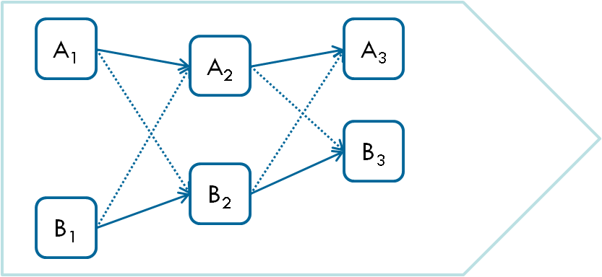
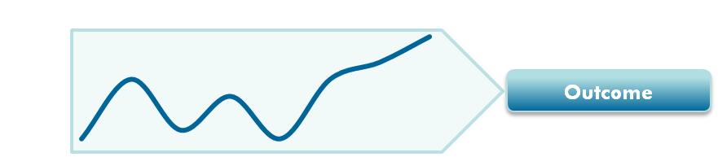
B – Inter-personal and intra-personal effects I
Until very recently research on emotions in negotiations largely focused on intra-personal effects (Liu, 2009)
  Appraisals: evaluation of the environment induces emotions (e.g. Lazarus, 1991; Weiner, 1995)
  Action tendencies: emotions induce actions (e.g. Burleson & Planalp, 2000; Oleklans & Smith, 2003)
Recently research on emotions in negotiations started paying more attention to inter-personal effects (Van Kleef et al., 2006)
  Social functions perspective: emotions communicate information (Keltner & Haidt, 1999), send feedback signals (Putnam, 1994), and thereby influence an opponent’s behavior (Van Kleef et al., 2004)
  Interpersonal behavior may be reciprocal or complementary (Adair & Brett, 2005; Butt et al., 2005; Friedman et al., 2004; Hatfield et al., 1993); “Emotional linkage” (Ilies et al., 2007)
    Initial evidence suggests that emotional transmission and reciprocity largely contributes to social dynamics (Van Kleef et al., 2004)
Importantly, emotional dynamics arise due to intra-personal as well as inter-personal influences (Barry, 2007; Côté, 2005; Morris & Keltner, 2000; Overbeck et al., 2010)
  Emotions are social characteristics of negotiations (Kelly & Barsade, 2001; Parkinson, 1996)

Slide 33
B – Inter-personal and intra-personal effects II
  Most negotiation research, however, still disregards either one of these effects (Overbeck et al., 2010; Turel, 2008)
  Ignoring central aspects of social interactions (Kenny & Cook, 1999; Raudenbush et al., 1995)
  Treats interdependent factors (negotiators, behavior) as independent from each other (Bonito, 2002; Butt et al., 2005; Liu, 2009; Maitlis & Ozcelik, 2004)
    = pseudounilaterality (Duncan et al., 1984), nowadays commonly referred to as assumption of independence (Kenny, 1995; Kenny & Judd, 1986)
Sparse recognition of intra- and inter-personal effects in negotiation research (Ferrin et al., 2008; Liu & Wilson, 2010)
With respect to the effects of emotional dynamics in negotiations, empirical evidence is even more limited
  Butt et al. (2005): Effects of self emotion, counterpart emotion, and counterpart behavior on negotiation behavior and outcome
  Liu (2009): Anger influences negotiation behavior
  Overbeck et al. (2010): Anger and happiness effects negotiation behavior
The impact of emotional dynamics on the negotiation process as well as on the outcome lacks attention, especially in online environments
 | Emotion ➜ Emotion
 | Online negotiations
 | Dynamic

Slide 34
B – Butt et al. (2005)
Butt et al., (2005): The effects of self-emotion, counterpart emotion, and counterpart behavior on negotiator behavior: A comparison of individual-level and dyad level dynamics
  Found that:
    Specific behaviors are predicted by distinct sets of emotion, counterpart emotion, and counterpart behavior
      E.g. counterpart pride-achievement emotions were positively related to compromising behavior at the negotiator and dyad level
      E.g. a negotiator’s anger (but not counterpart anger) increased his dominating behavior
    Negotiators tend to reciprocate behavior; integrating behavior was more dependent on interpersonal dynamics (rather than compromising or dominating behavior)
  Variables measures via self-report on Likert-scales

Slide 35
B – Liu (2009)
Liu (2009): The Intrapersonal and Interpersonal Effects of Anger on Negotiation Strategies: A Cross-Cultural Investigation
  Found that:
    Anger caused negotiators to use more positional statements and propose fewer integrative offers
    Anger caused the counterparts to use fewer positional statements but also exchange less information about priorities
  Variables measures via self-report on Likert-scales

Slide 36
B – Overbeck et al. (2010)
Overbeck et al., (2010): I feel, therefore you act: Intrapersonal and interpersonal effects of emotion on negotiation as a function of social power
  Found that:
    A negotiator’s anger induces him to be more assertiveness and claim more value
    A counterpart’s anger leads his opponent to lose focus and yield value (if the counterpart is more powerful)
  Variables measures via self-report on Likert-scales

Slide 37
B – Negotiation process: The three phases I
Initiation
Problem Solving
Resolution
Competitive, distributive^{2,13,19,20,25}
Spirited posturing²
General debate on issues⁸
Initial positions²³
Influence communication⁷
Relationship building, establish climate^{1,3,14,15,24}
Persuasion, search for information^{2,3}
Strategic use/interpretation of emotions²⁶
Limited negative emotions, signaling liking and interest^{3,17}
More positive emotions
“Spirited conflict” ^{1,2,23}
Competitive, cooperative^{2,20,27}
Facts, detailed discussion, priority information^{1,2,4}
Problem solving^{12,21}
Offers, rational influence^{1,2}
Trust, rapport building^{1,5,9,15}
Start of search for agreement^{1,10}
Offers and counter-offers, bartering^{2,10,16}
Balance of value creation/claiming (pos. and neg. emotions)^{3,11,17,18}
Confrontational (emotions)¹⁷
Importance of Fairness, non-verbal cues, being in-sync^{3,17}
More negative emotions
Integrative settlement phase¹⁹
Final offer sequence¹
Rejection of offers rather than persuasion²
More intense communication²
Reduction of alternatives, move towards final agreement^{6,10,16,22,23}
Concessions on minor issues²²
Distributive and integrative information are replaced by distributive and integrative action¹³
Looming deadlines, more offers and concessions¹⁸
Importance of outcome satisfaction³
¹Adair & Brett, 2004; ²Adair & Brett, 2005; ³Broekens et al., 2010; ⁴Davis, 1982; ⁵Drolet & Morris, 1999; ⁶Druckman, 1986; ⁷Glenn et al. 1977; ⁸Gulliver, 1979; ⁹Harrigan & Rosenthal, 1986; ¹⁰Holmes, 1992; ¹¹Lax & Sebenius, 1986; ¹²Lewicki et al, 1996; ¹³Lytle et al. 1999; ¹⁴McGinn & Keros, 2002; ¹⁵Moore et al. 1999; ¹⁶Morley & Stepbenson, 1977; ¹⁷Morris & Keltner, 2000; ¹⁸Olekalns et al., 1996; ¹⁹Olekalns et al., 2003; ²⁰Olekalns & Smith 2000; ²¹Pruitt & Rubin, 1986; ²²Putnam, 1990; ²³Putnam & Jones, 1982; ²⁴Rubin & Brown, 1975; ²⁵Simons, 1993; ²⁶Van Kleef et al., 2010; ²⁷Wilson & Putnam, 1990

Slide 38
B – Negotiation process: The three phases II
Phase modeling
Assumptions (Holmes & Poole, 1991; Koeszegi et al., 2008)
  Social behavior can be meaningfully described in larger units (phases)
  These phases pertain to larger social events
  Process dynamics shape these
Holmes (1992)
  What constitutes a phase and how can we identify it?
  What generates changes between phases and how can we identify these transitions?
Data driven identification of negotiations phases (Koeszegi et al., 2011)
  Length of phases can vary
  Based on endogenous dynamics (Contract imbalance)
Compatibility with existing literature (e.g. Adair & Brett, 2005; Broekens et al., 2010; Holmes, 1992; Morris & Keltner, 2000; Weingart & Olekalns, 2004)

Slide 39
B – Negotiation process: The three phases III
Data driven identification of negotiations phases (Koeszegi et al., 2011)
  Split each individual negotiation into the same number of negotiation phases
  Length (i.e. in terms of messages) of each phase may vary
    Also from negotiation to negotiation
  No arbitrary decision but “customized”, but negotiation cases still remain comparable
  We identify phases and their split points by maximizing the dissimilarity between phases with respect to the contract imbalance (CI)

Slide 40
B – Testing for indistinguishability I
Table 4x: Descriptive Statistics per negotiator
Dimensions: Valence (V) and Activation (A) |  |  |  | Dimensions: AP/DD and AD/DP
 | N | Mean | Std. Dev. |  | N | Mean | Std. Dev.
Phase 1 |  |  |  | Phase 1
V (n1) | 57 | 0.1316 | 0.1827 | AP/DD (n1) | 57 | 0.0454 | 0.2019
V (n2) | 57 | 0.0871 | 0.2450 | AP/DD (n2) | 57 | 0.0797 | 0.2161
A (n1) | 57 | -0.0651 | 0.1596 | AD/DP (n1) | 57 | -0.1391 | 0.1350
A (n2) | 57 | 0.0263 | 0.1692 | AD/DP (n2) | 57 | -0.0436 | 0.2048
Phase 2 |  |  |  | Phase 2
V (n1) | 57 | -0.0387 | 0.2085 | AP/DD (n1) | 57 | -0.0094 | 0.1681
V (n2) | 57 | -0.1251 | 0.2243 | AP/DD (n2) | 57 | -0.0803 | 0.1760
A (n1) | 57 | 0.0248 | 0.1793 | AD/DP (n1) | 57 | 0.0448 | 0.2177
A (n2) | 57 | 0.0103 | 0.2029 | AD/DP (n2) | 57 | 0.0964 | 0.2460
Phase 3 |  |  |  | Phase 3
V (n1) | 57 | -0.0303 | 0.2621 | AP/DD (n1) | 57 | -0.0089 | 0.2101
V (n2) | 57 | 0.0009 | 0.3020 | AP/DD (n2) | 57 | 0.0202 | 0.2594
A (n1) | 57 | 0.0172 | 0.2105 | AD/DP (n1) | 57 | 0.0335 | 0.2624
A (n2) | 57 | 0.0269 | 0.2595 | AD/DP (n2) | 57 | 0.0181 | 0.3022
Notes:
A first descriptive indicator of whether negotiators within dyads could be treated as distinguishable or indistinguishable is the examination of the mean values and standard deviations (with respect to the variables that are further analyzed) of the groups that are formed by the potentially distinguishing factor {Kenny 2006 #488}. These are shown in table 4, for each of the three identified negotiation phases, for the primary affective dimensions of valence (V) and activation (A) as well as for the secondary 45° rotated dimensions of PA and NA.
As found in table 4, the similarities of mean values and standard deviations for the two groups of negotiators indicate that the negotiators should be treated as indistinguishable.

Slide 41
B – Testing for indistinguishability II
Tests of equality of variances between groups (n1 and n2)
  Need to be adapted for nonindependent data (Kenny et al., 2006)
    Correlate: sum of negotiators’ scores (X_{n1} + X_{n2}) and differences of their scores (X_{n1} – X_{n2})
Table 5x: Tests for differences in variances
Dimensions: Valence (V) and Activation (A) |  |  |  | Dimensions: PA and NA
 | N | Corr. Coef. | Sig. |  | N | Corr. Coef. | Sig.
Phase 1 |  |  |  | Phase 1
Corr. (V) | 57 | .294 | .026 | Corr. (AP/DD) | 57 | .068 | .616
Corr. (A) | 57 | .058 | .666 | Corr. (AD/DP) | 57 | .402 | .002
Phase 2 |  |  |  | Phase 2
Corr. (V) | 57 | .076 | .573 | Corr. (AP/DD) | 57 | .047 | .729
Corr. (A) | 57 | .126 | .351 | Corr. (AD/DP) | 57 | .127 | .347
Phase 3 |  |  |  | Phase 3
Corr. (V) | 57 | .157 | .242 | Corr. (AP/DD) | 57 | .232 | .082
Corr. (A) | 57 | .216 | .107 | Corr. (AD/DP) | 57 | .149 | .270
Notes:
Comparing the variances on the scores for negotiator 1 and negotiator 2 (to see whether there is more or less variance in their scores), is an indicator for indistinguishability. If variances do not differ significantly -> indistinguishable
Normally we would compute a ratio of the two variances; under the null hypothesis of equal variances the quantity has an F-distribution with n-1 df.
Although this test is useful for unrelated individuals, it can rarely be used for dyadic data from a reciprocal design because both members of the dyad are measured and scores are nonindependent. When a reciprocal standard dyad design is used, the test of equal variance needs to be modified as follows: … slide …
Although it is not obvious, the test of whether this correlation coefficient equals zero evaluates a difference in the variances for X1 and X2. (See
Kenny, 1979, p. 21, for a proof.)
Further, we test for equality of variances between the groups formed by the potentially distinguishing factor {Kenny 2006 #488}. The tests for the equality of variances need to be adapted for the analysis of a dyadic reciprocal design, since the negotiators (and thus their scores on the variables) are nonindependent {Kenny 2006 #488}. Note that the issue of nonindependence is further elaborated in the next chapter D.6. As outlined by {Kenny 2006 #488 /footcit} we thus correlate the sum of the negotiators’ scores (i.e. X_{n1}+X_{n2}) and the difference of their scores (i.e. X_{n1}-X_{n2}), in order to test for a difference in variances. The respective tests for statistical significance are shown in table 5, again for each of the three identified negotiation phases, for the primary affective dimensions of valence (V) and activation (A) as well as for the secondary 45° rotated dimensions of PA and NA.
These results generally indicate that the variances for the variables to be analyzed (i.e. the affective dimensions) do not differ significantly for the negotiators. Overall, the findings for the means, standard deviations, and variances for the two negotiators lead us to conclude that the negotiators should be treated as indistinguishable, which consequently is the basis for the further analyses. In addition, we will also provide tests of distinguishability when introducing the results in part E, which will provide further justification for treating dyad members, i.e. negotiators, as indistinguishable.
ALSO we use a test of indistinguishability when estimating the APIMs:
the Χ² test of distinguishability tests whether the difference between the deviances of an APIM with dyad members treated as indistinguishable and an APIM with dyad members treated as distinguishable, is statistically significant

Slide 42
B – Intraclass correlation coefficient ICC I
Why ICC?
If the assignment of persons to X and Y is arbitrary
  the two individuals are interchangeable
Sometimes researchers adapt a strategy with such dyads of assigning members to X or Y randomly and then computing a Pearson correlation between the X and Y scores.
The problem with this strategy is that other assignments would likely yield different estimates.
It can be that supposedly distinguishable dyad members are in fact indistinguishable!
  The decision of whether or not the dyad members are distinguishable is both empirical and theoretical. (“meaningful variable”)
To assess indistinguishability:
  Do scores of the variable differ in their means, variances, or correlation
  Test of indistinguishability

Slide 43
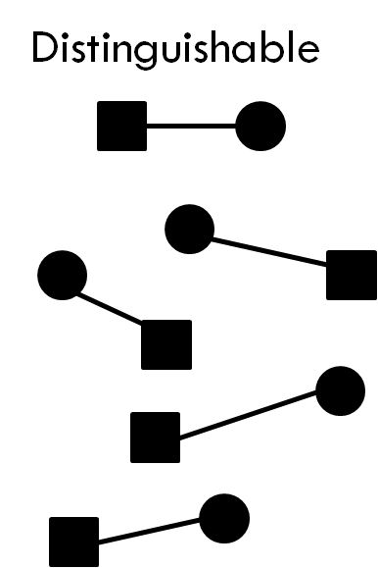
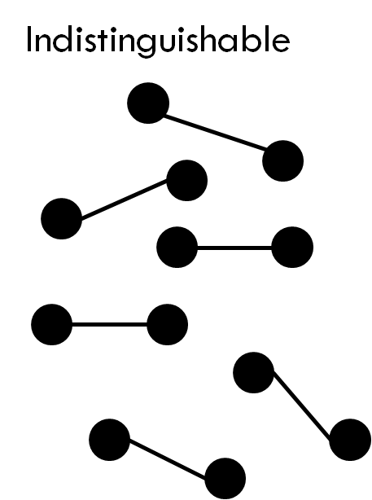
B – Intraclass correlation coefficient ICC II
Indistinguishability
Indistinguishability means we can not distinguish dyad members on a meaningful factor and not sort their scores in a systematic and meaningful way
  E.g. gay couples, negotiator A and B (≠ heterosexual couples, mother and child)
Why care?
  If dyad members are not distinguishable on a meaningful factor, there is no systematic or meaningful way to order scores
  Critical, as data-analytic techniques for distinguishable dyad members are not appropriate for indistinguishable dyad members
If dyad members are interchangeable (i.e. indistinguishable), it is not clear whose score should be treated as X variable and whose score should be treated as Y variable
 | Dyad A1 |  |  | Dyad B1 |  |  | Means Dyads A |  | Corr. Dyads A
Measure | Neg. 1 | Neg. 2 |  | Neg. 1 | Neg. 2 |  | Neg. 1 | Neg. 2 | 0,2875
1 | 10 | 5 |  | 10 | 5 |  | 6,5 | 6
2 | 6 | 11 |  | 6 | 11 |  | 7 | 7,5
3 | 3 | 7 |  | 3 | 7 |  | 2,5 | 6,5
 | Dyad A2 |  |  | Dyad B2 |  |  | Means Dyads B |  | Corr. Dyads B
 | Neg. 1 | Neg. 2 |  | Neg. 1 | Neg. 2 |  | Neg. 1 | Neg. 2 | -0,4714
1 | 3 | 7 |  | 7 | 3 |  | 8,5 | 4
2 | 8 | 4 |  | 4 | 8 |  | 5 | 9,5
3 | 2 | 6 |  | 6 | 2 |  | 4,5 | 4,5

Slide 44
B – Intraclass correlation coefficient ICC III
The ICC
A measure of non-independence
  Correlation of scores between dyad members
  Ignoring means: Biased standard errors, Loss of information
Estimate of the relationship between scores from indistinguishable members of dyads
Interpreted as the correlation between the scores from two individuals who are in the same group
  A common alternative interpretation of the intraclass correlation is the proportion of variation in the outcome measure that is accounted for by dyad or group
There is relatively little loss in power when data are treated as nonindependent when in fact they are independent (Kenny et al., 1998)

Slide 45
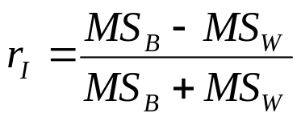
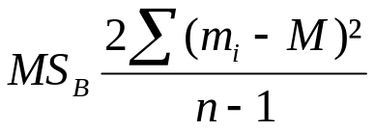
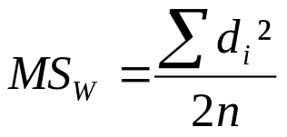

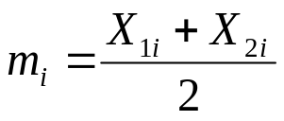
B – Intraclass correlation coefficient ICC IV
MS_{B} = 0 when all the dyad means are equal
MS_{W} = 0 when the two members of each dyad both have the same score
r_{I} = 0 when MSB = MSW
Computed using MLM
Can also be computed using ANOVA
  Independent variable = dyad (which has n levels)
  MS_{B} = variance in dyad means / 2
  MS_{W} = variance in the two scores in the dyad /2
MS_{B} = mean square between dyads
MS_{W} = mean square within dyads
Difference between the dyad members’ scores
Average of the dyad members’ scores
M … Average of all 2n scores / n … number of dyads

Slide 46
B – Actor-partner interdependence model (APIM) I
APIM estimates can be calculated via pooled-regression, MLM, SEM
Illustration via pooled-regression (Kashy & Kenny, 2000)
  Estimating two regression equation and pooling results
    Within-dyads regression: within-dyads effects of mixed independent variable
      Predicting (Y₁ – Y₂) with (X₁ – X₂) -> differences
      Intercept is not estimated because the direction of differencing is arbitrary
      Equation: Y_{1i} – Y_{2i} = b_{w}(X_{1i} – X_{2i}) + E_{wi}
    Between-dyads regression: between-dyads effects of mixed independent variable
      Predicting [(Y₁ + Y₂)/2] with [(X₁ + X₂)/2] -> dyad means
      Equation: (Y_{1i} + Y_{2i})/2 = b₀ + b_{b}(X_{1i} + X_{2i})/2 + E_{bi}
    Actor effect = (b_{b} + b_{w})/2
    Partner effect = (b_{b} – b_{w})/2
    For significance testing pooled standard errors are calculated
    The df can be fractional (Satterthwaite, 1946)

Slide 47
B – Actor-partner interdependence model (APIM) II
APIM estimation via MLM
Levels of analysis: Level 1 (negotiator), level 2 (dyad)
MLM for dyadic data is a special case:
  The slopes (the effect of X on Y for each dyad) must be constrained to be equal across all dyads -> a fixed effect
    Reason: Dyads do not have enough level 1 units to allow the slopes to vary from dyad to dyad (there must be more level 1 units within each level 2 unit than there are random variables)
    Thus we can allow for only one random variable: the intercept
  Intercepts can vary -> modeling of nonindependence
  Unable to estimate a model with different slopes for each dyad
  This does not bias the estimates, but confounds the variance of the slopes with error variance
  The (exemplary) SPSS syntax:
    MIXED
    affect_a_ph2 WITH affect_a_ph1 affect_p_ph1
    /FIXED = affect_a_ph1 affect_p_ph1
    /PRINT = SOLUTION TESTCOV
    /REPEATED = partnum | SUBJECT(dyadID) COVTYPE(CS).
Notes:
Random effects are specified as correlation (more technically a covariance) not as variance (so they can be negative) -> done by using the Repeated statement rather than the Random statement in SAS or SPSS
We use CS: compound symmetry -> forces the degree of unexplained variance of the dyad members to be equal / constrains the residual variances to be equal across the dyad members and specifies that there is a covariance between the residuals as well
The equal variance constraint is particularly important because the model specifies that the residuals are sampled from the same underlying population
Only a single actor and partner effect are estimated, as the estimates are pooled within dyads as well as between dyads
One might assume that being unable to estimate a model with different slopes for each dyad biases the estimates of the multilevel model for dyads. It does not. Rather, what it does is confound the variance of the slopes with error variance. Tests of the null hypothesis are not biased by
having differential slopes.
The REPEATED statement treats the nonindependence as correlation / if we would use the RANDOM statement we would treat the nonindependence as variance, which woulod mean it cannot handle negative nonindependence

Slide 48
B – Actor-partner interdependence model (APIM) III
Pseudo-R² (Snijders & Bosker, 1999)
  True R² values cannot be obtained for multilevel models
  Pseudo-R² = 1- (dyad covariance s_{dd} + error variance s_{e}²) / (dyad covariance s_{dd}’ + error variance s_{e}²’)
    s_{dd}’ and s_{e}²’ refer to the dyad covariance and the error variance of the unrestricted model without predictors

Slide 49
B – Actor-partner interdependence model (APIM) IV
Some might think it would be more appropriate to compare standardized instead of unstandardized coefficients.
Almost everyone who has studied this problem (e.g., Tukey, 1954) has recommended that the appropriate null hypothesis to be evaluated is that the two regression coefficients are equal. If we want to determine whether X has a stronger effect on Y for husbands than for wives, we want to know that if we increase a husband’s X score by 1 unit, do we get a bigger increase in Y than when we increase a wife’s X score by 1 unit?
This is what the difference in unstandardized regression coefficients evaluates. If we standardize within the two groups, then we have lost metric equivalence, and we are no longer comparing the same thing.
(Kenny & Ledermann, 2010)

Slide 50
B – False discovery rate (FDR)
Controls for the expected proportion of falsely rejected hypotheses (Benjamini & Hochberg, 1995)
  Compromise between the unadjusted analysis of the multiple tests, and the traditionally adjusted approaches (e.g. Bonferroni)
  Traditional approaches focus on limiting the chance of making a type I error, which can result in more type II errors (Verhoeven et al., 2005)
Notes:
For: families of comparisons under simultaneous consideration
Type I error
A type I error occurs when one rejects the null hypothesis when it is true. The probability of a type I error is the level of significance of the test of hypothesis, and is denoted by *alpha*.
Protection against false rejections of the null hypothesis, or type I errors, is usually achieved via a Bonferroni-type correction procedure (Holm 1979).
Type II error
A type II error occurs when one rejects the alternative hypothesis (fails to reject the null hypothesis) when the alternative hypothesis is true. The probability of a type II error is denoted by *beta*.

Slide 51
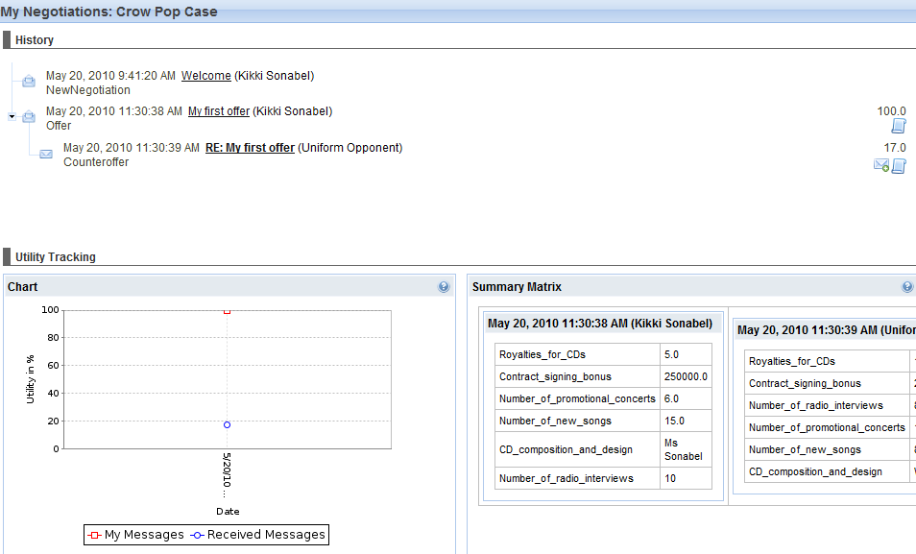
B – Negoisst: The support system I
Message history
Utility of each message
Utility Tracking

Slide 52
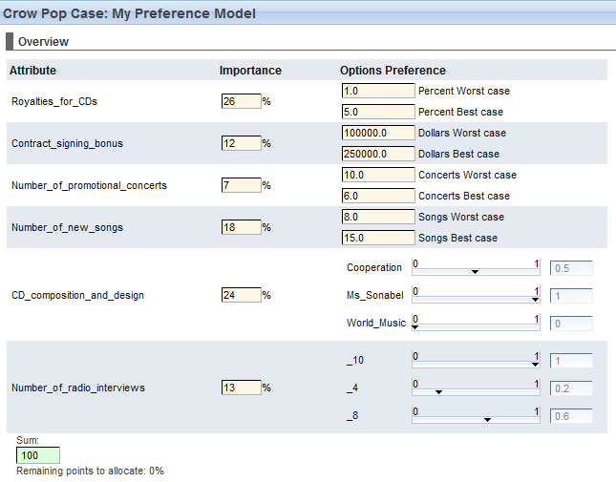
B – Negoisst: The support system II
relative importance
(weighting)

Slide 53
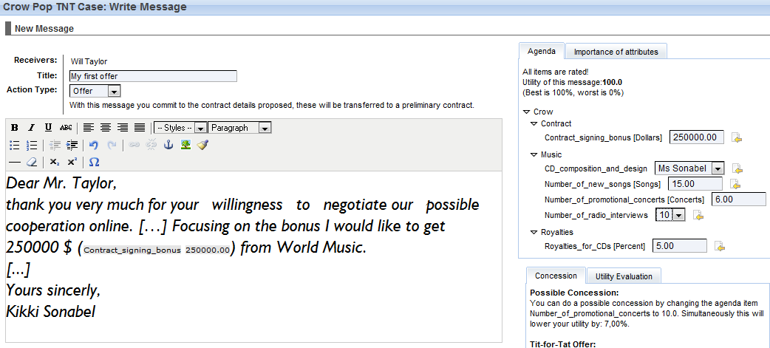
B – Negoisst: The support system III

Slide 54
Results: Actor and Partner Effects of Affective Expressions between Phases – Successful Negotiations
Table 4. APIMs (Actor-Partner Interdependence Models)
 | Valence (phase 2) |  | Activation (phase 2)
 | Model 1 | Model 2 | Model 3 | Model 4
Predictors (phase 1) | DSS | noDSS | DSS | noDSS
Intercept | -0.180 ** | -0.292 * | -0.014 | -0.203 *
c_CI (actor) | -0.038 | -0.020 | -0.096 | -0.028
c_CI (partner) | -0.290 ** | -0.282 | -0.152 | -0.163
Valence (actor) | -0.185 | -0.143 | -0.086 | -0.104
Valence (partner) | -0.039 | -0.156 | -0.030 | -0.299 **
Activation (actor) | -0.120 | -0.423 | -0.215 | -0.192
Activation (partner) | -0.100 | -0.334 | -0.265 | -0.011
Pseudo R² | -0.183 | -0.133 | -0.155 | -0.180
 | AP/DD (phase 2) |  | AD/DP (phase 2)
 | Model 5 | Model 6 | Model 7 | Model 8
Predictors (phase 1) | DSS | noDSS | DSS | noDSS
Intercept | -0.135 ** | -0.063 | -0.119 | -0.350 **
c_CI (actor) | -0.043 | -0.033 | -0.095 | -0.006
c_CI (partner) | -0.093 | -0.086 | -0.314 ** | -0.314 *
AP/DD (actor) | -0.038 | -0.105 | -0.097 | -0.186
AP/DD (partner) | -0.083 | -0.093 | -0.218 | -0.387 *
AD/DP (actor) | -0.302 ** | -0.142 | -0.007 | -0.436 *
AD/DP (partner) | -0.088 | -0.237 | -0.144 | -0.072
Pseudo R² | -0.220 | -0.043 | -0.146 | -0.228
Phase 1
Phase 2
Initiation
Problem Solving
Affect N1_{t-1}
Affect N1_{t}
Affect N2_{t-1}
Affect N2_{t}
Activation
AD
AP
Valence
DD
DP
Notes:
Now what do we find here. We see that a negotiator’s expressions of valence in phase 2 are not influenced by his or her own, or by his or her partner’s affective expressions in phase 1. (show what that means in graph at bottom)
What we, however, find is a significant and positive partner effect of CI for negotiations with a DSS, which means that the CI for offers that are made by the negotiation partner impact my own expressions of valence, positively. Again note that CI is a measure for offer fairness. So, the lower the CI or the more fair the offers made by the partner are, the more displeasure I express in phase 2.
[maybe don’t mention that since it is just a control, or maybe do when there is time:
So with a DSS it is more easy for me to figure out whether an offer is nice/fair, and I observe that my partner is a nice guy by making nice offers, this influences my decision positively to express more displeasure in the next phase, because I expect him then to be nice again and give me even more]

Slide 55
Results: Actor and Partner Effects of Affective Expressions between Phases – Successful Negotiations
Table 5. APIMs (Actor-Partner Interdependence Models)
 | Valence (phase 3) |  | Activation (phase 3)
 | Model 9 | Model 10 | Model 11 | Model 12
Predictors (phase 2) | DSS | noDSS | DSS | noDSS
Intercept | -0.001 | -0.301 ** | -0.035 | -0.001
c_CI (actor) | -0.164 | -0.460 | -0.062 | -0.172
c_CI (partner) | -0.045 | -0.261 | -0.204 | -0.056
Valence (actor) | -0.378 ** | -0.004 | -0.038 | -0.046
Valence (partner) | -0.025 | -0.058 | -0.235 | -0.169
Activation (actor) | -0.026 | -0.070 | -0.293 | -0.313
Activation (partner) | -0.150 | -0.003 | -0.252 | -0.196
Pseudo R² | -0.188 | -0.135 | -0.146 | -0.118
 | AP/DD (phase 3) |  | AD/DP (phase 3)
 | Model 13 | Model 14 | Model 15 | Model 16
Predictors (phase 2) | DSS | noDSS | DSS | noDSS
Intercept | -0.024 | -0.213 | -0.025 | -0.212 *
c_CI (actor) | -0.159 | -0.448 | -0.075 | -0.205
c_CI (partner) | -0.178 | -0.225 | -0.110 | -0.143
AP/DD (actor) | -0.341 ** | -0.207 | -0.011 | -0.146
AP/DD (partner) | -0.160 | -0.160 | -0.329 | -0.214
AD/DP (actor) | -0.075 | -0.167 | -0.331 * | -0.097
AD/DP (partner) | -0.056 | -0.046 | -0.067 | -0.015
Pseudo R² | -0.316 | -0.142 | -0.108 | -0.107
Phase 2
Phase 3
Problem Solving
Resolution
Affect N1_{t-1}
Affect N1_{t}
Affect N2_{t-1}
Affect N2_{t}
Activation
AD
AP
Valence
DD
DP

Slide 56
Results: Actor and Partner Effects of Affective Expressions between Phases – Successful Negotiations
Table 6. APIMs (Actor-Partner Interdependence Models)
 | Valence (phase 2) |  | Activation (phase 2)
 | Model 17 | Model 18 | Model 19 | Model 20
Predictors (phase 1) | DSS | noDSS | DSS | noDSS
Intercept | -0.188 ** | -0.039 | -0.241 * | -0.016
c_CI (actor) | -0.213 | -0.016 | -0.210 | -0.023
c_CI (partner) | -0.186 | -0.119 | -0.018 | -0.070
Valence (actor) | -0.285 * | -0.288 | -0.051 | -0.139
Valence (partner) | -0.053 | -0.240 | -0.305 | -0.168
Activation (actor) | -0.545 *** | -0.628 | -0.656 ** | -0.562
Activation (partner) | -0.089 | -0.264 | -0.485 | -0.576
Pseudo R² | -0.407 | -0.216 | -0.246 | -0.371
 | AP/DD (phase 2) |  | AD/DP (phase 2)
 | Model 21 | Model 22 | Model 23 | Model 24
Predictors (phase 1) | DSS | noDSS | DSS | noDSS
Intercept | -0.043 | -0.035 | -0.303 *** | -0.018
c_CI (actor) | -0.003 | -0.001 | -0.299 | -0.026
c_CI (partner) | -0.116 | -0.037 | -0.147 | -0.133
AP/DD (actor) | -0.179 | -0.048 | -0.443 | -0.382 **
AP/DD (partner) | -0.026 | -0.217 | -0.166 | -0.192
AD/DP (actor) | -0.052 | -0.100 | -0.762 *** | -0.798
AD/DP (partner) | -0.383 * | -0.605 | -0.405 * | -0.118
Pseudo R² | -0.208 | -0.175 | -0.338 | -0.356
Phase 1
Phase 2
Initiation
Problem Solving
Affect N1_{t-1}
Affect N1_{t}
Affect N2_{t-1}
Affect N2_{t}
Activation
AD
AP
Valence
DD
DP

Slide 57
Results: Actor and Partner Effects of Affective Expressions between Phases – Successful Negotiations
Table 7. APIMs (Actor-Partner Interdependence Models)
 | Valence (phase 3) |  | Activation (phase 3)
 | Model 25 | Model 26 | Model 27 | Model 28
Predictors (phase 2) | DSS | noDSS | DSS | noDSS
Intercept | -0.060 | -0.346 | -0.182 | -0.035
c_CI (actor) | -0.190 | -0.580 | -0.001 | -0.053
c_CI (partner) | -0.149 | -0.326 | -0.095 | -0.076
Valence (actor) | -0.480 * | -0.616 | -0.419 | -0.614 *
Valence (partner) | -0.032 | -0.120 | -0.639 ** | -0.040
Activation (actor) | -0.314 * | -0.266 | -0.010 | -0.013
Activation (partner) | -0.355 ** | -0.636 | -0.499 ** | -0.339
Pseudo R² | -0.362 | -0.284 | -0.373 | -0.213
 | AP/DD (phase 3) |  | AD/DP (phase 3)
 | Model 29 | Model 30 | Model 31 | Model 32
Predictors (phase 2) | DSS | noDSS | DSS | noDSS
Intercept | -0.089 | -0.211 | -0.170 | -0.279
c_CI (actor) | -0.132 | -0.429 | -0.137 | -0.391
c_CI (partner) | -0.172 | -0.163 | -0.041 | -0.302
AP/DD (actor) | -0.176 | -0.498 | -0.611 * | -0.155
AP/DD (partner) | -0.739 *** | -0.048 | -0.393 | -0.467
AD/DP (actor) | -0.124 | -0.734 * | -0.296 | -0.152
AD/DP (partner) | -0.107 | -0.218 | -0.271 | -0.534
Pseudo R² | -0.479 | -0.443 | -0.286 | -0.092
Phase 2
Phase 3
Problem Solving
Resolution
Affect N1_{t-1}
Affect N1_{t}
Affect N2_{t-1}
Affect N2_{t}
Activation
AD
AP
Valence
DD
DP

Slide 58
Agr (DSS): valence ph3
Estimates of Fixed Effectsa
Parameter | Estimate | Std. Error | df | t | Sig. | 95% Confidence Interval
 |  |  |  |  |  | Lower Bound | Upper Bound
Intercept | ,000796 | ,081682 | 21 | ,010 | ,992 | -,169072 | ,170663
ph2_CI_a | ,164410 | ,188710 | 38,784 | ,871 | ,389 | -,217360 | ,546179
ph2_CI_p | ,044761 | ,188710 | 38,784 | ,237 | ,814 | -,337009 | ,426530
ph2_VA_a | ,378494 | ,168213 | 36,830 | 2,250 | ,031 | ,037609 | ,719379
ph2_VA_p | -,024738 | ,168213 | 36,830 | -,147 | ,884 | -,365623 | ,316147
ph2_AC_a | -,025761 | ,205874 | 39,620 | -,125 | ,901 | -,441972 | ,390451
ph2_AC_p | -,149912 | ,205874 | 39,620 | -,728 | ,471 | -,566123 | ,266299
Estimates of Covariance Parametersa
Parameter |  | Estimate | Std. Error | Wald Z | Sig. | 95% Confidence Interval
 |  |  |  |  |  | Lower Bound | Upper Bound
Repeated Measures | CSR diagonal | ,040342 | ,008865 | 4,551 | ,000 | ,026224 | ,062059
 | CSR rho | -,118741 | ,215141 | -,552 | ,581 | -,498271 | ,298976

Slide 59
Agr (DSS): activation ph3
Estimates of Fixed Effectsa
Parameter | Estimate | Std. Error | df | t | Sig. | 95% Confidence Interval
 |  |  |  |  |  | Lower Bound | Upper Bound
Intercept | -,034565 | ,101453 | 21 | -,341 | ,737 | -,245548 | ,176418
ph2_CI_a | ,062160 | ,180824 | 40,441 | ,344 | ,733 | -,303175 | ,427494
ph2_CI_p | ,204334 | ,180824 | 40,441 | 1,130 | ,265 | -,161001 | ,569668
ph2_VA_a | ,038490 | ,157452 | 41,575 | ,244 | ,808 | -,279356 | ,356337
ph2_VA_p | ,235283 | ,157452 | 41,575 | 1,494 | ,143 | -,082564 | ,553129
ph2_AC_a | ,293377 | ,199491 | 39,708 | 1,471 | ,149 | -,109902 | ,696655
ph2_AC_p | ,252177 | ,199491 | 39,708 | 1,264 | ,214 | -,151102 | ,655455
Estimates of Covariance Parametersa
Parameter |  | Estimate | Std. Error | Wald Z | Sig. | 95% Confidence Interval
 |  |  |  |  |  | Lower Bound | Upper Bound
Repeated Measures | CSR diagonal | ,040351 | ,009356 | 4,313 | ,000 | ,025615 | ,063565
 | CSR rho | ,359189 | ,190064 | 1,890 | ,059 | -,051699 | ,666074

Slide 60
Agr (DSS): AP/DD ph3
Estimates of Fixed Effectsa
Parameter | Estimate | Std. Error | df | t | Sig. | 95% Confidence Interval
 |  |  |  |  |  | Lower Bound | Upper Bound
Intercept | -,024330 | ,070740 | 21 | -,344 | ,734 | -,171441 | ,122781
ph2_CI_a | ,159221 | ,123651 | 39,643 | 1,288 | ,205 | -,090757 | ,409199
ph2_CI_p | ,178150 | ,123651 | 39,643 | 1,441 | ,158 | -,071828 | ,428128
ph2_VA_a | ,291413 | ,107415 | 41,073 | 2,713 | ,010 | ,074496 | ,508330
ph2_VA_p | ,151430 | ,107415 | 41,073 | 1,410 | ,166 | -,065487 | ,368347
ph2_AC_a | ,193190 | ,136564 | 38,810 | 1,415 | ,165 | -,083080 | ,469459
ph2_AC_p | ,076354 | ,136564 | 38,810 | ,559 | ,579 | -,199916 | ,352623
Estimates of Covariance Parametersa
Parameter |  | Estimate | Std. Error | Wald Z | Sig. | 95% Confidence Interval
 |  |  |  |  |  | Lower Bound | Upper Bound
Repeated Measures | CSR diagonal | ,019020 | ,004473 | 4,252 | ,000 | ,011996 | ,030158
 | CSR rho | ,401878 | ,182974 | 2,196 | ,028 | -,001813 | ,692938

Slide 61
Agr (DSS): AD/DP ph3
Estimates of Fixed Effectsa
Parameter | Estimate | Std. Error | df | t | Sig. | 95% Confidence Interval
 |  |  |  |  |  | Lower Bound | Upper Bound
Intercept | -,024549 | ,109355 | 21 | -,224 | ,825 | -,251964 | ,202866
ph2_CI_a | -,074601 | ,230220 | 41,164 | -,324 | ,748 | -,539484 | ,390283
ph2_CI_p | ,110071 | ,230220 | 41,164 | ,478 | ,635 | -,354813 | ,574954
ph2_VA_a | -,244620 | ,203800 | 39,777 | -1,200 | ,237 | -,656587 | ,167347
ph2_VA_p | ,181584 | ,203800 | 39,777 | ,891 | ,378 | -,230383 | ,593551
ph2_AC_a | ,222905 | ,252012 | 41,608 | ,885 | ,382 | -,285818 | ,731629
ph2_AC_p | ,282817 | ,252012 | 41,608 | 1,122 | ,268 | -,225907 | ,791540
Estimates of Covariance Parametersa
Parameter |  | Estimate | Std. Error | Wald Z | Sig. | 95% Confidence Interval
 |  |  |  |  |  | Lower Bound | Upper Bound
Repeated Measures | CSR diagonal | ,061653 | ,013461 | 4,580 | ,000 | ,040189 | ,094582
 | CSR rho | ,033523 | ,217973 | ,154 | ,878 | -,374944 | ,431090

Slide 62
Agr (noDSS): valence ph3
Estimates of Fixed Effectsa
Parameter | Estimate | Std. Error | df | t | Sig. | 95% Confidence Interval
 |  |  |  |  |  | Lower Bound | Upper Bound
Intercept | ,300601 | ,135952 | 17 | 2,211 | ,041 | ,013766 | ,587435
ph2_CI_a | -,459779 | ,281118 | 27,389 | -1,636 | ,113 | -1,036201 | ,116644
ph2_CI_p | -,260761 | ,281118 | 27,389 | -,928 | ,362 | -,837183 | ,315662
ph2_VA_a | -,004330 | ,170101 | 27,194 | -,025 | ,980 | -,353233 | ,344572
ph2_VA_p | ,058115 | ,170101 | 27,194 | ,342 | ,735 | -,290788 | ,407017
ph2_AC_a | ,070063 | ,263529 | 30,210 | ,266 | ,792 | -,467979 | ,608105
ph2_AC_p | -,003383 | ,263529 | 30,210 | -,013 | ,990 | -,541425 | ,534659
Estimates of Covariance Parametersa
Parameter |  | Estimate | Std. Error | Wald Z | Sig. | 95% Confidence Interval
 |  |  |  |  |  | Lower Bound | Upper Bound
Repeated Measures | CSR diagonal | ,063388 | ,017985 | 3,525 | ,000 | ,036349 | ,110538
 | CSR rho | ,607054 | ,153158 | 3,964 | ,000 | ,224967 | ,827327

Slide 63
Agr (noDSS): activation ph3
Estimates of Fixed Effectsa
Parameter | Estimate | Std. Error | df | t | Sig. | 95% Confidence Interval
 |  |  |  |  |  | Lower Bound | Upper Bound
Intercept | ,001048 | ,099869 | 17 | ,010 | ,992 | -,209657 | ,211754
ph2_CI_a | -,171613 | ,231482 | 32,853 | -,741 | ,464 | -,642647 | ,299422
ph2_CI_p | -,055749 | ,231482 | 32,853 | -,241 | ,811 | -,526784 | ,415285
ph2_VA_a | ,046480 | ,139815 | 32,713 | ,332 | ,742 | -,238070 | ,331031
ph2_VA_p | -,169180 | ,139815 | 32,713 | -1,210 | ,235 | -,453730 | ,115370
ph2_AC_a | ,313051 | ,222888 | 33,984 | 1,405 | ,169 | -,139921 | ,766022
ph2_AC_p | -,196307 | ,222888 | 33,984 | -,881 | ,385 | -,649278 | ,256665
Estimates of Covariance Parametersa
Parameter |  | Estimate | Std. Error | Wald Z | Sig. | 95% Confidence Interval
 |  |  |  |  |  | Lower Bound | Upper Bound
Repeated Measures | CSR diagonal | ,040983 | ,010503 | 3,902 | ,000 | ,024801 | ,067724
 | CSR rho | ,341285 | ,214286 | 1,593 | ,111 | -,119244 | ,680963

Slide 64
Agr (noDSS): AP/DD ph3
Estimates of Fixed Effectsa
Parameter | Estimate | Std. Error | df | t | Sig. | 95% Confidence Interval
 |  |  |  |  |  | Lower Bound | Upper Bound
Intercept | ,212633 | ,130598 | 17 | 1,628 | ,122 | -,062905 | ,488170
ph2_CI_a | -,446441 | ,278049 | 29,175 | -1,606 | ,119 | -1,014967 | ,122085
ph2_CI_p | -,224798 | ,278049 | 29,175 | -,808 | ,425 | -,793324 | ,343728
ph2_VA_a | ,028243 | ,168160 | 28,972 | ,168 | ,868 | -,315697 | ,372183
ph2_VA_p | -,079302 | ,168160 | 28,972 | -,472 | ,641 | -,423242 | ,264638
ph2_AC_a | ,267715 | ,262637 | 31,876 | 1,019 | ,316 | -,267342 | ,802771
ph2_AC_p | -,144979 | ,262637 | 31,876 | -,552 | ,585 | -,680035 | ,390078
Estimates of Covariance Parametersa
Parameter |  | Estimate | Std. Error | Wald Z | Sig. | 95% Confidence Interval
 |  |  |  |  |  | Lower Bound | Upper Bound
Repeated Measures | CSR diagonal | ,061211 | ,016842 | 3,634 | ,000 | ,035696 | ,104962
 | CSR rho | ,535705 | ,172933 | 3,098 | ,002 | ,122139 | ,790766

Slide 65
Agr (noDSS): AD/DP ph3
Estimates of Fixed Effectsa
Parameter | Estimate | Std. Error | df | t | Sig. | 95% Confidence Interval
 |  |  |  |  |  | Lower Bound | Upper Bound
Intercept | -,212336 | ,106949 | 17 | -1,985 | ,063 | -,437979 | ,013306
ph2_CI_a | ,205924 | ,235435 | 30,917 | ,875 | ,389 | -,274301 | ,686149
ph2_CI_p | ,144302 | ,235435 | 30,917 | ,613 | ,544 | -,335922 | ,624527
ph2_VA_a | ,035091 | ,142311 | 30,726 | ,247 | ,807 | -,255260 | ,325441
ph2_VA_p | -,160621 | ,142311 | 30,726 | -1,129 | ,268 | -,450972 | ,129729
ph2_AC_a | ,172638 | ,224177 | 33,171 | ,770 | ,447 | -,283366 | ,628641
ph2_AC_p | -,136311 | ,224177 | 33,171 | -,608 | ,547 | -,592314 | ,319693
Estimates of Covariance Parametersa
Parameter |  | Estimate | Std. Error | Wald Z | Sig. | 95% Confidence Interval
 |  |  |  |  |  | Lower Bound | Upper Bound
Repeated Measures | CSR diagonal | ,043269 | ,011538 | 3,750 | ,000 | ,025657 | ,072972
 | CSR rho | ,456923 | ,191899 | 2,381 | ,017 | ,018053 | ,748166

Slide 66
noAgr (DSS): valence ph3
Estimates of Fixed Effectsa
Parameter | Estimate | Std. Error | df | t | Sig. | 95% Confidence Interval
 |  |  |  |  |  | Lower Bound | Upper Bound
Intercept | -,059907 | ,124948 | 11 | -,479 | ,641 | -,334916 | ,215102
ph2_CI_a | -,189925 | ,196269 | 21,631 | -,968 | ,344 | -,597365 | ,217516
ph2_CI_p | -,148667 | ,196269 | 21,631 | -,757 | ,457 | -,556108 | ,258773
ph2_VA_a | ,480101 | ,265592 | 19,049 | 1,808 | ,086 | -,075693 | 1,035895
ph2_VA_p | -,031561 | ,265592 | 19,049 | -,119 | ,907 | -,587355 | ,524233
ph2_AC_a | ,314076 | ,170402 | 21,740 | 1,843 | ,079 | -,039561 | ,667713
ph2_AC_p | ,355017 | ,170402 | 21,740 | 2,083 | ,049 | ,001380 | ,708655
Estimates of Covariance Parametersa
Parameter |  | Estimate | Std. Error | Wald Z | Sig. | 95% Confidence Interval
 |  |  |  |  |  | Lower Bound | Upper Bound
Repeated Measures | CSR diagonal | ,032207 | ,010005 | 3,219 | ,001 | ,017519 | ,059208
 | CSR rho | ,248153 | ,282944 | ,877 | ,380 | -,325251 | ,688130

Slide 67
noAgr (DSS): activation ph3
Estimates of Fixed Effectsa
Parameter | Estimate | Std. Error | df | t | Sig. | 95% Confidence Interval
 |  |  |  |  |  | Lower Bound | Upper Bound
Intercept | ,182241 | ,128198 | 11 | 1,422 | ,183 | -,099920 | ,464402
ph2_CI_a | ,000516 | ,220490 | 21,929 | ,002 | ,998 | -,456838 | ,457869
ph2_CI_p | -,094885 | ,220490 | 21,929 | -,430 | ,671 | -,552239 | ,362469
ph2_VA_a | -,418875 | ,290787 | 20,950 | -1,440 | ,165 | -1,023687 | ,185937
ph2_VA_p | ,639469 | ,290787 | 20,950 | 2,199 | ,039 | ,034657 | 1,244280
ph2_AC_a | -,009888 | ,191818 | 21,866 | -,052 | ,959 | -,407836 | ,388060
ph2_AC_p | ,499107 | ,191818 | 21,866 | 2,602 | ,016 | ,101159 | ,897055
Estimates of Covariance Parametersa
Parameter |  | Estimate | Std. Error | Wald Z | Sig. | 95% Confidence Interval
 |  |  |  |  |  | Lower Bound | Upper Bound
Repeated Measures | CSR diagonal | ,039735 | ,012006 | 3,310 | ,001 | ,021978 | ,071840
 | CSR rho | ,064981 | ,300238 | ,216 | ,829 | -,482224 | ,575711

Slide 68
noAgr (DSS): AP/DD ph3
Estimates of Fixed Effectsa
Parameter | Estimate | Std. Error | df | t | Sig. | 95% Confidence Interval
 |  |  |  |  |  | Lower Bound | Upper Bound
Intercept | ,088677 | ,092320 | 11 | ,961 | ,357 | -,114518 | ,291872
ph2_CI_a | -,131567 | ,177508 | 20,751 | -,741 | ,467 | -,500986 | ,237853
ph2_CI_p | -,171555 | ,177508 | 20,751 | -,966 | ,345 | -,540974 | ,197864
ph2_VA_a | ,034199 | ,227805 | 21,974 | ,150 | ,882 | -,438271 | ,506669
ph2_VA_p | ,437018 | ,227805 | 21,974 | 1,918 | ,068 | -,035452 | ,909488
ph2_AC_a | ,212334 | ,154739 | 20,551 | 1,372 | ,185 | -,109892 | ,534560
ph2_AC_p | ,605081 | ,154739 | 20,551 | 3,910 | ,001 | ,282855 | ,927307
Estimates of Covariance Parametersa
Parameter |  | Estimate | Std. Error | Wald Z | Sig. | 95% Confidence Interval
 |  |  |  |  |  | Lower Bound | Upper Bound
Repeated Measures | CSR diagonal | ,025160 | ,007648 | 3,290 | ,001 | ,013867 | ,045651
 | CSR rho | -,127756 | ,296590 | -,431 | ,667 | -,616544 | ,432114

Slide 69
noAgr (DSS): AD/DP ph3
Estimates of Fixed Effectsa
Parameter | Estimate | Std. Error | df | t | Sig. | 95% Confidence Interval
 |  |  |  |  |  | Lower Bound | Upper Bound
Intercept | ,170045 | ,153383 | 11 | 1,109 | ,291 | -,167549 | ,507640
ph2_CI_a | ,136238 | ,235926 | 21,316 | ,577 | ,570 | -,353956 | ,626432
ph2_CI_p | ,040473 | ,235926 | 21,316 | ,172 | ,865 | -,449721 | ,530667
ph2_VA_a | -,636058 | ,321322 | 18,503 | -1,980 | ,063 | -1,309818 | ,037703
ph2_VA_p | ,468188 | ,321322 | 18,503 | 1,457 | ,162 | -,205572 | 1,141949
ph2_AC_a | -,231745 | ,204725 | 21,463 | -1,132 | ,270 | -,656936 | ,193446
ph2_AC_p | ,093608 | ,204725 | 21,463 | ,457 | ,652 | -,331583 | ,518798
Estimates of Covariance Parametersa
Parameter |  | Estimate | Std. Error | Wald Z | Sig. | 95% Confidence Interval
 |  |  |  |  |  | Lower Bound | Upper Bound
Repeated Measures | CSR diagonal | ,046807 | ,014711 | 3,182 | ,001 | ,025281 | ,086663
 | CSR rho | ,294210 | ,275413 | 1,068 | ,285 | -,280093 | ,713423

Slide 70
noAgr (noDSS): valence ph3
Estimates of Fixed Effectsa
Parameter | Estimate | Std. Error | df | t | Sig. | 95% Confidence Interval
 |  |  |  |  |  | Lower Bound | Upper Bound
Intercept | -,345567 | ,279662 | 8 | -1,236 | ,252 | -,990468 | ,299334
ph2_CI_a | ,579557 | ,562743 | 10,236 | 1,030 | ,327 | -,670398 | 1,829513
ph2_CI_p | ,326187 | ,562743 | 10,236 | ,580 | ,575 | -,923769 | 1,576143
ph2_VA_a | ,616381 | ,394012 | 13,263 | 1,564 | ,141 | -,233121 | 1,465883
ph2_VA_p | ,120414 | ,394012 | 13,263 | ,306 | ,765 | -,729088 | ,969916
ph2_AC_a | -,266151 | ,612874 | 14,887 | -,434 | ,670 | -1,573327 | 1,041025
ph2_AC_p | -,635630 | ,612874 | 14,887 | -1,037 | ,316 | -1,942806 | ,671546
Estimates of Covariance Parametersa
Parameter |  | Estimate | Std. Error | Wald Z | Sig. | 95% Confidence Interval
 |  |  |  |  |  | Lower Bound | Upper Bound
Repeated Measures | CSR diagonal | ,052286 | ,019607 | 2,667 | ,008 | ,025072 | ,109038
 | CSR rho | -,353504 | ,309371 | -1,143 | ,253 | -,786579 | ,312676

Slide 71
noAgr (noDSS): activation ph3
Estimates of Fixed Effectsa
Parameter | Estimate | Std. Error | df | t | Sig. | 95% Confidence Interval
 |  |  |  |  |  | Lower Bound | Upper Bound
Intercept | ,035099 | ,345633 | 8 | ,102 | ,922 | -,761933 | ,832130
ph2_CI_a | ,053414 | ,662113 | 8,568 | ,081 | ,938 | -1,455970 | 1,562797
ph2_CI_p | -,076079 | ,662113 | 8,568 | -,115 | ,911 | -1,585462 | 1,433305
ph2_VA_a | ,613899 | ,328187 | 15,376 | 1,871 | ,081 | -,084127 | 1,311926
ph2_VA_p | ,039560 | ,328187 | 15,376 | ,121 | ,906 | -,658466 | ,737587
ph2_AC_a | ,012736 | ,645983 | 10,232 | ,020 | ,985 | -1,422200 | 1,447671
ph2_AC_p | ,338555 | ,645983 | 10,232 | ,524 | ,611 | -1,096380 | 1,773490
Estimates of Covariance Parametersa
Parameter |  | Estimate | Std. Error | Wald Z | Sig. | 95% Confidence Interval
 |  |  |  |  |  | Lower Bound | Upper Bound
Repeated Measures | CSR diagonal | ,039297 | ,014562 | 2,699 | ,007 | ,019008 | ,081241
 | CSR rho | ,313892 | ,318718 | ,985 | ,325 | -,352324 | ,768973

Slide 72
noAgr (noDSS): AP/DD ph3
Estimates of Fixed Effectsa
Parameter | Estimate | Std. Error | df | t | Sig. | 95% Confidence Interval
 |  |  |  |  |  | Lower Bound | Upper Bound
Intercept | -,212588 | ,173524 | 8 | -1,225 | ,255 | -,612736 | ,187560
ph2_CI_a | ,433268 | ,367644 | 11,984 | 1,178 | ,261 | -,367878 | 1,234413
ph2_CI_p | ,166600 | ,367644 | 11,984 | ,453 | ,659 | -,634546 | ,967745
ph2_VA_a | ,870669 | ,312389 | 11,086 | 2,787 | ,018 | ,183755 | 1,557584
ph2_VA_p | ,116874 | ,312389 | 11,086 | ,374 | ,715 | -,570040 | ,803789
ph2_AC_a | -,167765 | ,436259 | 15,983 | -,385 | ,706 | -1,092671 | ,757141
ph2_AC_p | -,191533 | ,436259 | 15,983 | -,439 | ,667 | -1,116439 | ,733373
Estimates of Covariance Parametersa
Parameter |  | Estimate | Std. Error | Wald Z | Sig. | 95% Confidence Interval
 |  |  |  |  |  | Lower Bound | Upper Bound
Repeated Measures | CSR diagonal | ,031984 | ,013147 | 2,433 | ,015 | ,014290 | ,071586
 | CSR rho | -,593112 | ,229180 | -2,588 | ,010 | -,879918 | ,010498

Slide 73
noAgr (noDSS): AD/DP ph3
Estimates of Fixed Effectsa
Parameter | Estimate | Std. Error | df | t | Sig. | 95% Confidence Interval
 |  |  |  |  |  | Lower Bound | Upper Bound
Intercept | ,271128 | ,410930 | 8 | ,660 | ,528 | -,676480 | 1,218735
ph2_CI_a | -,375725 | ,790330 | 8,700 | -,475 | ,646 | -2,173024 | 1,421574
ph2_CI_p | -,287598 | ,790330 | 8,700 | -,364 | ,725 | -2,084897 | 1,509701
ph2_VA_a | -,002167 | ,407857 | 15,843 | -,005 | ,996 | -,867482 | ,863149
ph2_VA_p | -,056684 | ,407857 | 15,843 | -,139 | ,891 | -,921999 | ,808632
ph2_AC_a | ,200932 | ,779040 | 10,721 | ,258 | ,801 | -1,519177 | 1,921040
ph2_AC_p | ,693064 | ,779040 | 10,721 | ,890 | ,393 | -1,027044 | 2,413173
Estimates of Covariance Parametersa
Parameter |  | Estimate | Std. Error | Wald Z | Sig. | 95% Confidence Interval
 |  |  |  |  |  | Lower Bound | Upper Bound
Repeated Measures | CSR diagonal | ,059967 | ,021695 | 2,764 | ,006 | ,029509 | ,121860
 | CSR rho | ,217055 | ,336896 | ,644 | ,519 | -,440127 | ,722815

