Slide 1
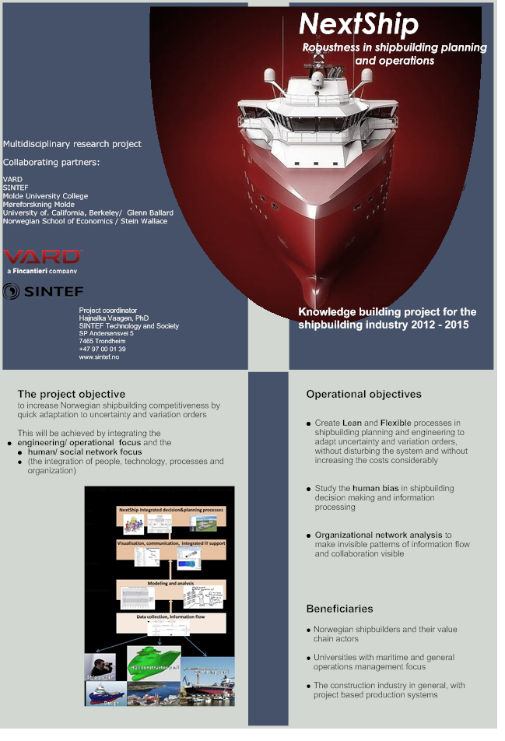
Social Preconditions for Operational Excellence in engineer-to-order dynamic systems
The context of the Norwegian offshore shipbuilding
Hajnalka Vaagen,
SINTEF Applied Economics and Operations Research , Trondheim, Norway
Jan Emblemsvåg
Managing Director Kongsberg Evotec (former Senior Vice President Innovation and Process Management VARD Group)
Eirik Borgen,
SINTEF Applied Economics and Operations Research , Trondheim, Norway

Slide 2
KEY RESEARCH ELEMENTS
Connecting
Technology
Processes
People
organisation

Slide 3
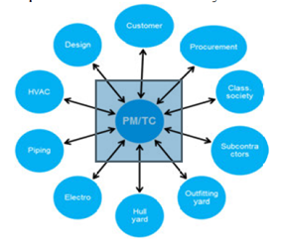
Network organised projects
Kjersem and Emblemsvåg, 2014
One-of-a-kind specialized vessels
Engineer-to-order – customers select design features during the construction processes (late into the production)
Frequent changes in design specifications and legal regulations – leading to continuous adjustments in design, procurement and productions
Iterative nature of design and engineering activities
Concurrent engineering (overlapping activities that do not always follow a logic of sequential order

Slide 4
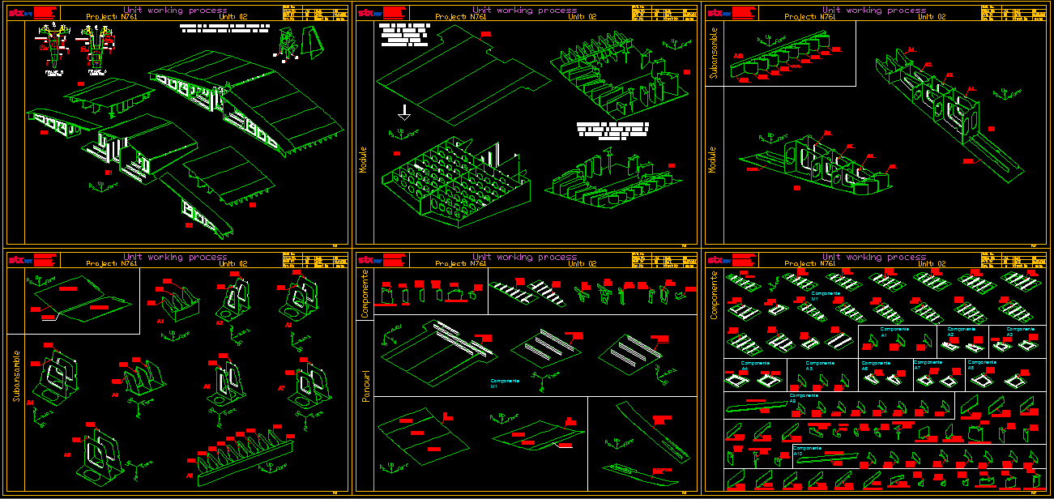
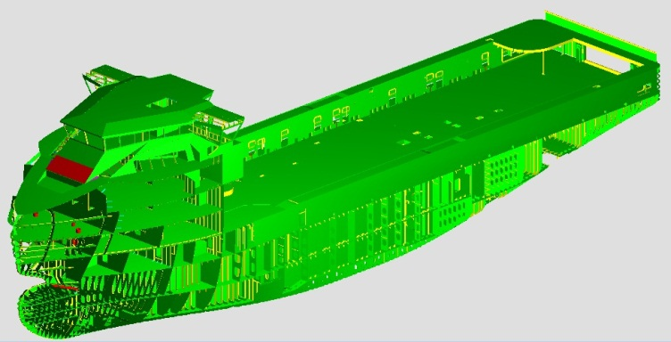
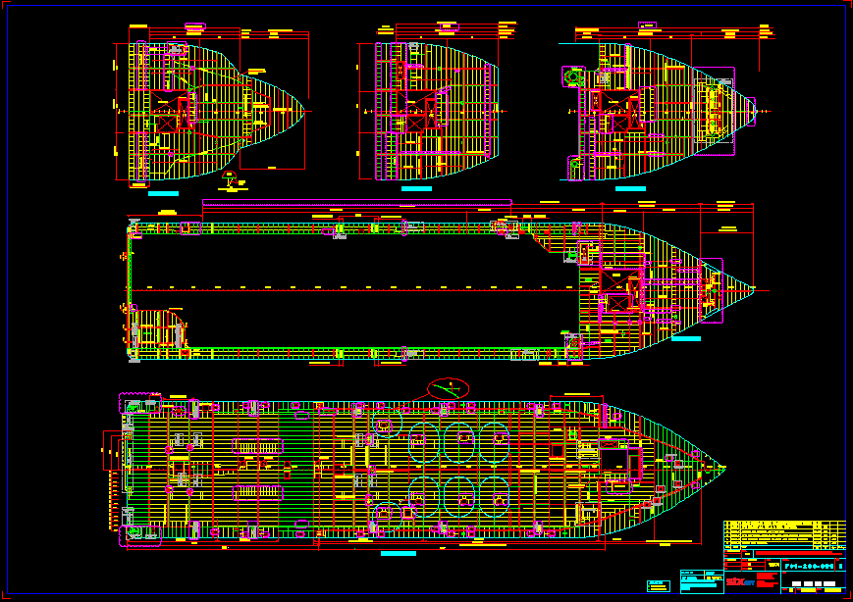
The engineering design process has many challenges (Emblemsvåg, VARD)
Detail design team responsibility
3D model
Extract class dwgs. from 3D model
DNV approval
/comments
Update 3D model
with DNV comm.
Update class dwgs. by
extracting dwgs. from 3D model
Basic design team responsibility
Splitting 3D model in
blocks/hull units
Complete the 3D model
with production details
Extract detail design
dwgs. from 3D model
Release detail design
dwgs. in production
Comments /
Modifications
Update 3D model
with comm.
Update class dwgs. by
extracting dwgs. from 3D model
Note:
Splitting of basic design blocks will be done gradually after basic design finished jobs

Slide 5
Motivation
Engineering and construction projects are dependent on two fundamental elements (Chinowsky et al., 2008):
The ability to plan and manage tasks and resources - the traditional OR perspective with focus on modelling and optimisation
The ability of the project participants to develop into high performance teams for decision-making and knowledge transfer, and their judgmental competences to handle uncertainty in planning and execution (social science and behavioral aspects)

Slide 6
The objective - Improve understanding on the impact of the human and social elements on engineering planning and decision-making
RESEARCH QUESTION
How social capital and micro-level behaviour in engineering (like motivation, trust, risk attitudes, cognitive overloading) influences macro level decision-making (e.g. design flexibility offered to the market) ?

Slide 7
Multi-method research:
Initial qualitative research for scope definition
  Current state understanding on the factors that are believed to drive success and leading international position
Organisational Network Analysis with quantitative data collection, analysis and dynamic visualisation to understand the invisible social mechanisms in decision making and planning
  Intra-organisational, full, multi-project network design with the boundary of engineering
Behavioural studies to assess the cognitive dimension of the engineering networks

Slide 8
Findings from the qualitative study…
Social capital (tacit knowledge, trust, network connections) is believed to be the major driver of the competitive advantage (e.g. design flexibility throughout the construction processes)
Human behaviour is driven by social motivations - violating the OM/OR assumption of people being hyper-rational decision makers; Urda and Loch, 2013
Potential difference between established formal reporting systems and 'true' networks
  Time consuming to maneuver through the 'tacit' informal network

Slide 9
Findings from the qualitative study…
Engineers use a large share of their time on coordination activities upstream and downstream in the value chain
Model based decision aids and current PM approaches fail to capture important characteristics of real systems, e.g. concurrency between advanced design, engineering and execution, and complex uncertainty and dependency patterns
  State-of-the-practice: judgemental adjustments of some 'deterministic' plans provided by standards software
The listed challenges are believed to apply to the Norwegian shipbuilding cluster as a whole

Slide 10
Organisational Network Analysis
Understanding built by 4 networks:
Daily work
Challenge handling
Personal, trust
True project organisation

Slide 11

Findings from SNA wrt. the RQ:
How micro level behaviour (trust, risk perception, human-computer interaction) influences macro level decision-making (i.e. flexibility offered to customers)?
TRUST - High level of trust in the organisation.
  The structural dimensions of the A, B, C networks, and the relational dimension (strength and orientation; in-out degree) of A and C networks overlap
  Trust potentially plays a vital role in daily work and uncertainty handling
  Large extent of tacit knowledge, trust, and the ability to form high performance networks to develop innovative solutions and handle variations, directly affects the design flexibility offered to the customers
  micro level behaviour drives strategic decisions and competitive advantage

Slide 12
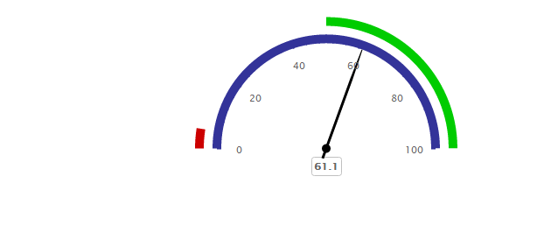
Trust benchmark : measures the proportion of mutual relationships across the network.
The ideal level of trust is 50% or more
The case company is positioned over 60%

Slide 13
  2. RISK Perception
  Daily work and challenge handling networks overlap - indicating that challenge and risk is part of the daily work
    The perceived risk is 'lower' than in contexts where changes occur occasionally
    The impact of a 'change' is low compared to the overall wealth of the company, leading to 'risk neutral decision making
    Judgemental adjustments reflect experience, tacit knowledge and individual aspiration levels
  Valence theory: optimistic risk perceptions are attributed positive emotions (Lerner and Keltner, 2000)
  Customer driven design uncertainty is a profit- driver opportunity - positive emotions, optimistic risk perception and self-esteem facilitate innovative solutions on different levels in the organisation

Slide 14
The true communication network - to make invisible patterns of information flow, knowledge transfer and collaboration visible
SNA helps to identify:
  Central people, functions- in terms of information flow within the group
  'cognitive overload' (in terms of information and knowledge transfer, informal advisor, collaborator) - bottlenecks
  Peripheral people , that essentially represent untapped expertise and underutilized resource – members in theory but not in practice
  Subgroups, within a network, as a product of location, function, hierarchy, tenure, age, gender
  The connection between different divisions in the organisation (for example: connection between engineering-production packages, planning-production, etc) – Connect engineering and production work packages
  Visualisation of the relationships, and quick dynamic display of a network

Slide 15
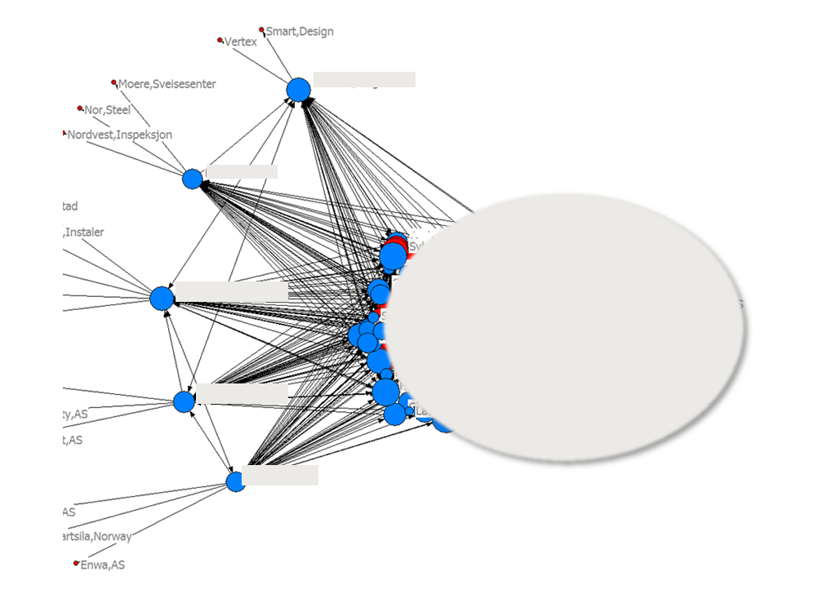
Gatekeepers to external organisations – Why is this information useful?
Names are shaded

Slide 16
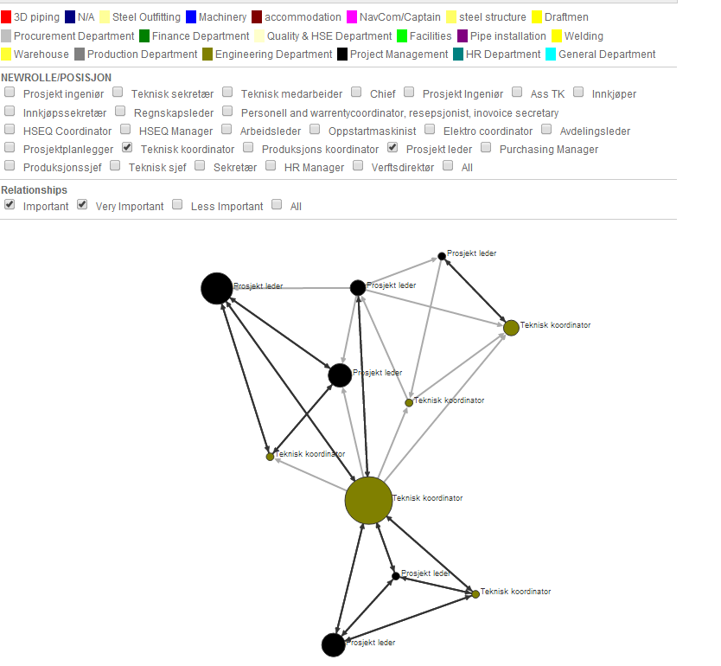
Brokers, central people

Slide 17
Ongoing behavioural research in offshore shipbuilding
The cognitive dimension of the organisational networks
Cognitive bias in project planning
Judgmental decision-making in shipbuilding engineering and project planning , using learning derived by stochastic programs within lean construction (hedging by negative correlation, learning how to use/adjust deterministic programs in stochastic settings, etc)

Slide 18
Thank you for your attention
Hajnalka Vaagen, hajnalka.vaagen@sintef.no
SINTEF Applied Economics and Operations Research , Trondheim, Norway

