Slide 1
Reflections on the design and analysis of Behavioural Operational Research experiments
Tuomas J. Lahtinen 20.5.2016
Summer School on Behavioural Operational Research
tuomas.j.lahtinen@aalto.fi
The document can be stored and made available to the public on the open internet pages of Aalto University. All other rights are reserved.

Slide 2
Typical Behavioural Laboratory Experiment
Subjects assigned randomly into 2 or more treatments
E.g. different models / processes / instructions to analyze the same problem
One or more measurable output variables related to e.g. behaviour of the subjects, success in the task
Experiments (ideally) enable causal inference
What is the effect of the treatment?
Studied by looking how output variables vary across the treatments

Slide 3
Variability in output values
Variability due to differences in treatments
Intended differences – what we really want to study
(Non-intended e.g. mistakes by the instructor)
Variability due to other factors
Differences between subjects (skills, experiences, preferences, way of thinking)
Measurement error
Lack of concentration

Slide 4
Statistical testing
To detect the effect of the treament
Cf. random variability in data
Institutional reasons: Encouraged common practice in many areas of science
Attitudes vary across disciplines e.g. psychology vs physics
Related biases
Clustering illusion (seeing patterns in random data)
Confirmation bias

Slide 5
Null hypothesis significance testing
Can the results be explained by random variability?
If yes, the results are not statistically significant
Null hypothesis: Different treatments lead to same output values on average
(any observed differences between treatments only due to random variability)
Alternative hypothesis: Different treatments lead to different output values
(observed differences between groups affected by treatments!)

Slide 6
Example: Expert judgment task
Independent two-sample t-test
40 subjects assigned randomly into a control group and treatment group

Slide 7
Which one is true?
Null hypothesis: All observations
come from same distribution
Alternative hypothesis: Different groups have
different mean response values

Slide 8
Test statistic
If null hypothesis is true (and data is normally distributed)
Test statistic ”T” will follow student distribution t(38):
Extreme values are unlikely
if null hypothesis is true

Slide 9
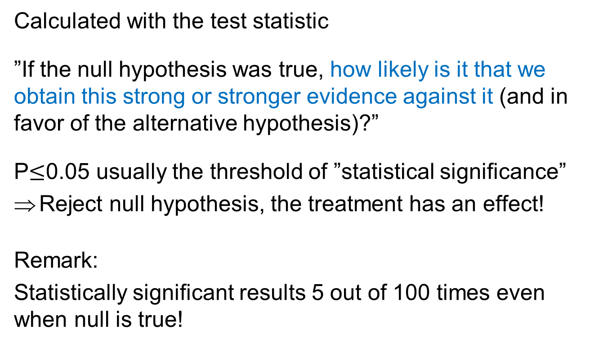
P-value
Calculated with the test statistic
”If the null hypothesis was true, how likely is it that we obtain this strong or stronger evidence against it (and in favor of the alternative hypothesis)?”
P$≤$0.05 usually the threshold of ”statistical significance”
Reject null hypothesis, the treatment has an effect!
Remark:
Statistically significant results 5 out of 100 times even when null is true!

Slide 11
If null hypothesis is true, 0.4%
probability to obtain this extreme data

Slide 12
Interpretation:
Very unlikely to observe similar results if the null hypothesis is true
=>
Reject null hypothesis
=>
Treatment has an effect on the mean response

Slide 13
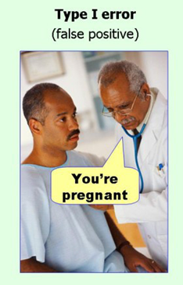
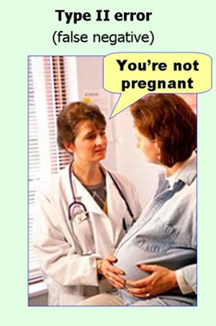
Inference errors
Alternative is true, but results not significant
Null hypothesis is true, but results still statistically significant
Also*:
Sign error
Magnitude error
*Gelman, Carlin (2014):
Beyond Power Calculations
Assessing Type S (Sign) and Type M (Magnitude) Errors

Slide 14
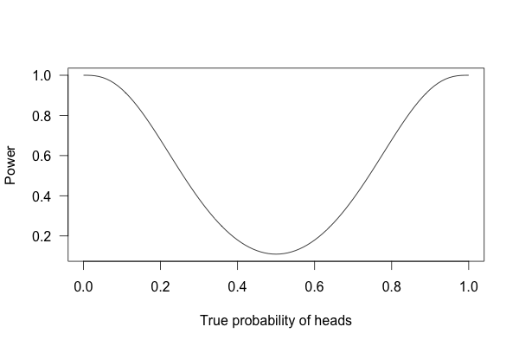
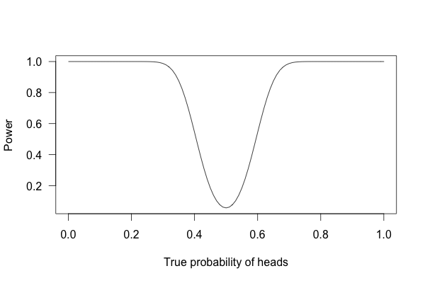
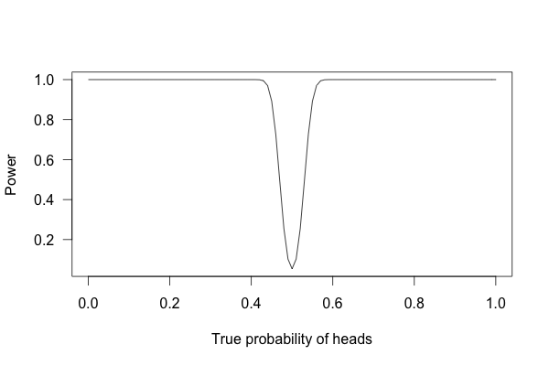
Statistical power
”Probability to reject H0, given that a certain true effect exists”
Power depends on:
Statistical significance criterion
Magnitude of the effect
Sample size
Statistical test used
Experimental design
…
Weighted coin example*
10 coin flips
Significance criterion = 5%
100 flips
1000 flips
*http://www.statisticsdonewrong.com/power.html

Slide 15

Statistical power
”Probability to reject H0, given that a certain true effect exists”
Power depends on:
Statistical significance criterion
Magnitude of the effect
Sample size
Statistical test used
Experimental design
…
Weighted coin example*
10 coin flips
Significance criterion = 5%
*http://www.statisticsdonewrong.com/power.html

Slide 16
Choosing the right statistical test
Number of experimental conditions?
Ratio, interval, ordinal or categorical data?
Within or between subject design?
How the data is distributed? Normality of residuals?
Examples of statistical tests:
T-test (previous example), Mann Whitney U-test
McNemar’s test
ANOVA
(Regression analysis)

Slide 17
Analysis of variance (ANOVA)
Two or more treatments
Null hypothesis: Mean response same across treatments
Alternative hypothesis: At least one treatment produces different mean response
Basic equation of ANOVA:
Total variance in response data = Variance between treatments + Variance within treatments
Test statistic = Variance between treatments / Variance within treatments
High values are unlikely if null hypothesis is true

Slide 18
Examples of
Behavioural OR experiments

Slide 19
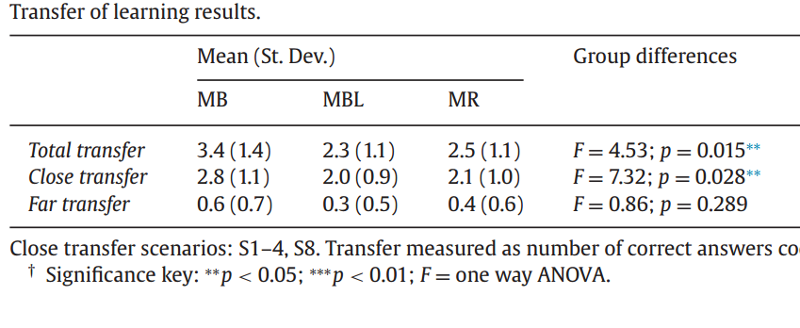

Transfer of learning experiment
Monks, Robinson, Kotiadis (2016) in EJOR special issue on BOR
Conditions (between subjects design):
MB = Model building
MBL= Model building
with limited time
MR = Model reuse
$${\overline{X}}^{MB}$$
3 output variables
Null hypothesis = All conditions produce the same mean
Alternative hypothesis = At least one condition produces different mean

Slide 20
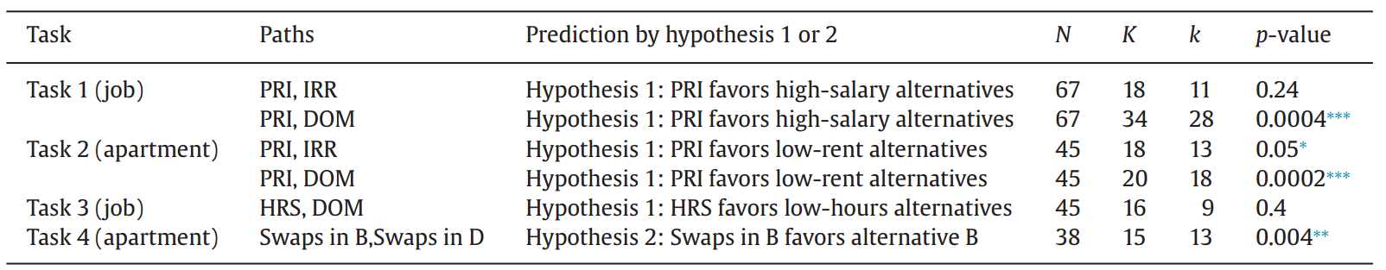
Path dependence in Even Swaps
Lahtinen and Hämäläinen (2016) in EJOR special issue on BOR
Conditions (within subject design):
PRI = Ss’ follow pricing out strategy
IRR = Ss’ use Irrelevance feature of the software
DOM = Ss’ use Dominance features of the software
Directional
alternative hypothesis
Six pairwise comparisons
Probability to obtain 28 or more success
with 34 coinflips (McNemar’s test)

Slide 21
How to improve your statistical experiment
Design of experiments
Within subject experiment possible?
Blocking = grouping data based factors known to influence results, e.g. gender (c.f. the idea of control variables)
Increase data quality
Enhance motivation to perform the task: Familiarity, alignment with personal interests, topical
Incentives: Money, learning
Choose ”accurate” output variables
Enable concentration, measure it, discard ”bad” data
Clear instructions to reduce errors

Slide 22
Statistically significant results – this is it, let’s write the paper! Right?

Slide 23
Statistically significant results – this is it, let’s write the paper! Right?

Slide 24
Practical vs. statistical significance
Even minimal effect size can be statistically significant, if number of subjects is high enough
Statistical significance does not imply practical significance
What does the result imply for the wider problem or system one is dealing with?
Practical significance to decision making
Does our decision change if we assumed that X is xA or xB?
If not, the result is not practically significant for the decision making context given.

Slide 25
Understanding the mechanism
Why different results are obtained with different conditions?
Can be studied by looking at what happens during the experiment – not just the inputs and the ouputs
Helps to
solve the research puzzle
build confidence in the results
generalize
study the phenomenon by simulation
create prescriptive recommendations

Slide 26
Example: Even Swaps
Mechanism: Accumulated effect of two known trade-off biases
Studied by looking at swaps conducted during the experiment
Loss aversion: Average out by switching reference alternative used
Measuring stick effect: Reduce it by using a measuring stick where alternatives are initially close to each other
Reduce accumulated error and bias: Restart with original consequences after each elimination

Slide 27
Drawing generalizations from a laboratory experiment
Purpose of experimentation is to provide information that is useful in other situations and to guide future actions
Does our sample represent the population of interest?
People factors: gender, age, assumptions, values?
What is the context / decision problem like?
Work backwards to achieve representativeness
Try mimic the real situation where the information will be used.

Slide 28
Attitudes towards generalizing when not sure of representativeness
”Existence proof”
We show that a phenomenon occurs in some contexts with some people
”Proof of concept”
We demonstrate that a solution can be useful
”List of possibilities”
Observe and list phenomena that can occur in certain types of situations
Practitioner can benefit from being aware of these possibilities

Slide 29
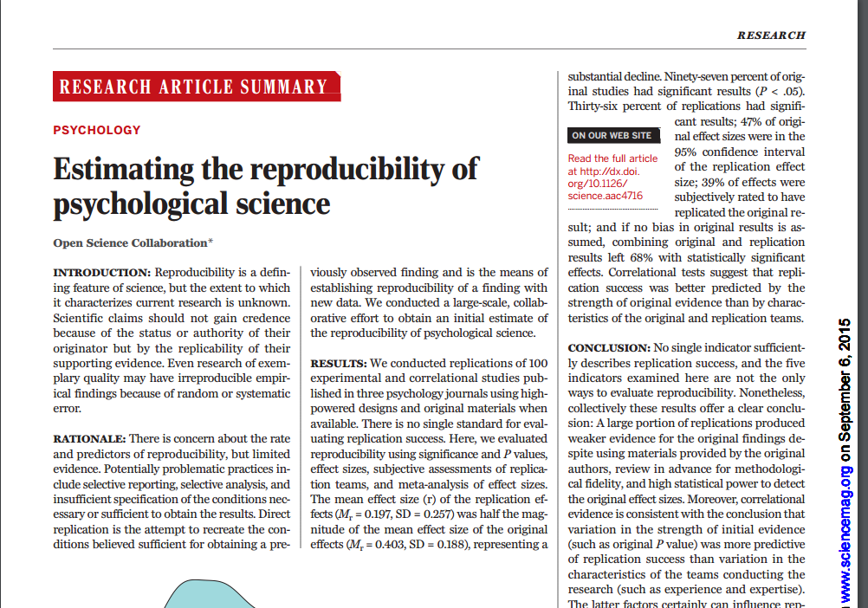
The ”statistical crisis” in science
Open Science Collaboration (2015) Estimating the reproducibility of psychological science (Science)
Only thirty-six percent of replications had significant results
Mean effect size in replications was half the original size
Total 100 replications

Slide 30
Traps in data analysis
Data dredging (also p-fishing):
Searching for several patterns in the data without first specifying a hypothesis
Once a ”statistically significant” pattern is found, develop an explanation for it
Is not a problem in explorative research but researcher should clearly acknowledge it
10 independent data analyses on random data, chance to get at least one statistically significant result is
1-(0.95)^10 *100% = 40%

Slide 31

Garden of forking paths (Gelman, Loken 2013)
Data analysis is a garden of forking paths even if research hypothesis was posited ahead of time
So many ways to find statistically significant results, that you can if you want to!
Choices:
What you will primarily look into?
Do you look into interactions between variables?
How you code, process and analyze data?
Which data you exclude?
How you combine data and interpret combined data?

Slide 32
What can we learn from this as Behavioural OR researchers?
Run pilot experiments
Subjects can be friends, colleagues, yourself
Test initial hypotheses, decide how data is analyzed, form quantitative hypotheses, try to understand the mechanisms
Real experiment:
Set quantative hypotheses and decide how data is analyzed in advance
Communicate openly about data analysis
As a research community: Replications? Pre-registration?

Slide 33
Thank you
Photo by Dioboss, CC BY-NC-SA 2.0

