Slide 1
Systems Intelligence
BOR Summer School
Otaniemi 18.5.2016
Philosopher Esa Saarinen
Prof., Aalto University
Husband of Pipsa the Queen
Chief Elevation Officer, Muutostehdas Oy
www.esasaarinen.com

Slide 2
There Is More to Us Than Meets the Eye – More That Is Good

Slide 3
Raimo on the way back from Paphos in 2000
Notes:
Systems Engineers
Wholes, from the point of view of Improving those wholes.
We Model and we Intervene
We Act
We’re inerested in what works, and your what-ever-it-is works. So instead of addressesing engineers in the worklife after they have become fixed in many of their ways of thinking, why not come to teach future engineers before their midns hets fixed.

Slide 4
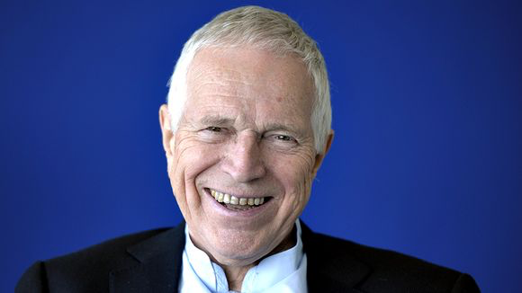
Edmund Phelps, Nobel laureate of economics 2006, author of Mass Flourishing

Slide 5
“Neoclassical growth theory [in economics] was conspicuous in having no people in it.”
Edmund Phelps, Nobel laureate of economics 2006, author of Mass Flourishing, in his Nobel price acceptance speech

Slide 7
s
How

Slide 8
s
How

Slide 9
s
How

Slide 10
Competencies
Obj’ve Resources
Structures
Knowledge
Results
Expectations
Beliefs, Motives
”Deeper Thoughts”
s
How
How tasks are perceived
How other people are per’d
Tolstoy’s ”Factor X”, Finns in WW-2, Nokia 1992-2004, Timo Joensuu in 1999 & Docrates Cancer Clinic

Slide 11
By Systems Intelligence we mean intelligent behaviour in the context of complex systems involving interaction and feedback. She perceives herself as part of the whole, the influence of the whole upon herself as well as her own influence upon the whole. Observing her own interdependency with the feedback-intensive environment, she is able to act intelligently. (Hämäläinen and Saarinen 2004)

Slide 12
Systems Intelligence Inventory (short version) R.P. Hämäläinen, J. Törmänen, E. Saarinen http://systemsintelligence.aalto.fi/
Systemic Perception | I form a rich overall picture of situations I keep both the details and the big picture in mind
Effective Responsiveness | I'm able to put the first things first When things don't work, I take action to fix them
Attunement | I approach people with warmth and acceptance I am fair and generous with people from all walks of life
Spirited Discovery | I like to play with new ideas I look for new approaches
Positive Engagement | I'm good at alleviating tension in difficult situations I bring out the best in others
Wise Action | I am willing to take advice I keep my cool even when situations are not under control
Attitude | (neg) I explain away my mistakes I have a positive outlook on the future
Reflection | I pay attention to what drives my behavior I make strong efforts to grow as a person

Slide 13
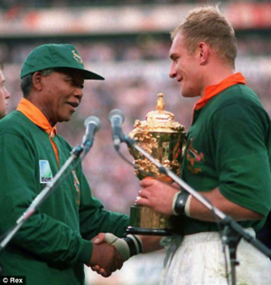
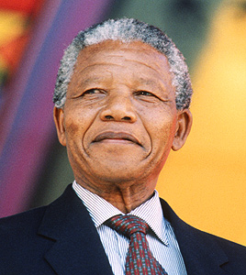
Mandela’s Systems Intelligence Lessons in Two Minutes

Slide 14
Microchange. Or: Towards the Art and Theory of Systems Intelligent Interventons as a Way of Life

Slide 15
Task Oriented Looking Out System vs. Task Disconnected, Reflective Looking In System M.H. Immordino-Yang et al 2012 Perspectives on Psyc. Science
Two networks: ”as one network is increasingly engaged, the other is decreasingly engaged”
”adequate developmental opportunities for appropriate lapses in outwardly directed attention, and potentially even for high-quality introspective states, may be important for well-being and for optimal performance on focused tasks”

Slide 16
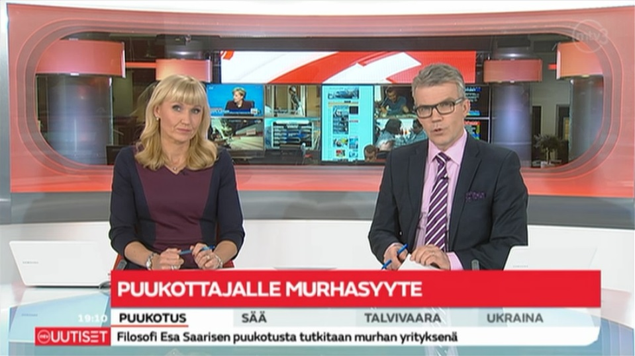
5th March 2014. ”Knife attacker charged with murder”

Slide 17
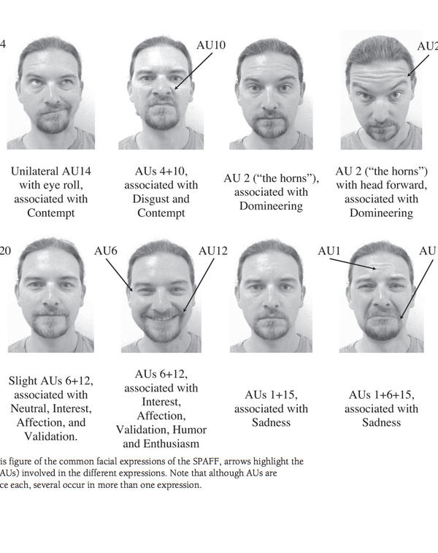

Slide 18
”Predicting Divorce among Newlyweds from the First Three Minutes of a Marital Conflict Discussion”, Carrère & Gottman 1999 Specific Affect Coding System (SPAFF)
Joy +4
Humor +4
Affection +4
Validation +4
Interest +2
Neutral +0.1
Contempt (halveksunta) -4
Disgust -3
Defensiveness -2
Belligerence(riitaisuus) -2
Stonewalling -2
Domineering -1
Anger -1
Whining (Mariseminen) -1
Sadness -1
Tension/fear 0

Slide 19
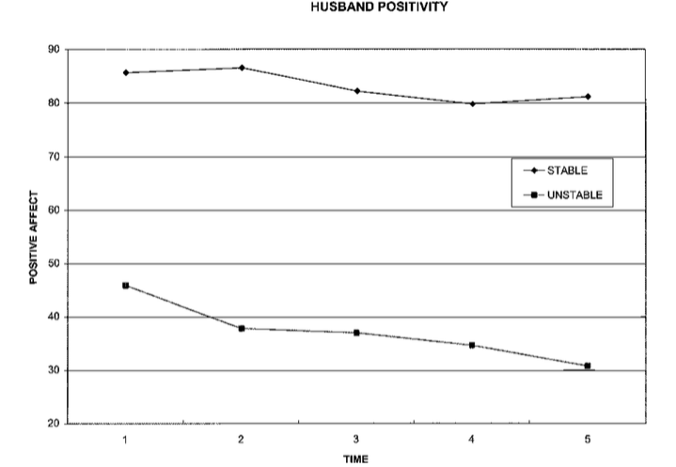
15 minutes conflict discussion in 5 x 3 min phrases
85
81
45
30

Slide 20
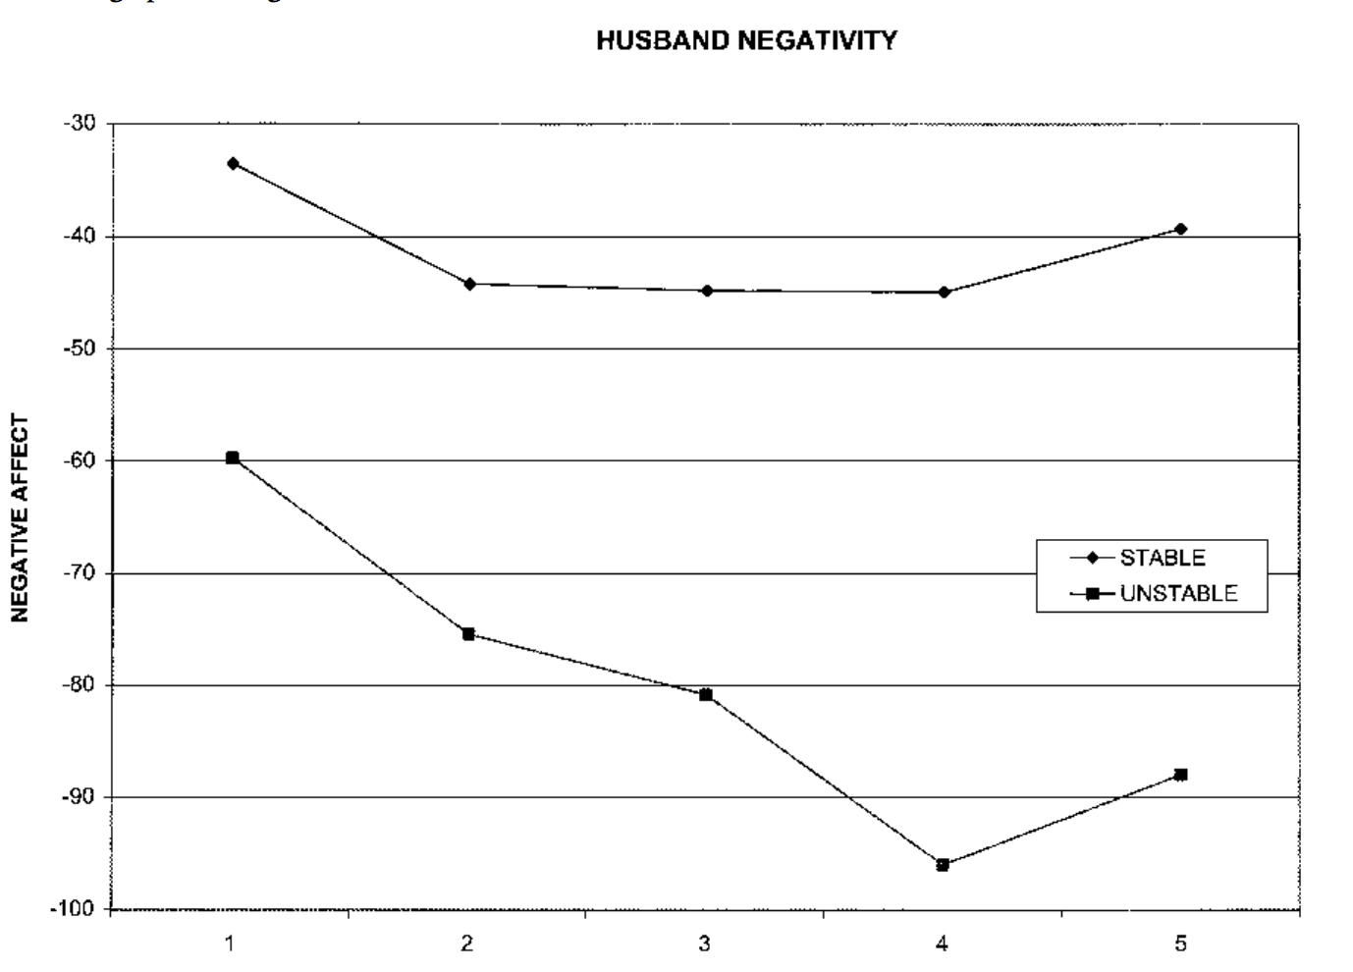
15 minutes conflict discussion in 5 x 3 min phrases
-34
-39
-60
-88

Slide 21
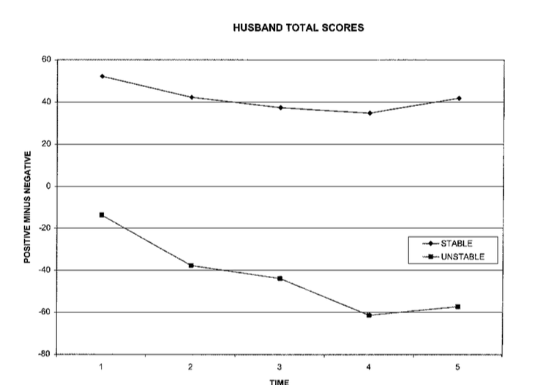
15 minutes conflict discussion in 5 x 3 min phases
52
41
-14
-57

