Slide 1
Multicriteria Evaluation in Space. The case of tourists in Alghero.
Giovanna Fancello
PhD in Architecture and Planning
Post-doc researcher at LAMSADE - Paris-Dauphine University - PSL
Bor summer school
Helsinki 2016

Slide 2
Aim of my research
to define decision analysis and evaluation models
able to understand and synthetize multiple information in space
useful, meaningful, legitimated and legitimating
for the definition of innovative public policies
Measures of (ine)qualities in space
poverty; accessibility; exclusion
Urban resilience, risk, vulnerability, …
Quality of life, …
Which information?
We suppose that it is possible to measure it in space with observable phenomena…
The individual perception of the reality is the same of the measured one?
Notes:
NO! so…how can we legitimate our policy? Most of the times policy makers need to construct some evidence that support a certain action within a policy making process) concerning issues including a subjective perception of the reality
People are differently poor.
Citizens are differently empowered.
Urban consumers use the city in many different ways.
Threats are differently perceived.

Slide 3
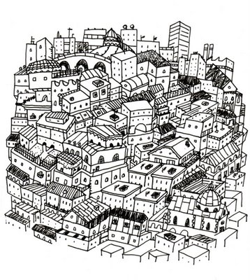
The relations between individual and space matter!
Individual features affect the manner peoples can access and use the space
Individual values affect the manner people perceive the space
Individual actions in the space can define new spaces and dynamics
The relations into multiple factors aging in the urban system
The capability approach
(Sen A. , 1993; 2009)
The right to the city
(Harvey, 2011)

Slide 4
Some questions…
How can we synthetize objective and subjective information in space?
How can we synthetize among individuals?
We have to do with additive or non additive measures?
Do we need something more than static maps?

Slide 5
Case studies
Walkability
Tourist’s behaviours in space
Urban Resilience

Slide 6
Walkability
Physical urban space influences the effective freedom of individuals to choose between different things to do.
How is urban context conducive for walking?
how to measure it?
number and type of destinations/opportunities
walking distance
quality of the paths and their surrounding environment
n: number of available destinations; X_{i}: number of times the resident visits the i-th destination; 1/(1 – ρ): elasticity of substitution among destinations.
Blečić, I., Cecchini, A., Congiu, T., Fancello, G., & Trunfio, G. A. (2015). Evaluating walkability: a capability-wise planning and design support system. International Journal of Geographical Information Science, 29(8), 1350-1374.
Notes:
Needs and perceptions of the space are important!

Slide 7
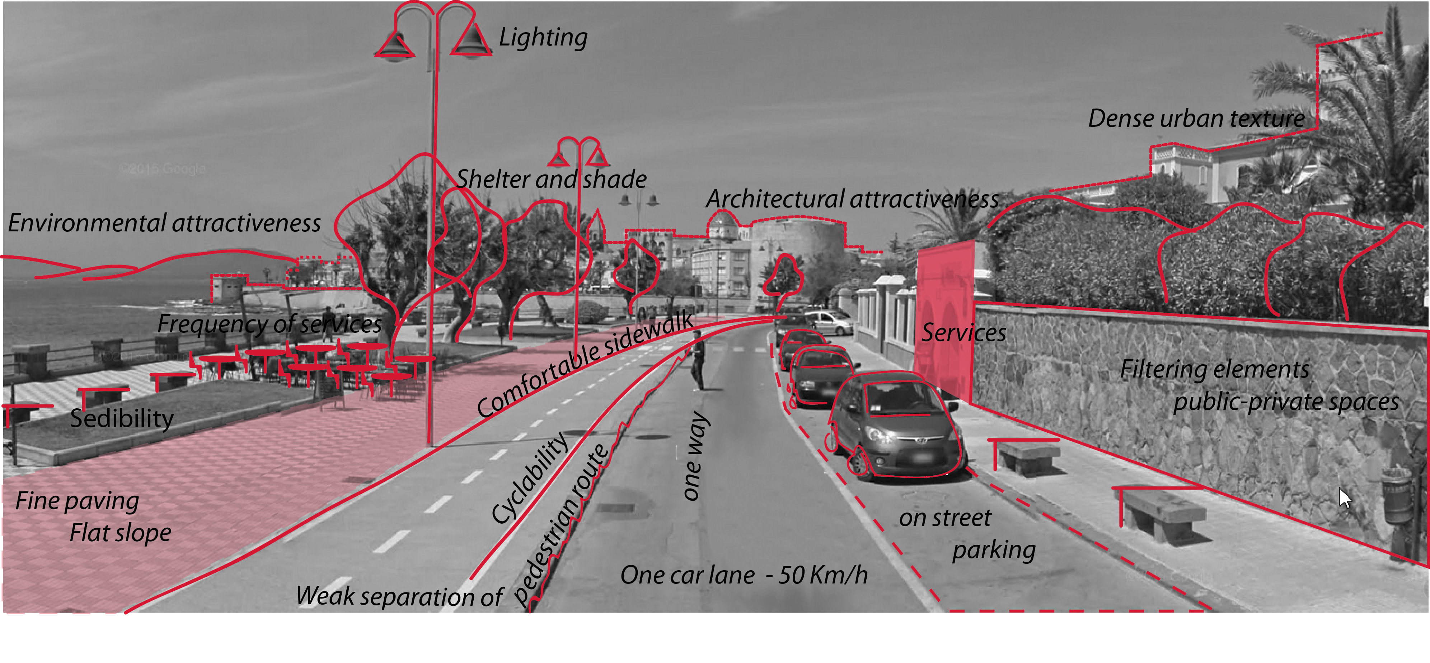
Walkability
Blečić, I., Cecchini, A., Congiu, T., Fancello, G., & Trunfio, G. A. (2015). Evaluating walkability: a capability-wise planning and design support system. International Journal of Geographical Information Science, 29(8), 1350-1374.

Slide 8
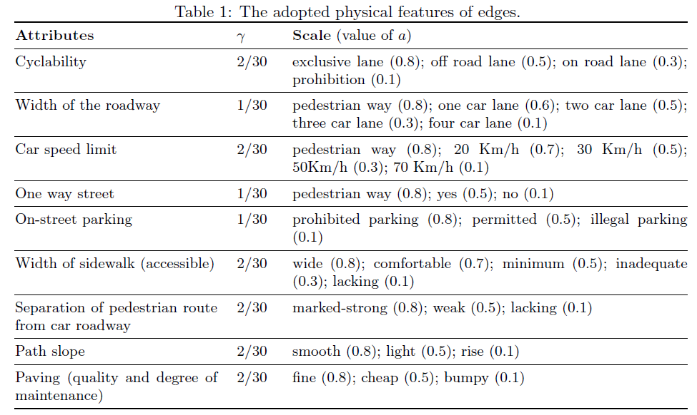
Walkability
Blečić, I., Cecchini, A., Congiu, T., Fancello, G., & Trunfio, G. A. (2015). Evaluating walkability: a capability-wise planning and design support system. International Journal of Geographical Information Science, 29(8), 1350-1374.

Slide 9
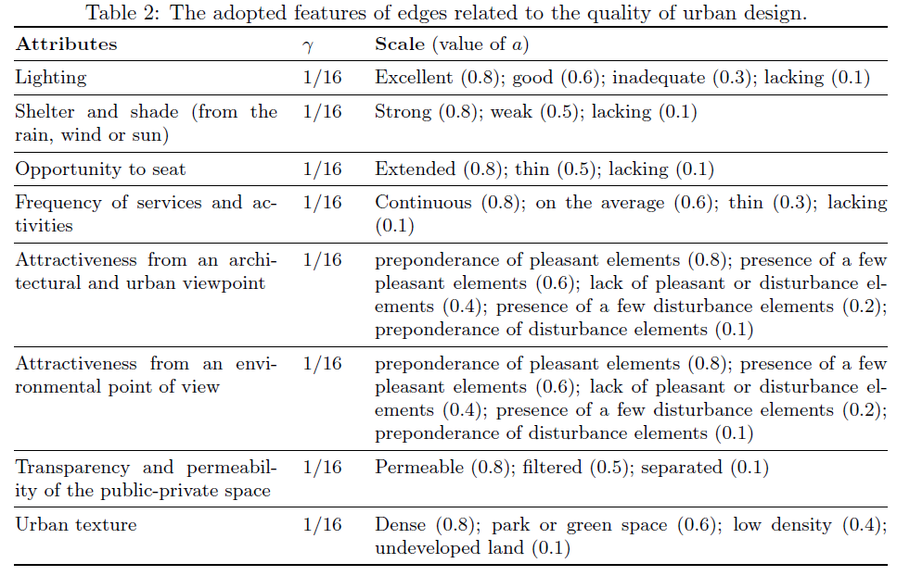
Walkability

Slide 10
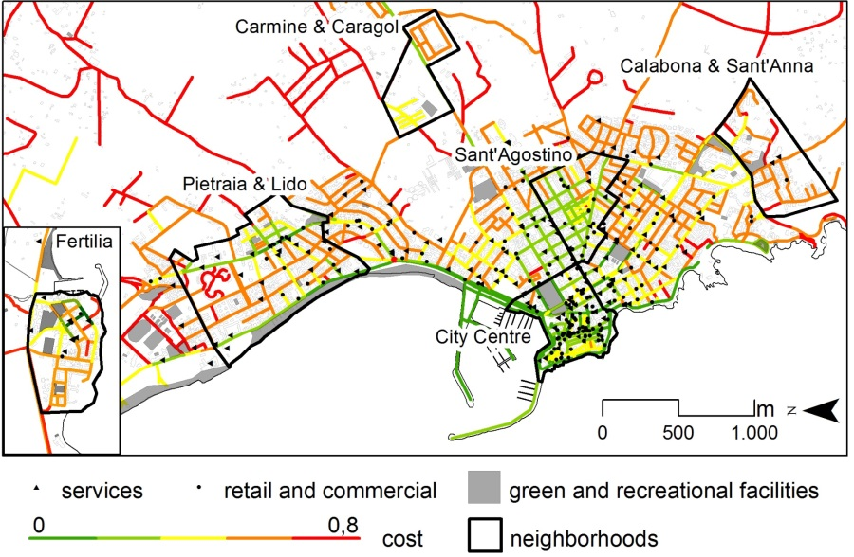
Walkability
Different space evaluation in respect to different needs and perceptions
Blečić, I., Cecchini, A., Congiu, T., Fancello, G., & Trunfio, G. A. (2015). Evaluating walkability: a capability-wise planning and design support system. International Journal of Geographical Information Science, 29(8), 1350-1374.

Slide 11
Tourists’ spatial behaviour
Tourist population has different profiles influencing their choices to act and access in the city.
Individual point of view
Tourists’ behaviours in space
Individual characteristics
Individual interests/needs and degree of satisfaction
Spatial point of view
Spatial distribution of urban activities
Accessibility to these urban activities
Quality of urban activities
Notes:
Tourism policies are foremost territorial policies, so such information, if wisely used, may become of particular relevance when investigating the relationship between tourists’ behaviour, their individual characteristics and interests [2] on one hand, and the spatial distribution and accessibility of urban and territorial attractors and activities on the other[3]. It may, for instance, serve to better understand preferences and choices of different populations of tourists, in order to put in place policies for tourism de-seasoning; or to more efficiently coordinate activities, attractions and transportation services; or to build tourist fidelity. In general, to better understand tourists’ behaviours in space and time is to have useful information for public policies which aim at development and governing of tourism.
The case study of Alghero
a study we conducted in October-November 2014 in the city of Alghero (Italy), a tourist destination of approximately 40.000 inhabitants in the North-West Sardinia in Italy
to explore tourists’ movements, expectations and degree of satisfaction with the destination during a period of “low-season”, considering that Alghero’s peek period is the summer season, with highest tourist concentration between July and September.
The collected data was thus meant to provide useful information and hints on possible policies to attract tourists outside the summer season.
Participants were recruited in five venues in Alghero, both hotels and bed&breakfasts, selected taking into account their geographic distribution

Slide 12
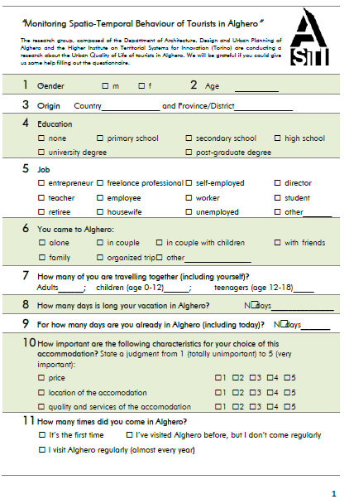
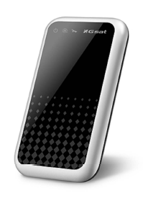
The Alghero (Italy) case study
October-November 2014 in the city of Alghero (Italy), a tourist destination of approximately 40.000 inhabitants in the North-West Sardinia in Italy
Questionnaire
profiling
declared preferences
real actions
GPS tracker
Time (10 s)
Space

Slide 13
Results of the coupled survey and GPS tourist tracking
Tourist profile: the analysis of socioeconomic and demographic data, preferences, attendances and personal evaluation of the day
Behaviours in space: the analysis of GPS tracking in respect to space and time use
Behaviours in space in respect to tourist’s profile: the analysis of GPS tracking in respect to time use by tourist profiles .

Slide 14
75 GPS movement tracking
225 people involved
205 adults, 17 adolescenti, 3 children

Slide 15
Tourist profile

Slide 16
Provenience
Italy 28%
Sweden 22,67%
Germany 16%
UK 8%, Benelux8%, France2,67%, Slovakia11,97, other* 11,97%

Slide 17
Job
Employee 28%
Teacher 22,67%
Freelance18,66%
Director 9,33%, Retiree 6,67%, Housewife 4%, Entrepreneur 2,67%, other* 7,99%

Slide 18
Travelling
Couple 46.67%
Alone 17.33%
Family 9,33%, Friends 8%, Couple with children 8%, Organized trip 4%, other* 6,67%

Slide 19
Behaviours in space and time

Slide 20
Behaviours in space and time
Macro-area |  | Area |  |  | Zone
Alghero and its territory | 80.29% | Town | 64.01% | Historical centre |  | 37.74%
 |  |  |  | Garibaldi and Lido waterfront |  | 30.34%
 |  |  |  | Dante/Valencia waterfront |  | 7.82%
 |  |  |  | Other |  | 24.10%
 |  | Surrounding territory | 35.99% | Park and marine area |  | 43.26%
 |  |  |  | Bombarde-Lazzaretto |  | 25.59%
 |  |  |  | Maria Pia beaches |  | 22.26%
 |  |  |  | Fertilia |  | 8.89%
Outside Alghero | 19.71%

Slide 21
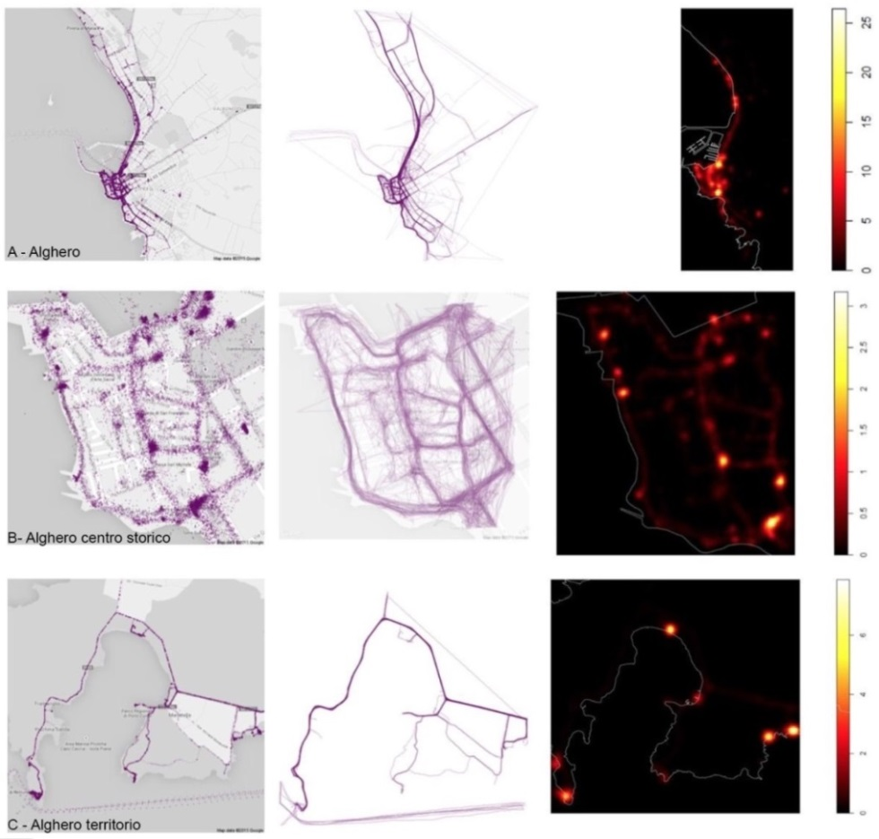
Behaviours in space and time

Slide 22
Behaviours in space in respect to tourists’ profile

Slide 23
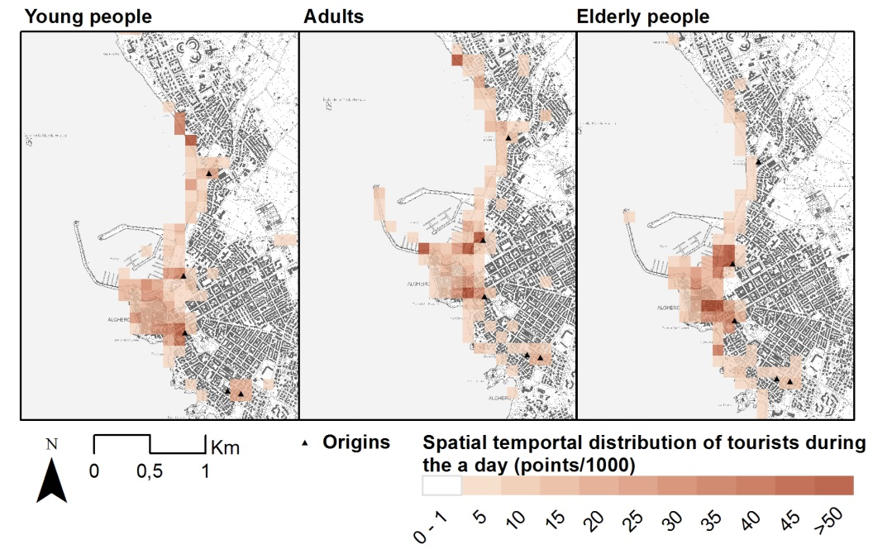
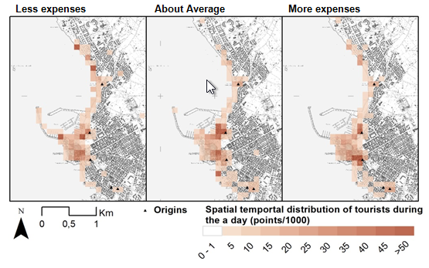
Behaviours in space
in respect
to tourists’ profile

Slide 24
Next steps of the research
Tourists’ Preference learning
Urban resilience and risk perception for natural disasters: the Paris case study

Slide 25
Thank you!
Giovanna Fancello
PhD in Architecture and Planning
Post-doc researcher at LAMSADE - Paris-Dauphine University - PSL
giovanna.fancello@dauphine.fr
Bor summer school
Helsinki 2016

