Slide 1
Supporting Policy Design: Lesson Learned From Water Management In The Apulia Region (Italy)
Irene Pluchinotta
LAMSADE-CNRS, Paris Dauphine University (France)

Slide 2
How to support public policy design
Water management complexity
Multiple DMs with disparity of interests, backgrounds, societal positions and values
Densely ramified network of interactions btw actors with different problem frames
Water is used by several competing actors and owned by no one: what other DMs are going to do is unknown
POLICY RESISTANCE MECHANISMS: lack of decision legitimacy, unexpected reactions, dysfunctional dynamics
Notes:
In these complex and uncertain environments, it is very difficult to determine how effective a policy will be. Part of the difficulty resides in the fact that even when a policy is targeted to regulate the behavior of individual actors (e.g. water users’ actions), actors are interdepend in performing their tasks, individually and collectively
- WATER MANAGEMENT COMPLEXITY:
multiple decision-makers with disparity of interests
complex networks of governance and distribution
various socio-political events
intensive socio-economic development
water pollution, climate change and the related alterations
political unbalances of power affecting the (bio) regional resources
water is used by several competing actors and owned by no on
In multiple decision-makers situation, with multiple goals and multiple vision on these goals, each agent has its own personal perspective in defining and interpreting a problem situation, thus creating disparity according to their backgrounds, experiences, societal positions, values and beliefs
- When a policy is intended to regulate the behaviour of individual agents, agents are interdependent in performing their tasks, so that any action choice will influence and be influenced by the action choices of the other agents
- Ambiguity in frames can result in a polarization of viewpoints and the incapacity of a group to create a joint basis for communication and action

Slide 3
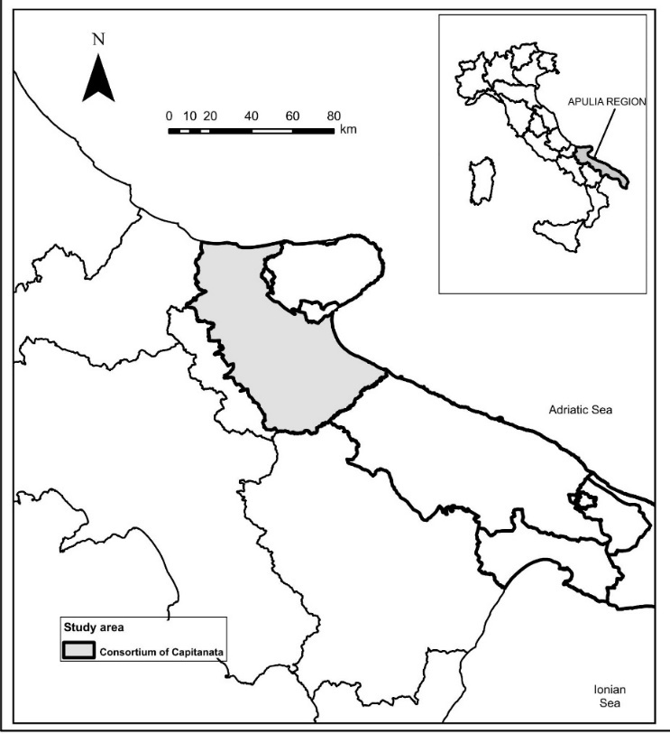
Agricultural Water Management In The Apulia Region/1
PROBLEM: The Mediterranean countries are characterized by the spread of intensive irrigated agricultural areas and the recurring droughts events, due to the climatic conditions
CONSEQUENCE: Several environmental problems (i.e. water pollution or groundwater overexploitation) and an increasing level of conflicts between water users and managers
SOLUTION: After traditional analysis, the Regional Water Authority proposed the enforcement of the restrictive measures (CEE 2000/60), reducing the GW use (Water Protection Plan)
CONSEQUENCE 2: POLICY RESISTANCE MECHANISM.
The new legislation caused strong conflicts between DMs and economic damages to the agricultural sector. The Water Protection Plan has not been implemented yet, and the Regional Authority is carrying on a time/money consuming revision process
Notes:
GOALS: To protect the GW and to fairly distribute water.
Most of the policies implemented in the Mediterranean basin aims to improve the efficiency of GW use through innovative irrigation techniques or to restrict the GW use through policies and a tight control of farmers activities (Giordano et al., 2014). The decision-making processes do not warn of the behavioral issues that need to be taken into account. They are supported by operational research interventions, but there is a gap in our knowledge in understanding the outcomes of a certain decision on people (White et al., 2016; Hämäläinen et al, 2013; Franco et al, 2010; Keys, 1997).
Evidence suggests that many times those policies largely failed to achieve a sustainable use of GW (Giordano et al., 2013; Portoghese et al., 2013). Several scholars have argued that these failures are mostly due to an over simplification, or in some cases even the neglect, of the uncertainty and complexity associated with the water management systems (Knűppe and Pahl-Wostl, 2011; Borowoski and Hare, 2007). Complexity due to the densely interconnected networks in which decision-actors behave, which span between and across ecological, economic and socio-political domains. Uncertainty because what other decision-actors involved in the network are going to do is largely unknown, making difficult to predict whether the choices pay off or not (Rosenhead and Mingers, 2001).

Slide 4
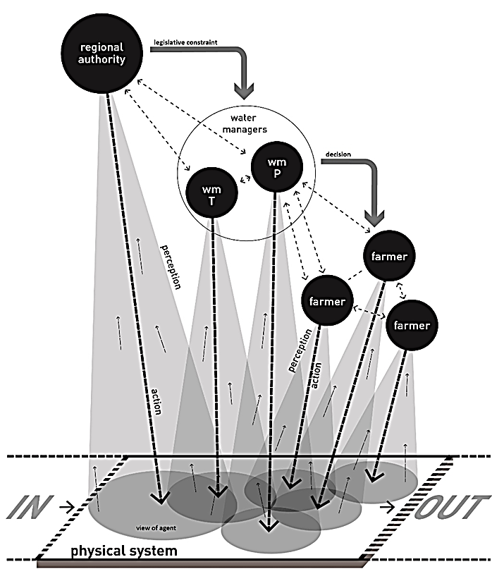
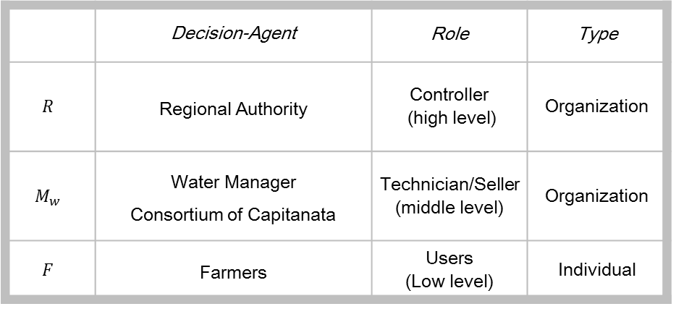
AWM In The Apulia Region/2
 | Decision-Agent | Role | Type
$$R$$ | Regional Authority | Controller (high level) | Organization
$$M_{w}$$ | Water Manager Consortium of Capitanata | Technician/Seller (middle level) | Organization
$$F$$ | Farmers | Users (Low level) | Individual

Slide 5
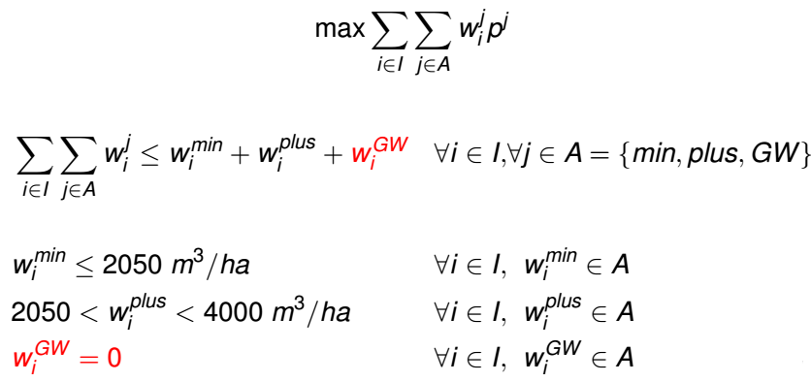
AWM In The Apulia Region/3
The WATER MANAGER has to deal with drought events and with the request of water from each farmer $i$

Slide 6
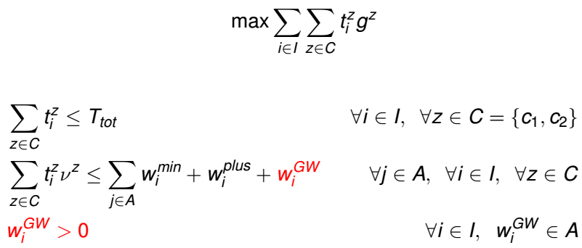
AWM In The Apulia Region/4
Each FARMER $i$ chooses the right mix of crops depending on the quantity of available water and on the hectares of arable land, in order to maximize her/his profits
INNOVATIVE ALTERNATIVE
Notes:
The traditional set of alternatives is defined as a compromise between different constraints and technical criteria and often it brings unexpected behavioural reactions of involved actors.
The case studies highlight innovative actions that lead to the creation of a new policy, trought the creation of a new variable that was not considered before.

Slide 7
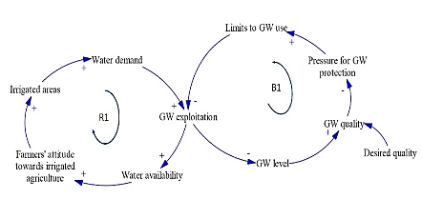
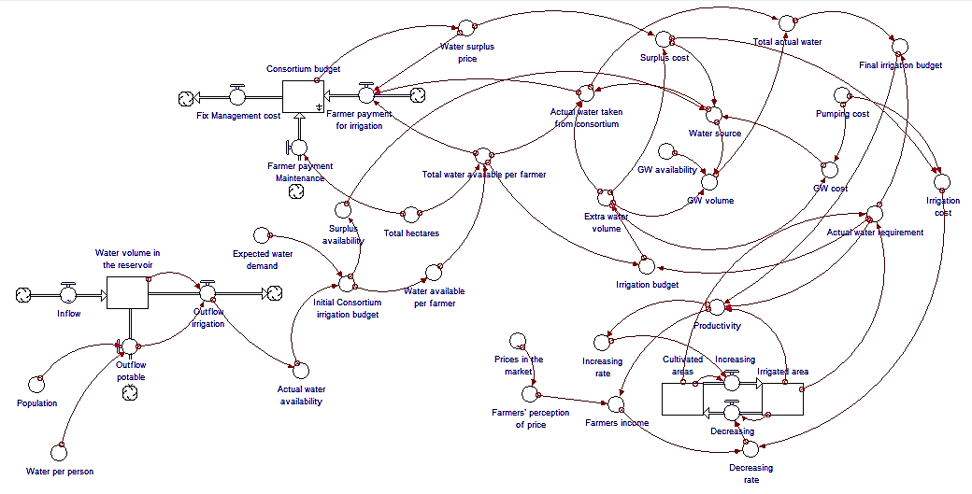
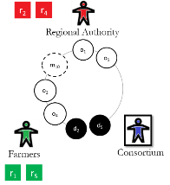
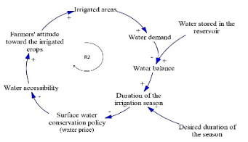
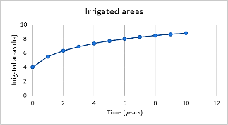
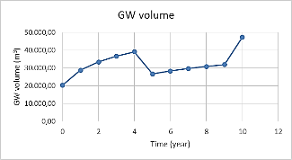
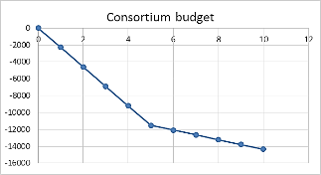
AWM In The Apulia Region/5
Interviews, workshops with stakeholders to data collection and group modelling
Stakeholder’s analysis to identify the multiple and conflicting interests
Interaction Spaces analysis to define and formally represents the ambiguity in problem frames
Mental Model to represent the perceived cause-effect chains influencing the evolution
System Dynamic Model to formalize the behaviors of DMs, the interdependencies and the negative feedback, in order to deactivate the policy resistance mechanism
Notes:
Of course, to arrive to this point we carried out several analysis, it was a long process that start before my phd thesis and it is still on going. I will not talk about this today, you can read something on the paper already published and in the ones that will arrive in the next future (if I will finish to write them!!)
-- my thesis and the sdm ended with the analysis of new possible scenario built with some of the stakeholders that were supporting the agricultural sytem
--
of the spaces where actors interact with their objectives and resources
The stakeholder’s analysis and the knowledge elicitation can help to define the values and the interdependencies, to display the different decision problem frames, in order to integrate the set of suitable alternatives innovatively

Slide 8
Public Policy Design
BEHAVIORAL PERSPECTIVE
The traditional set of alternatives is defined as a compromise between different constraints and technical criteria and often it brings unexpected behavioral reactions
The DMs as well as the analyst are subject to behavioral effects. Embracing the behavioral perspective helps generating theoretical insights and innovative alternatives
INNOVATIVE POLICY DESIGN
The innovation is the capacity to expand the boundaries of the decision space, modifying the set of alternatives and inducing the adjustment of the actors’ behaviors
A worthy policy design process has a preponderant impact on the quality of the alternative policies being considered
DESIGN PROCESS
Design theory could develop a different perspective on the problem in order to explore how innovative policies can be laid out
Notes:
1)
To support innovation in public policy design using formal and analytic tools it is necessary to build a methodology that identify the boundaries of a new set of alternatives.
While monitoring and assessing public policies is a largely established research field, the designing of public policies is far less analyzed and developed
And this is stronger in PP domain
explore how design theory can be matched with constructive decision analysis in order to assist the design of “policies” and how these can be used for innovative public decision making;
In this regard, a worthy policy design process has a preponderant impact on the quality of the alternative policies being considered. The recent demand for assisting the policies design is fascinating and design theory could develop an alternative perspective on the problem in order to explore how innovative policies can be laid out. Briefly, design theory was originally conceived for supporting practitioners in “designing” and it has evolved in a more formal version aiming at assisting and organizing any process of creating “objects”, possibly immaterial and abstract. These “objects” do not exist within our knowledge, but can be designed out of it (Hatchuel and Weil, 2003). In this context, the talk addresses the problem of how to support innovation in policy design using formal analytic tools. It explores how design theory can be matched with decision analysis in a behavioral perspective, in order to assist the policy design in an innovative public decision-making.

Slide 9
Design Theory/1
Design theory was conceived for supporting practitioners in designing and it has evolved in a formal version aiming at assisting any process of creating objects (Hatchuel, 2002)
These objects do not exist within our knowledge, but can be designed out of it, supporting a rule-breaking process (Hatchuel, 2003)
C-K theory is a general theory of design reasoning (Hatchuel and Weil 1999, 2002, 2003, Hatchuel 2002, Hatchuel et al. 2004)
C-K theory suggests a distinction between concepts (propositions about new objects) and their interaction with the knowledge (propositions about known objects) of the designer
Notes:
Briefly, what I am exploring now, and I started a couple of month ago
Abstract objectives
The theory is based on the distinction and interaction between two spaces:

Slide 10
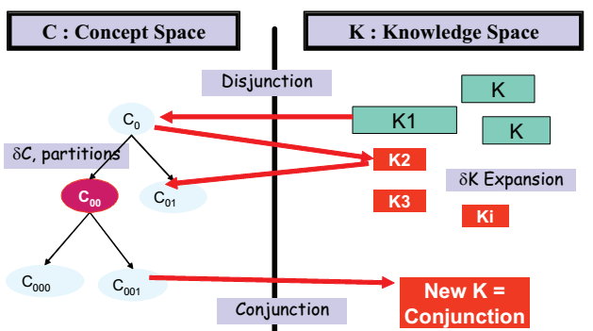
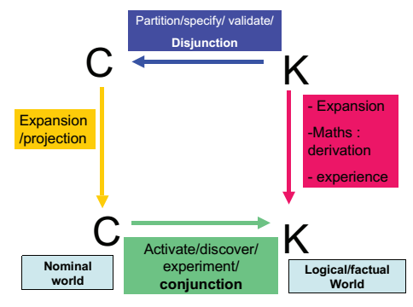
Design Theory/2
The knowledge space represents all the knowledge available to a designer (or to a group of designers) at a given time. These are propositions that the designer is capable of stating as true or false; i.e., propositions whose logical status are known (e.g., some phones are mobile)
The concept space represents propositions whose logical status are unknown and cannot be determined with a given knowledge space. These are propositions that can be stated as neither true, nor false at the moment of their creation (e.g., some phones prevent heart attacks)
The interaction and co-evolution of concepts and knowledge is the main engine through which design progresses (Kazakci et al., 2010). C-K theory proposes to model them through four operators (Hatchuel, 2003)
Notes:
(
First, the two spaces are separated and have different structures. • The C-space is a tree of undecidable propositions. Each node of the tree refers to the partitioning (in the mathematical sense) of an initial concept into several sub-concepts. Thus, a design process is modeled by a step-by-step partitioning of an initial concept. Basically, designers envisage different concepts and different possible design paths. • The K-space is an archipelagic structure. Each knowledge base contains propositions with logical status for designers (i.e. designers consider those propositions as either true or false). a knowledge base includes all designers’ skills, learning or experiences.
Secondly, interactions between the two spaces match the particular cognitive efforts that designers deploy during the design process. C-K theory proposes to model them through four operators (ibid.) • K→C: this operator adds or subtracts a property from the K-space as a new attribute of a concept in the C-space. As it allows partitions of an initial concept, this operator expands the C-space with elements from the K-space. From a managerial perspective, it models a step of the description of a design path. • C→K: this operator seeks to add or subtracts properties in the K-space in order to reach propositions with a logical status. When it succeeds, it creates a “conjunction” which stops the design process. When it does not succeed, the operator expands knowledge with the help of concepts’ adjunction, which leads designers in the knowledge acquisition process. • C→C: this operator relies on the classical rules in set theory that control partition or inclusion. From a managerial perspective, a partition can be either restrictive or expansive. The restrictive partition reduces the space of possibilities without changing the definition or the attributes of the object to be designed. An expansive partition modifies the identity of the initial design object by adding unexpected attributes to the initial concept. It is precisely because of those expansions that breakthrough innovations, including surprises, are possible. • K→K: this operator relies on the classical rules of logic and propositional calculus that allow the K-space to have a self-expansion, e.g. proving new theorems. For managers, K→K operations describe designers’ actions to increase the reliability of propositions in K.

Slide 11
Conclusion
There is a demand for innovating the methodology and toolkit of decision analysis aiming at aiding policy makers and relevant stakeholders during the policy design
Explore how design theory can be matched with constructive decision analysis in order to assist the policy design and how these can be used for innovative public decision making
Notes:
The policy design is one of the major critical issues in order to pursue such innovation and design theory can support the evolution

Slide 12
PAPERS:
Giordano, R. et al., (2013). Bayesian Belief Network to support conflict analysis for groundwater protection: The case of the Apulia region. Journal of Environmental Management, 15, 136-146.
Portoghese, I., et al., (2013). An integrated modelling tool to evaluate the acceptability of irrigation constraint measures for groundwater protection. Environmental Modelling & Software, 46, 90-103.
Giordano, R. et al., (2015). Evaluating acceptability of groundwater protection measures under different agricultural policies. Agricultural Water Management,
Giordano R., Brugnach M., Pluchinotta I., Ambiguity in problem framing as a barrier to collective actions: some hints from groundwater protection policy in the Apulia Region, Group Decision and Negotiation. Under review
Pluchinotta I. et al., A System Dynamic Analysis to deal with complexity in water resources management: the case of groundwater protection in the Apulia region. Paper in progress
Ferretti V., Pluchinotta I., Tsoukiàs A., How to design innovatively public policies? Paper in progress
Pluchinotta I., Kazakci A., Tsoukiàs A, Innovative public policy making assisted by design theory: is it possible? Paper in progress
Notes:
These are the paper that have been written on this case study during the years AND YOU CAN SEE A PARTIAL EVOLUTION OF IT

Slide 13
Thank you!
Irene Pluchinotta
irene.pluchinotta@dauphine.fr

